Slide 1
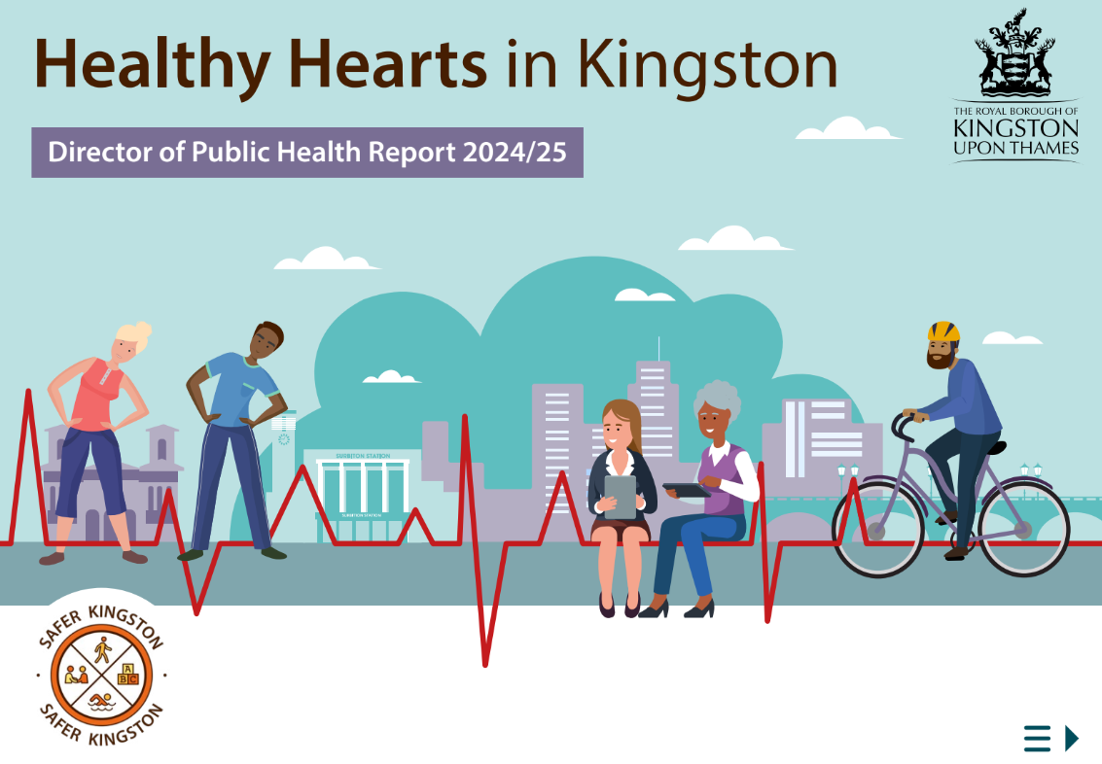
A focus on reducing health inequalities

Slide 2
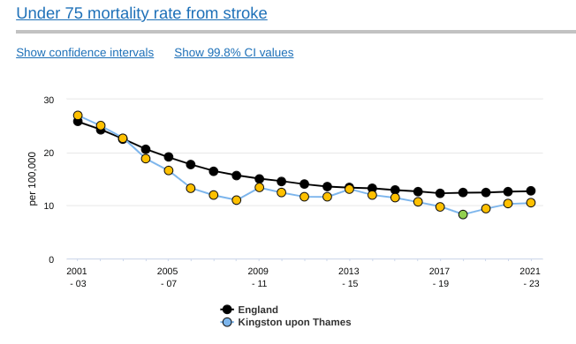
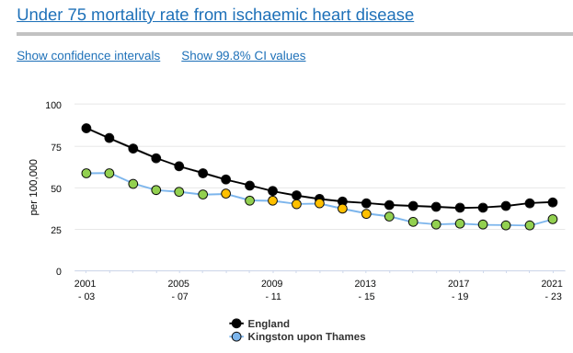
Healthy Hearts in Kingston - progress but more to do
Notes:
"rates have halved in the past 20 years both in Kingston and nationally, but a slight rise across the board in the past few years"

Slide 3
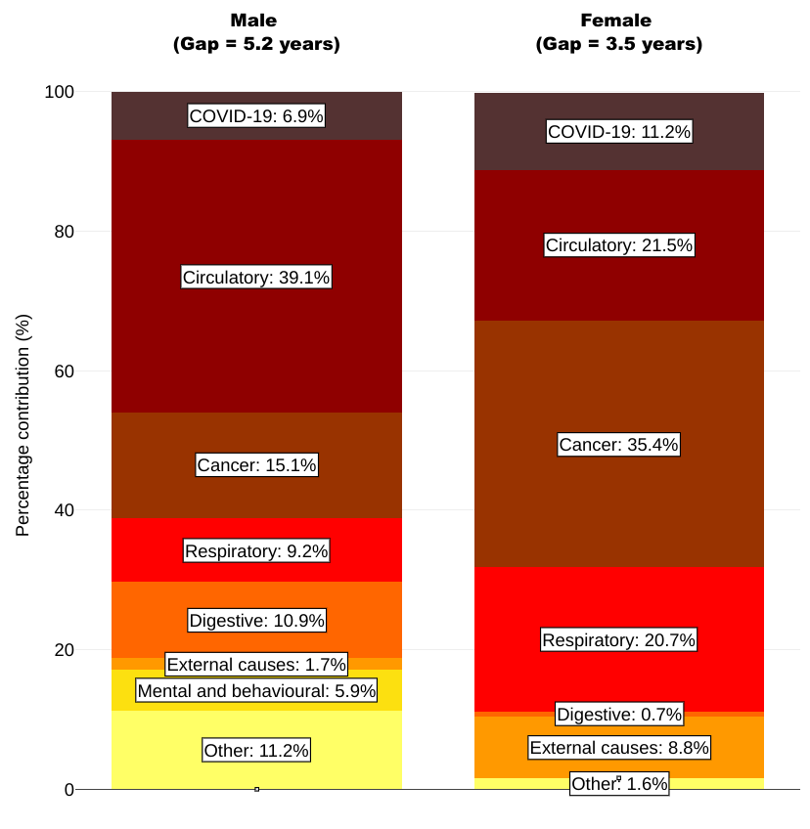
Heart health is an equalities issue
Improving heart health which results in fewer early heart health deaths will reduce health inequalities overall in Kingston
This is because the rate of heart health problems in our most deprived areas is higher than in the least deprived
Early heart health-related deaths are the main cause of the 5 year life expectancy gap between men in the most and least deprived parts of the borough - and the second main cause for women
Some risks for heart health are also higher in some groups than others.
Breakdown of the life expectancy gap between the most and least deprived quintiles of Kingston upon Thames by cause of death, 2020 to 2021
Notes:
Segment source link: https://analytics.phe.gov.uk/apps/segment-tool/

Slide 4
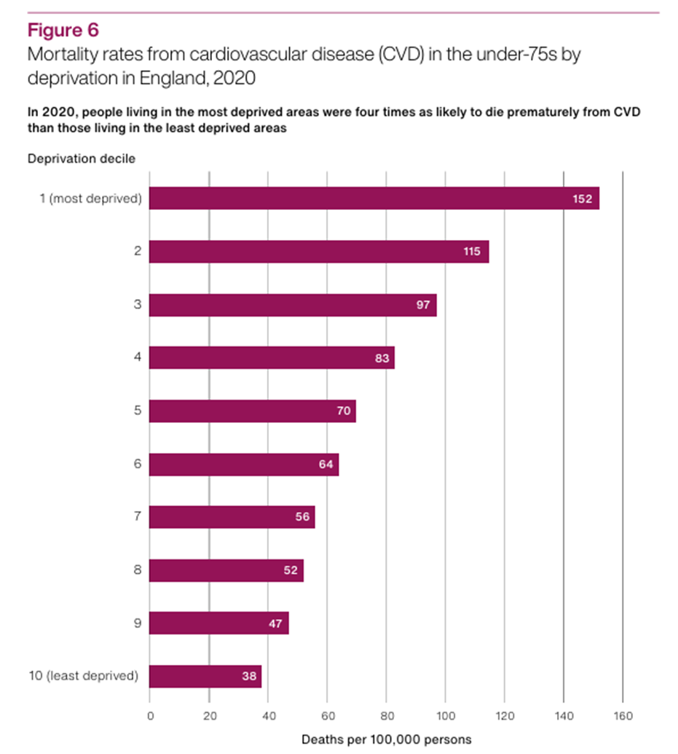
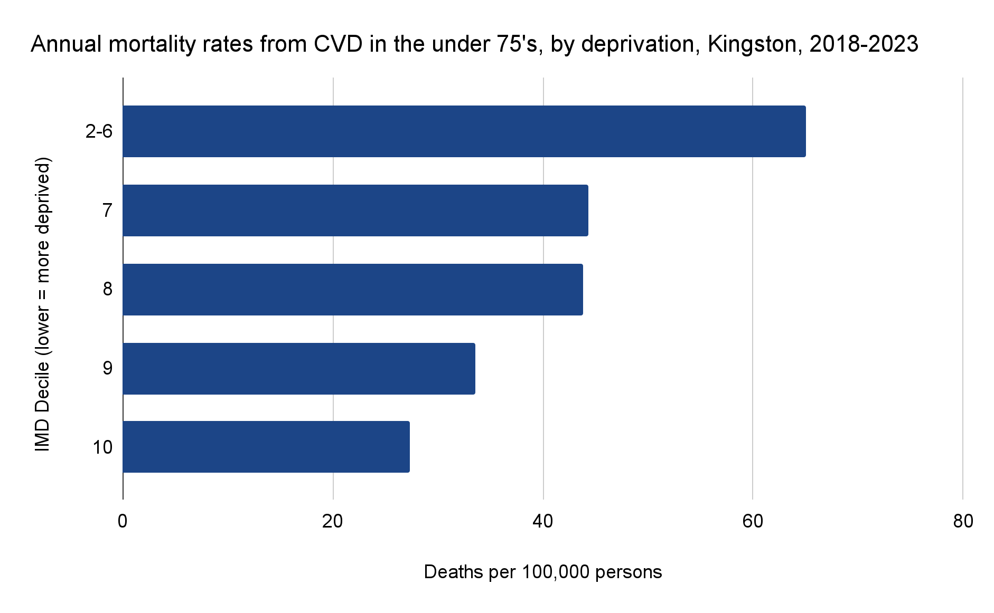
Heart health is an equalities issue
People living in the most deprived parts of the borough are more than twice as likely to die prematurely from CVD as those in the least deprived areas

Slide 5
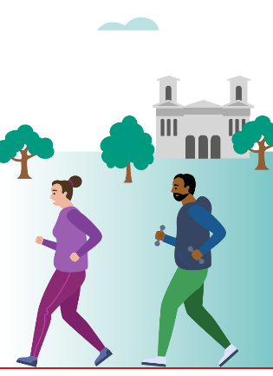
Keeping hearts healthy: four key actions
not smoking,
having a healthy diet
avoiding excess alcohol consumption
taking enough physical activity
Notes:
We have a way to go in all of these areas - with a particular need to reduce smoking rates in residents who work in routine and manual occupations and those with poor mental health.
We may also be building up trouble with large numbers of children not meeting minimum recommended physical activity levels. There are currently large numbers of children failing to achieve the minimum recommended levels of physical activity that may cause them health problems in the future.

Slide 6
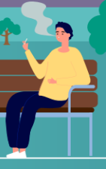
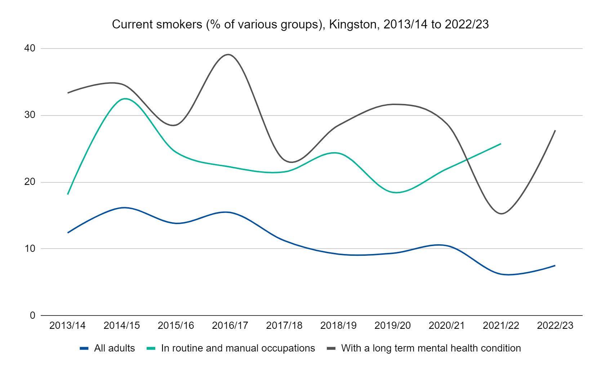
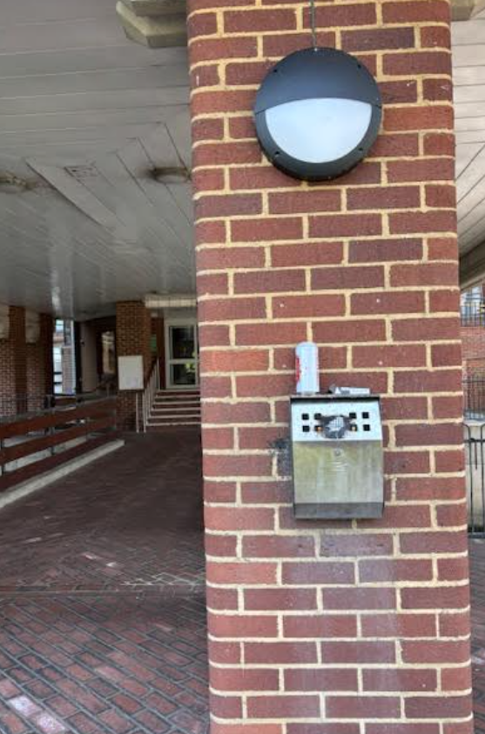
How are we doing on the four key actions?
Smoking in Kingston - contributing to health inequalities
Around 1 in 4 people in ‘routine and manual’ occupations and those with a long term mental health condition, smoke
Notes:
And the report also includes data on the the other three areas - ie healthy weight and diet, physical activity and alcohol

Slide 7
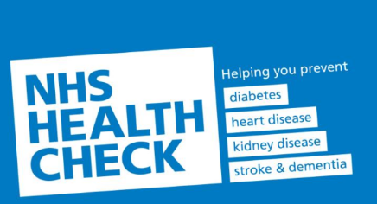
And a fifth key action:
‘Knowing our ABCs’
Detecting (and treating) heart health risks
Atrial Fibrillation
Blood Pressure
Cholesterol levels
Estimated to be around 11,500 Kingston residents with high blood pressure but who don’t know it (and won’t be taking action to reduce it)
Notes:
A fifth key action is detecting risks for poor heart health at an early stage - because support and treatment is at hand and can be lifesaving.
Atrial Fibrillation (which can increase the risk of a stroke), and knowing our
Blood Pressure and
Cholesterol levels. Having high blood pressure and high cholesterol are risks for poor heart health - and these can be identified in an NHS Health (or other) Check.
Hypertension undetected estimate 2021 (8.3% of adult population)

Slide 8
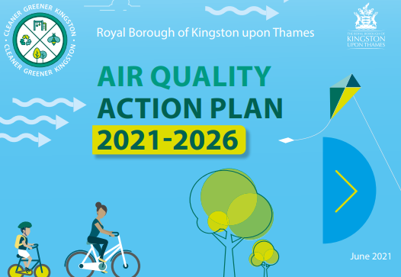
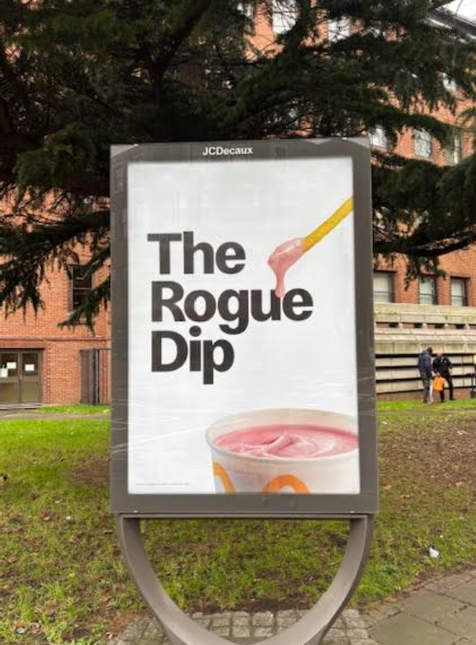
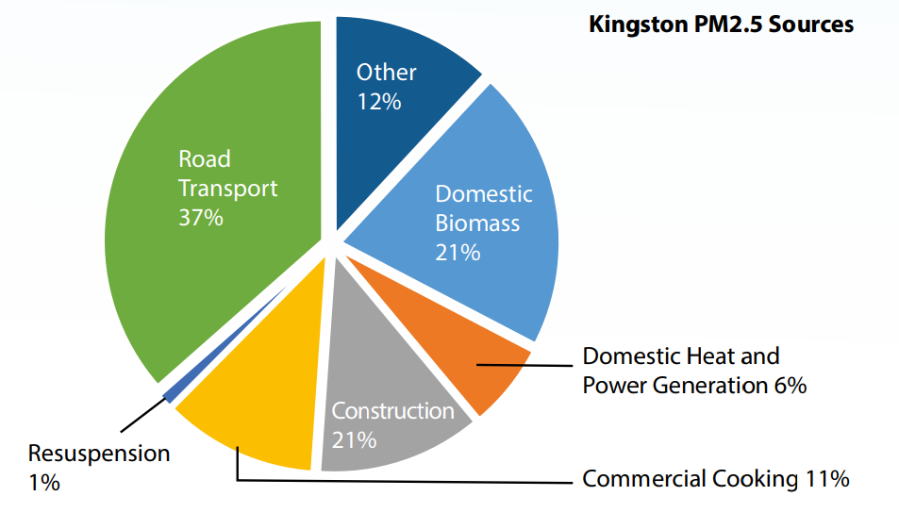
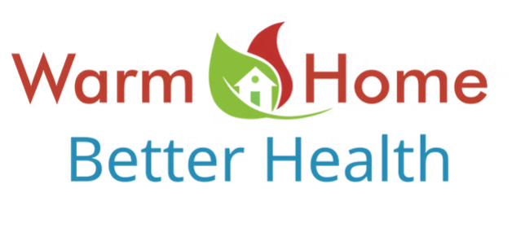
Our environment and heart health
Notes:
Our environment plays a key role in heart health - from the air that we breathe (air pollution increases heart attack risks), to the advertising around us and to the warmth of our own homes (cold homes can raise heart attack risks for vulnerable people).
Yet, - our environment in the borough is inconsistent in supporting good heart health - with junk food advertising across billboards and junk food vending machines in key locations.
McDonald's "Rogue Dip" is a term used to describe the act of dipping McDonald's fries into a milkshake. It's been embraced by the fast food chain as a fun, slightly rebellious fan ritual. McDonald's has even launched marketing campaigns around it

Slide 9
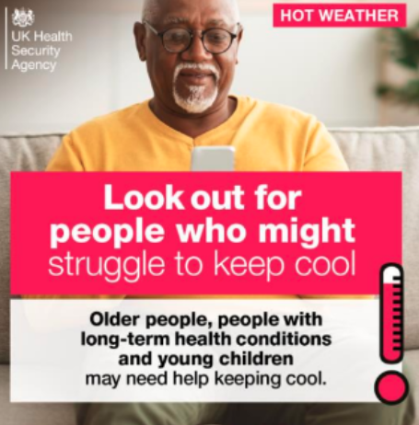
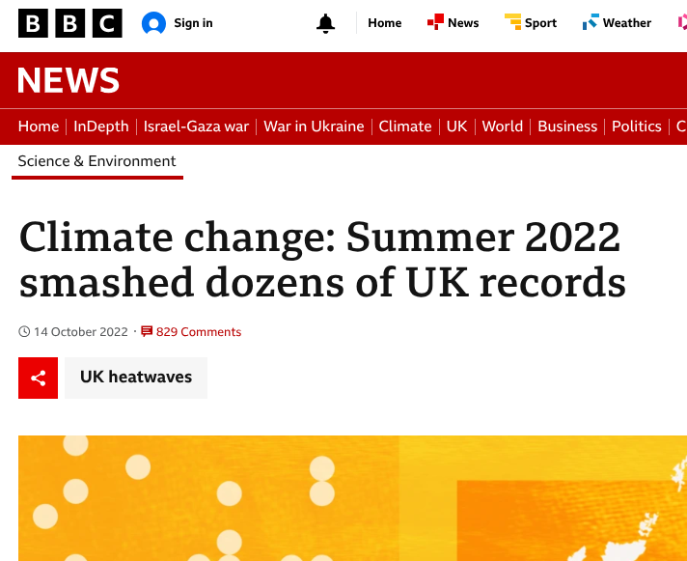
Climate and heart health
Synergies
A healthy heart environment is supportive of our aims to reduce carbon emissions - more cycling and walking instead of car journeys helps hearts and reduces carbon emissions.
A warm insulated home helps protect heart health and reduces carbon emissions.
Risks
Conversely, extreme heat, associated with climate change, increases heart health risks in vulnerable individuals.
Notes:
Synergy: the interaction or cooperation of two or more organizations, substances, or other agents to produce a combined effect greater than the sum of their separate effects.

Slide 10
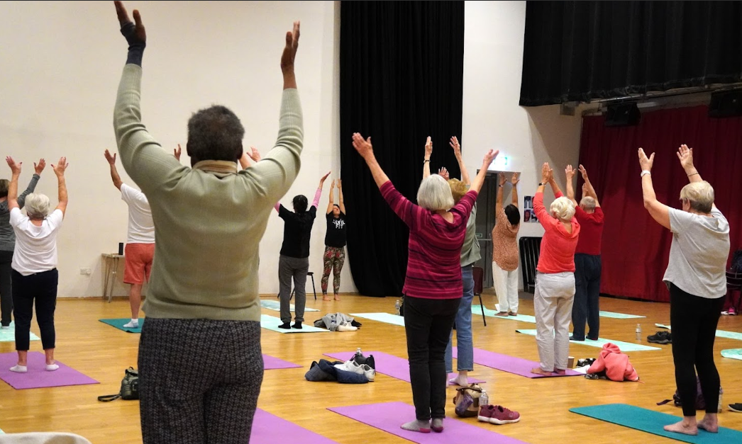
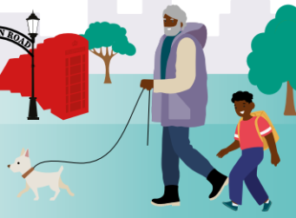
‘What is good for the heart is good for the head’
‘nearly 40% of all Alzheimer’s disease and related dementias may be prevented or delayed by modifying 12 ‘risk factors’’
(2020, Lancet)
education
Hypertension (high blood pressure)
hearing impairment
smoking
obesity
depression
physical inactivity
diabetes
low social contact
excessive alcohol consumption
traumatic brain injury
air pollution
Notes:
‘What is good for the heart is good for the head’ is what the science shows. Acting to support heart health also reduces risk factors for dementia. Thus, taking action on heart health will contribute to our aims of being an Age Friendly borough, with residents staying in good health for longer through reducing these associated risks.
Acting to support heart health also reduces risk factors for dementia. A 2020 study indicates that nearly 40% of all Alzheimer’s disease and related dementias may be prevented or delayed by modifying 12 ‘risk factors’ - several of which also support heart health. The 12 ‘modifiable factors’ are: education, hypertension, hearing impairment, smoking, obesity, depression, physical inactivity, diabetes, low social contact, excessive alcohol consumption, traumatic brain injury, and air pollution. As we have seen, if we improve many of these twelve factors - such as reducing high blood pressure, we improve not only heart health but also reduce dementia risks in Kingston.
Source: Dementia prevention, intervention, and care: 2020 report of the Lancet Commission
Livingston, Gill et al. The Lancet, Volume 396, Issue 10248, 413 - 446
https://www.thelancet.com/article/S0140-6736%2820%2930367-6/fulltext

Slide 11
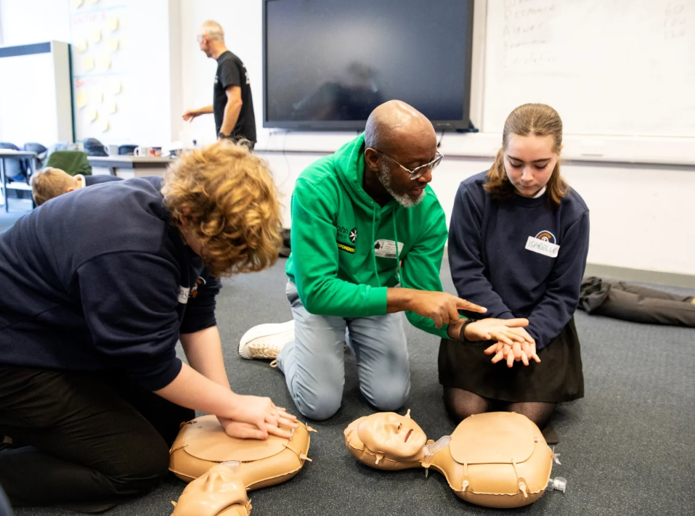
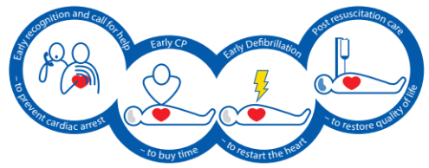
Saving lives in an emergency - learning CPR
Finally, learning CPR is something that everyone can do - and it can save a life in the event of a cardiac arrest
Let's get as many children and adults in Kingston trained as we can

Slide 12
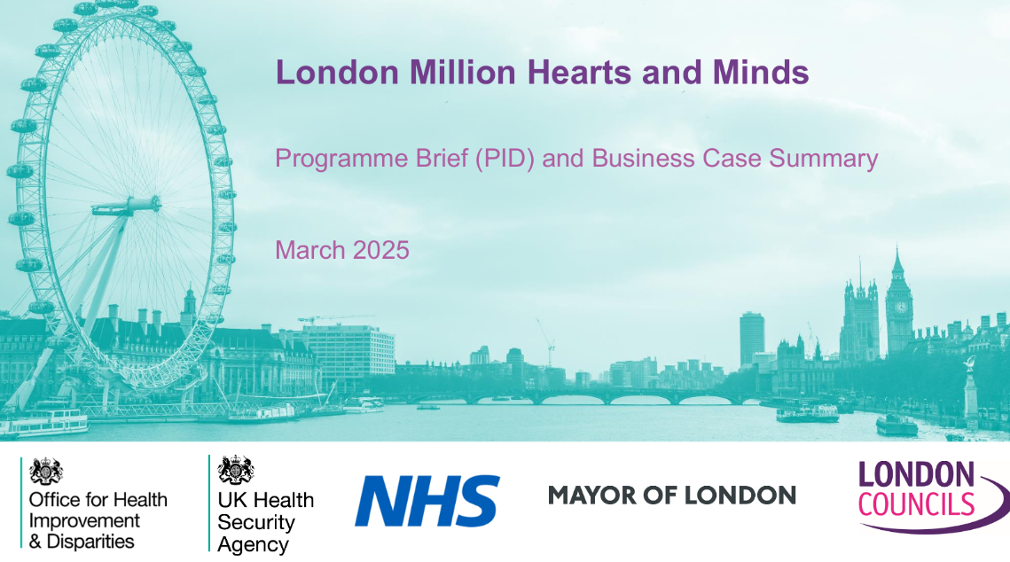
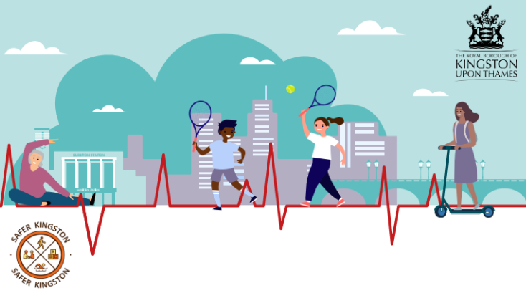
Working together to make progress and reduce inequalities: report recommendations
Report recommendations include targeted actions on:
Supporting work to reach London Million Hearts and Minds goals (which focus on ‘detecting and treating ‘the ABCs’)
Making Every Contact Count for heart health
Physical activity promotion
Healthy diet (and associated environmental factors)
Smoking
Planning
NHS Health Checks
Climate
Alcohol
Encouraging CPR training
Notes:
Will be launched on the 23rd June 2025
Report will be published on the Kingston Data website (data.kingston.gov.uk)

Slide 13
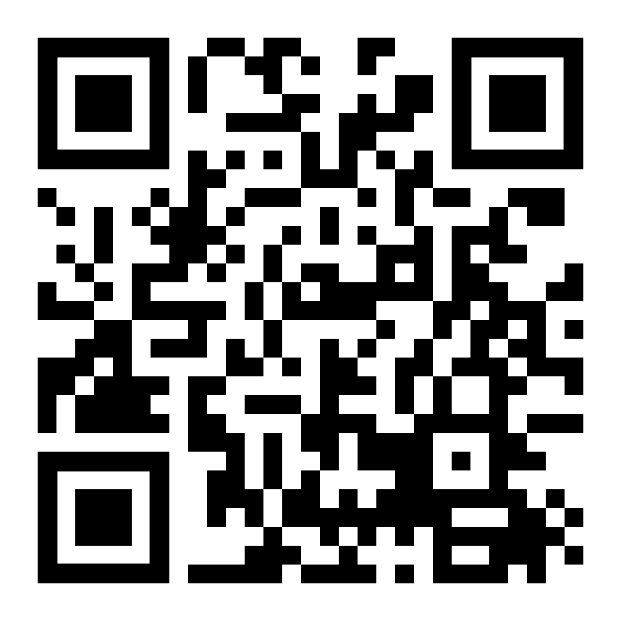
Get the full report here
https://data.kingston.gov.uk/phreport-2/

