Slide 1
Pathway zero
“Just do something”
Toby@crewenergy.london

Slide 2
Change behaviours and save energy
Boiler Controls
Appliances
Turn down your thermostat 1º savings £84
Reduce the boiler flow temperatures down to 60º £ 84
Balance your heating system £67
Don’t overfill kettle £30
Wash at 30º £45
Turn off appliances £50
Switch from fan heathers to infrared save 90%
Walls: 35%
Roof: 25%
Fabric improvements
Lagging
Draw curtains at dusk £117
Cut down on heat leaks by draught proofing doors and windows £50
Install a chimney a balloon £40
Lag hot water pipes £60
Hot water tanks should have 80mm of insulation, if not install at hot water jacket £50
Radiator foil £40
Thermal blankets and gilets (Steve lagging)
Floor: 15%
Windows: 25%
Heat escapes from your home through the roof, walls, floor and windows

Slide 3
Energy Efficiency Technologies
SMART RADIATOR VALVES
Smart radiator valves enable to heat different radiators at different times of day to different temperatures, saving 20% on your heating costs.
Cost to install: £240
Energy saving pa: £110 (12.5%)
Payback (years) 2.18 years
Cost to install: £250
SMART THERMOSTAT
Smart thermostats learn heating patterns, understand the fabric of the house and consider outside temperatures when heating the home, saving 10% on heating costs
Energy saving pa: £88 (10%)
Payback (years) 2.84
Energy efficiency measures tend to have a low upfront cost and a fast payback so should be the first area to address
Cost to install: £36
LED LIGHTING
LED bulbs can be up to 80% more energy efficient than conventional bulbs and last 10x longer.
Energy saving pa: £153
Payback (years) 0.25
*Based on light being on 2-4 hours per day
Notes:
Smart TRV’s cost approximately £60 each – 3 bed house with 6 radiators with TRV’s = £360
LED lighting 15 lights – x10 Downlighters = £20, lamps = £4 = £220

Slide 4
Hydromx Heat Transfer Solution
Cost to install: £1500
Energy saving pa: £280
Payback (years): 5.35
CO2 saved pa: 0.75 tonnes
Boiler life extension saving: £33 a year
Hydromx
Hydromx is a nanotechnology heat transfer solution which is used to improve the heat transfer within a closed-loop heating system such as a boiler and radiators. This is achieved by reaching the required temperature faster, meaning that the energy required is vastly reduced, therefore saving money and cutting carbon emissions.
The benefits of Hydromx:
• Reduces heating demand by 20-35% with commensurate carbon savings
• Cuts gas flue emissions, improving air quality
• Warms home quicker 2.4 times quicker
• Installation is quick with minimum disruption.
• Little annual maintenance and extends boiler life
• 20-year warranty protection against corrosion and freezing.

Slide 5
Renewable Energy Options
SOLAR PV
Solar photovoltaic generates electrical energy from sunlight through an array of panels generally fixed on a south facing sunny roof. The energy can either be used in your home or exported to the National Grid for someone else to use.
Battery storage can also be considered. Here you need to consider the cost of the battery and how many cycles it will last. This will allow you to calculate the cost per cycle and therefore if it is economical for you.
Cost of instal: £5000
Energy savings p.a £607
CO2 saved 0.43 tonnes
Payback in year 8.23 years
Consider differential between you tariff and export rate
Could you benefit from a time of use tariff like economy & Octopus’ Agile tariff.
AIR SOURCE HEAT PUMP
Air source heat pumps capture heat that is in the air and concentrate it up to a higher temperature with the use of a refrigerant.
Heat pumps work best when you can reduce the heating load to a minimum and spread the load over a longer period. They therefore work better in well insulated homes with under-floor heating or over sized radiators.
To incentivise householders to make the change, the government has set up the Boiler Upgrade scheme which offers a £7500 grant towards the purchase.
Cost to install: £12.5-15k
Energy saving pa: gas:elec dependent
BUS Grant: £7500
CO2 saved pa: 2.8 tonnes
Floor Insulation
Implementing renewable energy technologies can eliminate your remaining home energy carbon footprint
By moving to a cheaper electricity tariff, the heat pump running costs could become cheaper than gas running costs.
This includes £92 of standing charge for gas.
In this scenario, you would be required to swap your gas hob for an electric hob.

Slide 6
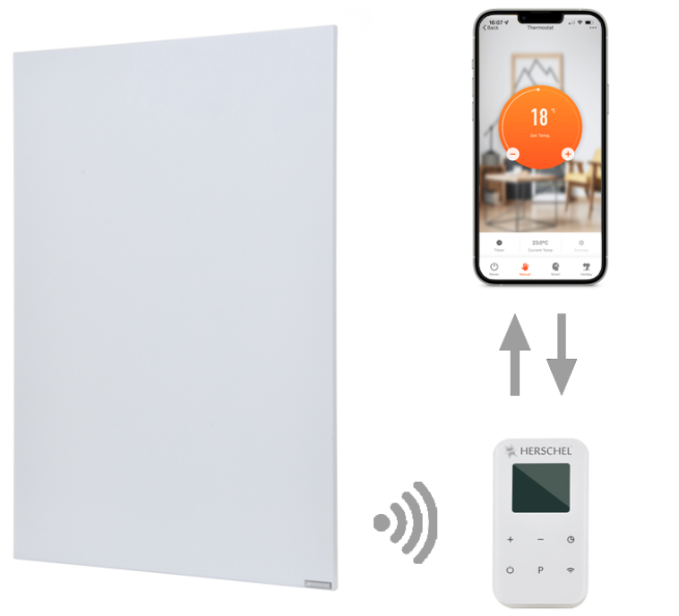
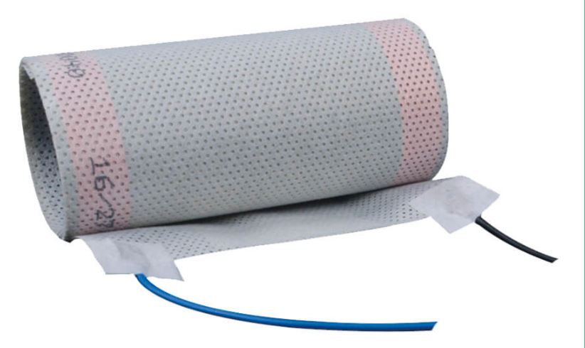
Radiant heating options
Infrared Heating panels
The oldest of the technologies. These panels can be fixed to walls or ceiling.
They heat up to between 100º and 120º and quickly start to beam heat onto room occupants, so heat can be felt within 1-2 minutes
Within 30-40 minutes walls, floors and furniture with start to emit heat and so warm the air temp.
They can be controlled with in-room thermostats and through smart apps
Infrared heat is a form of radiant heat, similar to the sun. While traditional radiators heat a room through convection heat, far infrared heats people and objects, providing a more efficient and effective way of heating a space.
The sector is pushing for regulatory approval to be considered a renewable heat source with efficiency rates of 250%.
Worth considering in conservation areas, where damp is an issue and for those who living a fews rooms in a large house.
Carbon fibre heat
Works in a similar fashion to IR panels but the surface temperature only rises to 35-40º.
Install in ceilings and sometimes walls. Offering a larger surface area and more even heat.
The rolls are embedded into the ceiling, so are unseen once installed.
Controls can be via thermostats or occupancy sensors.
Floor Insulation

Slide 7
Insulation
WALL INSULATION
LOFT INSULATION
Solid Wall Insulation
Cost to install: £150-260/sqm
Energy saving pa: £290
CO2 saved pa: 0.80 tons
Affordable option: Cork Sol
Cost to install: £300-£600
Energy saving pa: £210
CO2 saved pa: 0.56 tons
Requirement now 270mm
Walls: 35%
Roof: 25%
FLOOR INSULATION
WINDOW GLAZING
Floor: 15%
Windows: 25%
Solid, Suspended or Timber
Cost to install: £2500
Energy saving pa: £84
CO2 saved p.a.: 0.22 tonnes
Double or Triple
Cost per window: £400-£600
Energy saving pa: £128
CO2 saved pa: 0.56 tons
Affordable option: Acrylic glazing
Heat escapes from your home through the roof, walls, floor and windows

Slide 8
Grants
Great British Insulation Scheme
The scheme provides free or cheaper insulation to eligible households Including homeowners, landlords and tenants. The scheme covers cavity wall and loft insulation only. Energy Supplier lead process.
Eligibility:
EPC rating D-G
Council Tax band A-D
Household income/ Income support
Warm Homes Grant
The scheme providing funding for renewable heat and energy efficiency measures. Launches in April 2025. LA lead grant scheme. GLA has bid for $600m of funding over 3 years. Up to £30k of funding.
Eligibility:
One of : IMD eligible postcode/ Income support/ Income under £36k
Landlords: 1 property only. 50% match funding.
EPC rating D-G
Floor Insulation

Slide 9
Home Energy Transformations
Onezero is a company delivering quality solar, battery and heat pump technology at scale. Our ambition is to get homes off of fossil fuels and reduce your bills by making renewable home energy solutions accessible and affordable. We walk customers through the entire process, from your initial proposal, surveys and quote, to booking in the trades and completing your pre and post installation paperwork.
Bottom-up & Community Focused
Our approach to business is bottom-up, working closely with communities in developing street-by-street strategies for installations. This involves our team collaborating with local community energy groups (e.g. CREW Energy, Wandsworth) and other actors to identify areas with strong interest in de-carbonising their homes. We choose to use certified local tradespeople to keep the money in the local economy and upskill your local workforce.
Putting Homes at the Centre of the Energy System
Once your home is generating and storing electricity, we can begin to work with digital tools to maximise your benefits. How? This is achieved by coordinating your system with the grid’s intermittency and by aggregating and managing your system as part of a local, distributed energy resource. The results can be outstanding!
Our Partner

Slide 10
#JustDoSomething
@crewenergyldn
www.crewenergy.london
toby@crewenergy.london
Find out more and book a home energy assessment

