Slide 1
Surplus Hub Kingston
VCSE Forum
Wednesday 30th April 2025

Slide 2
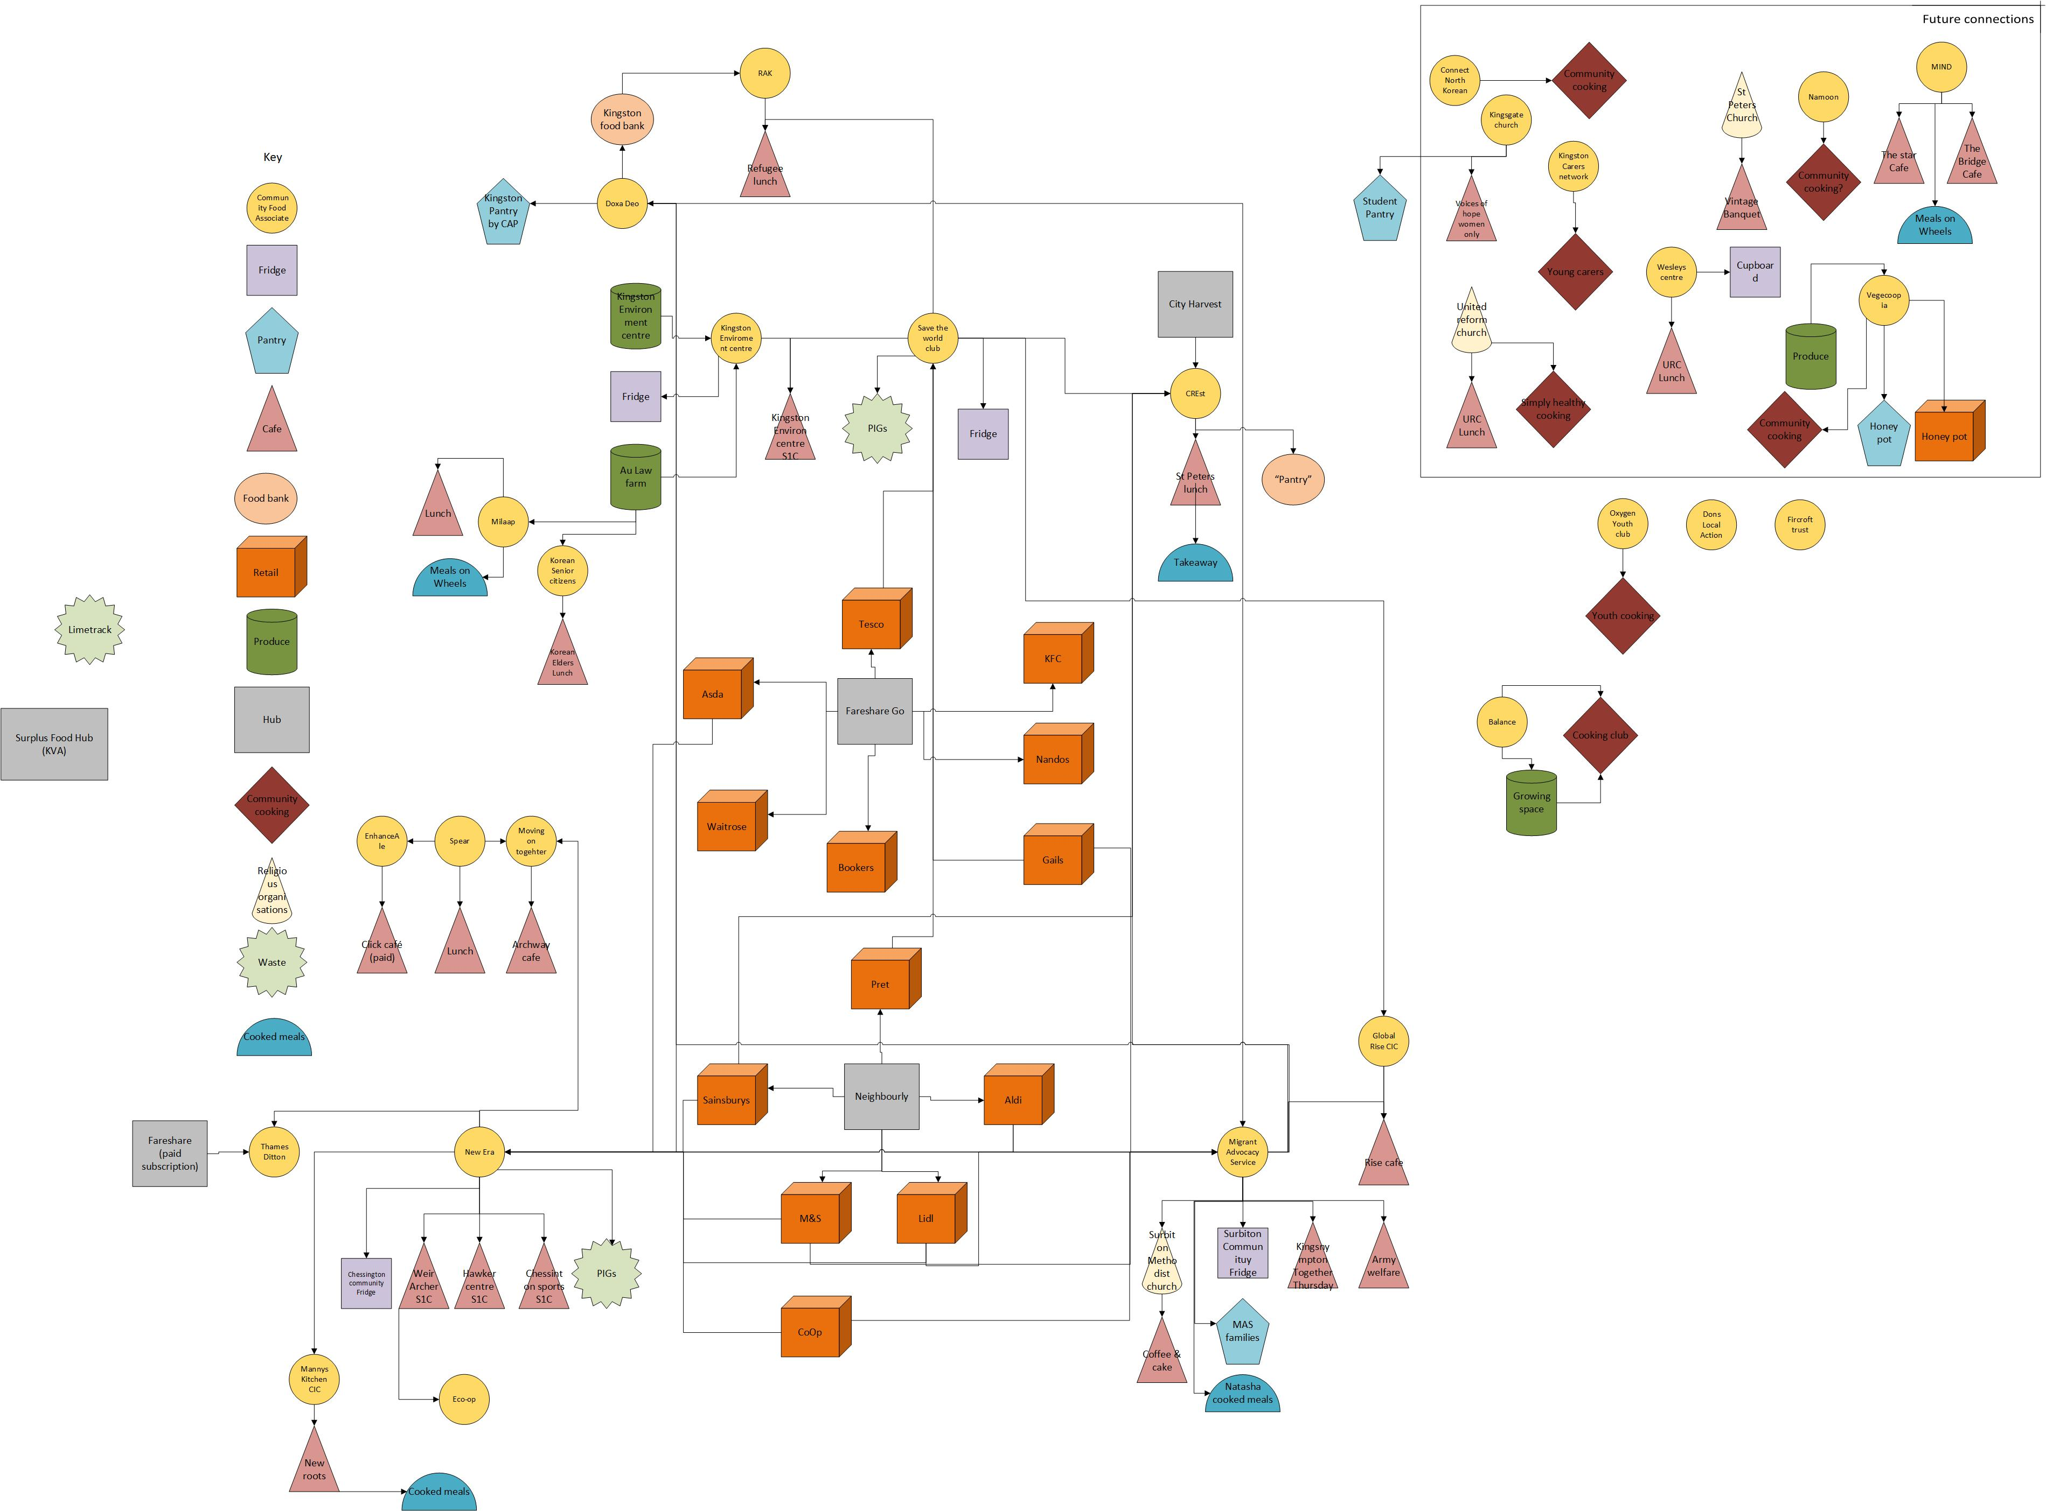
Kingston food organisations research
Category | Total
Fridge/Pantry/Food bank | 20
Cafes | 24
Community events | 100 +
Volunteers | 250 +
Community reached | 1000 +
Notes:
Reduce food waste and environmental impact

Slide 3
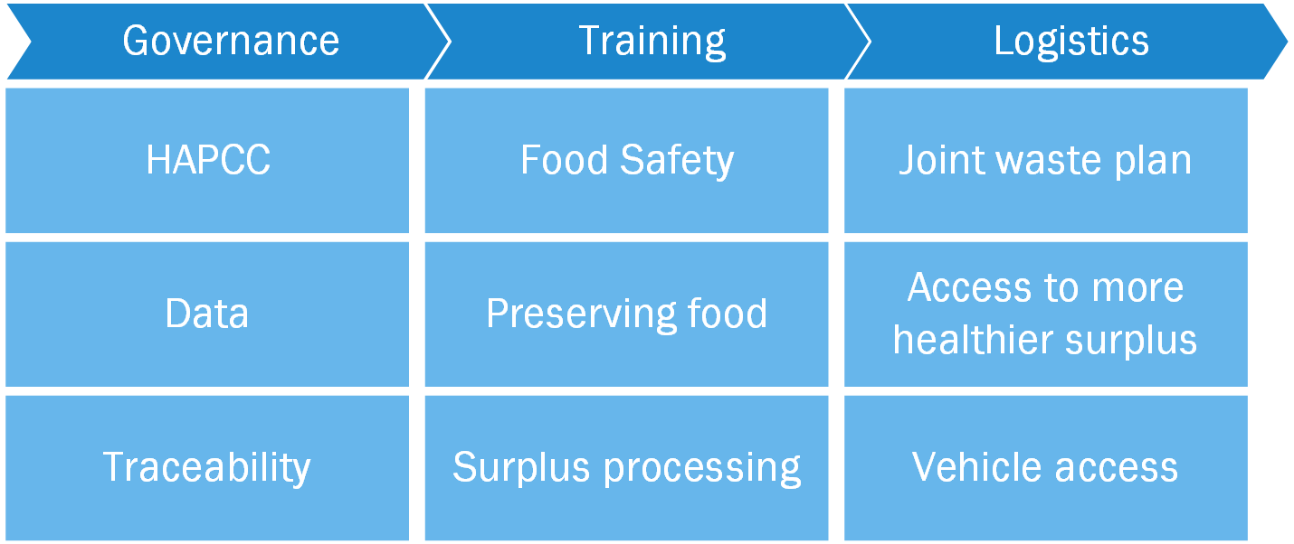
Good Food Group feedback themes

Slide 4
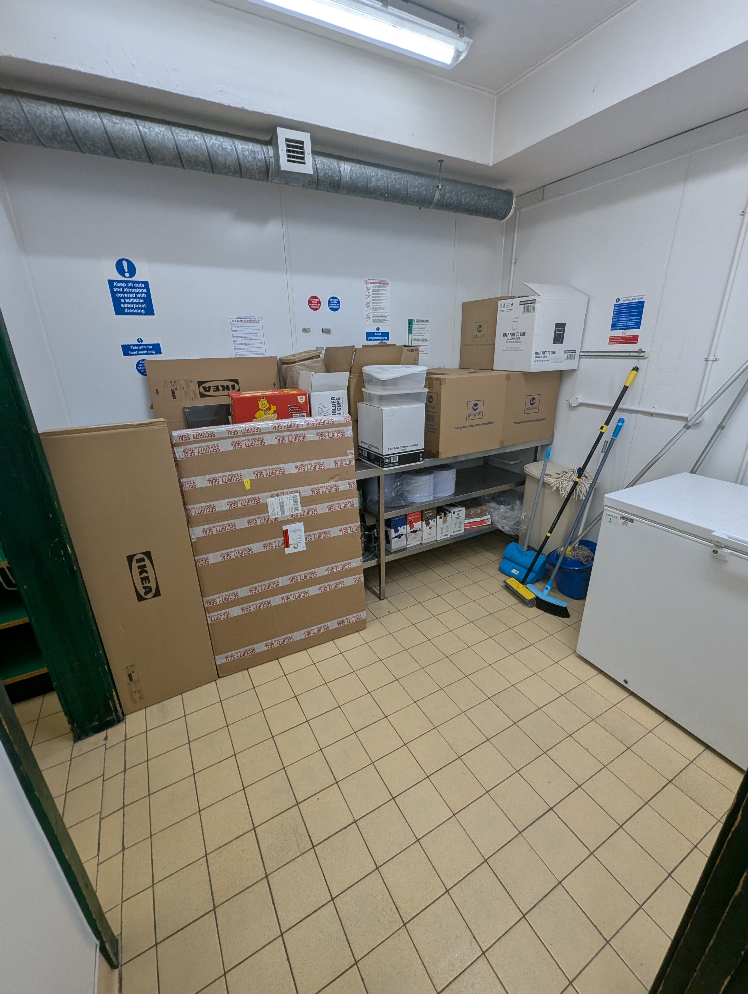
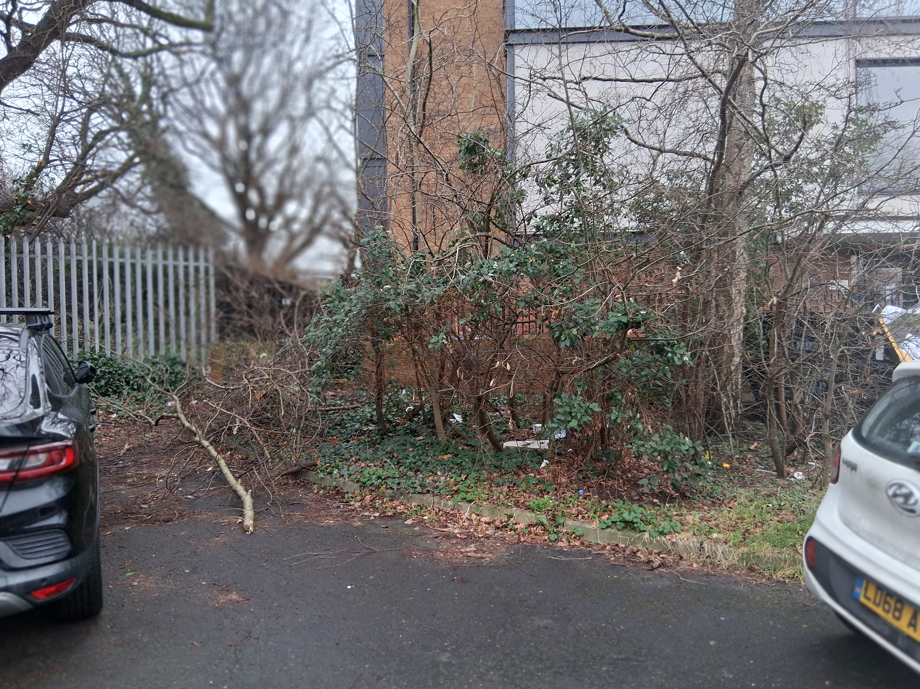
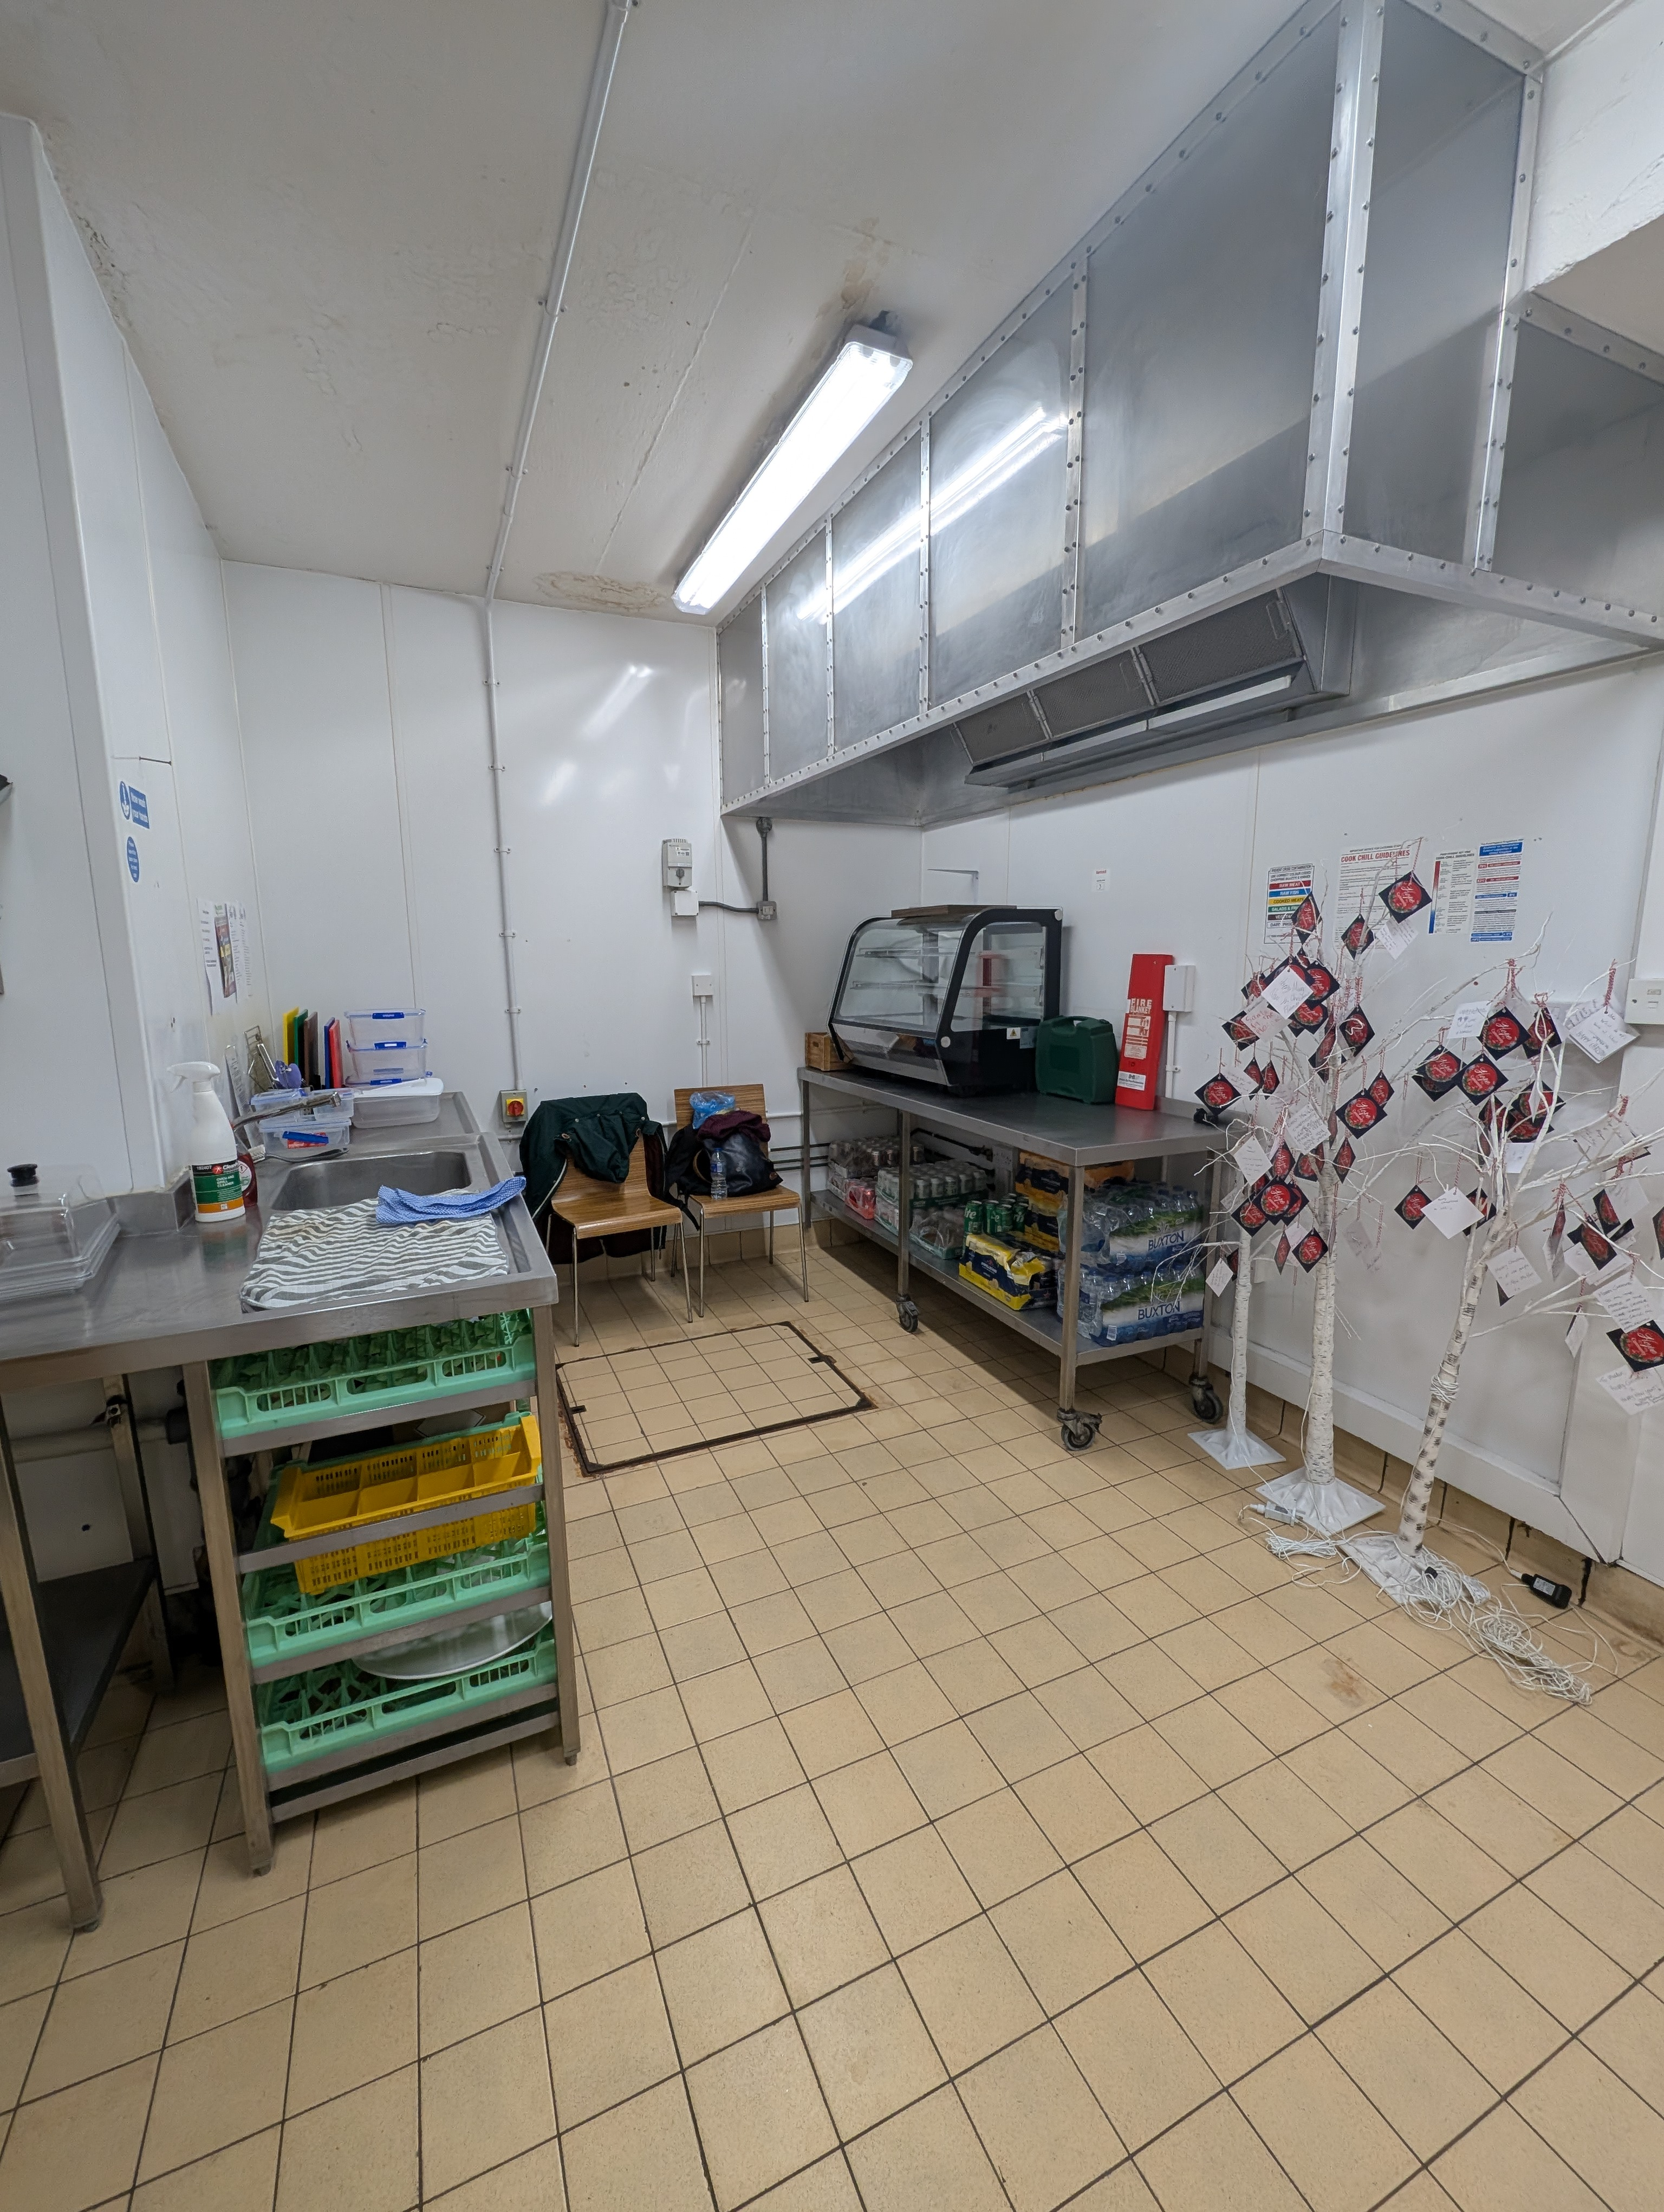
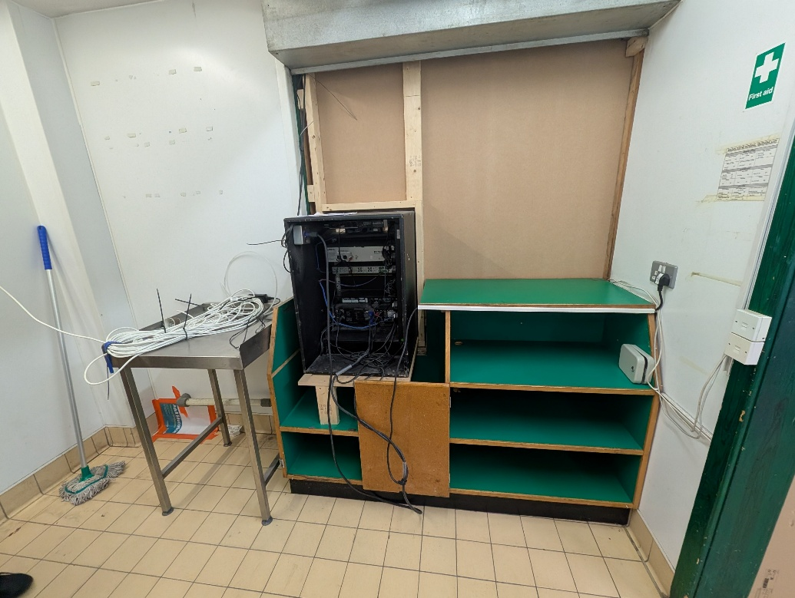
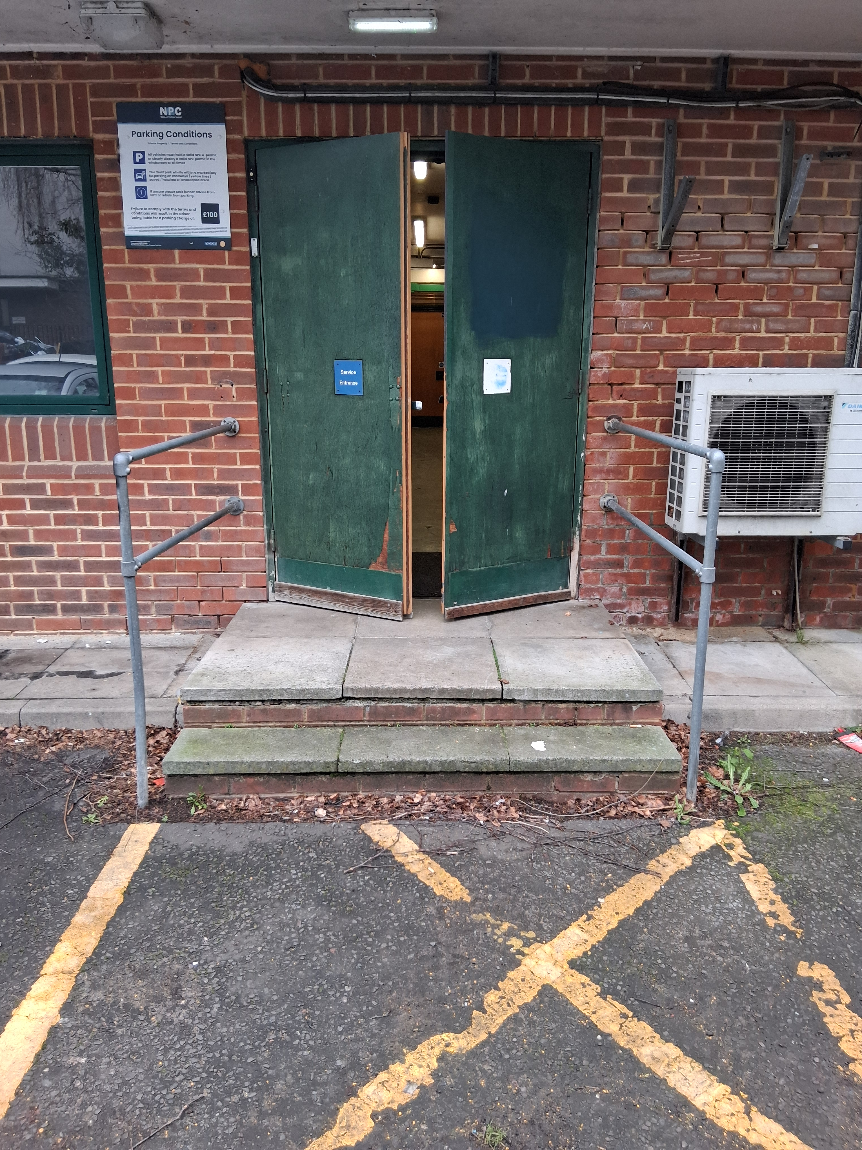
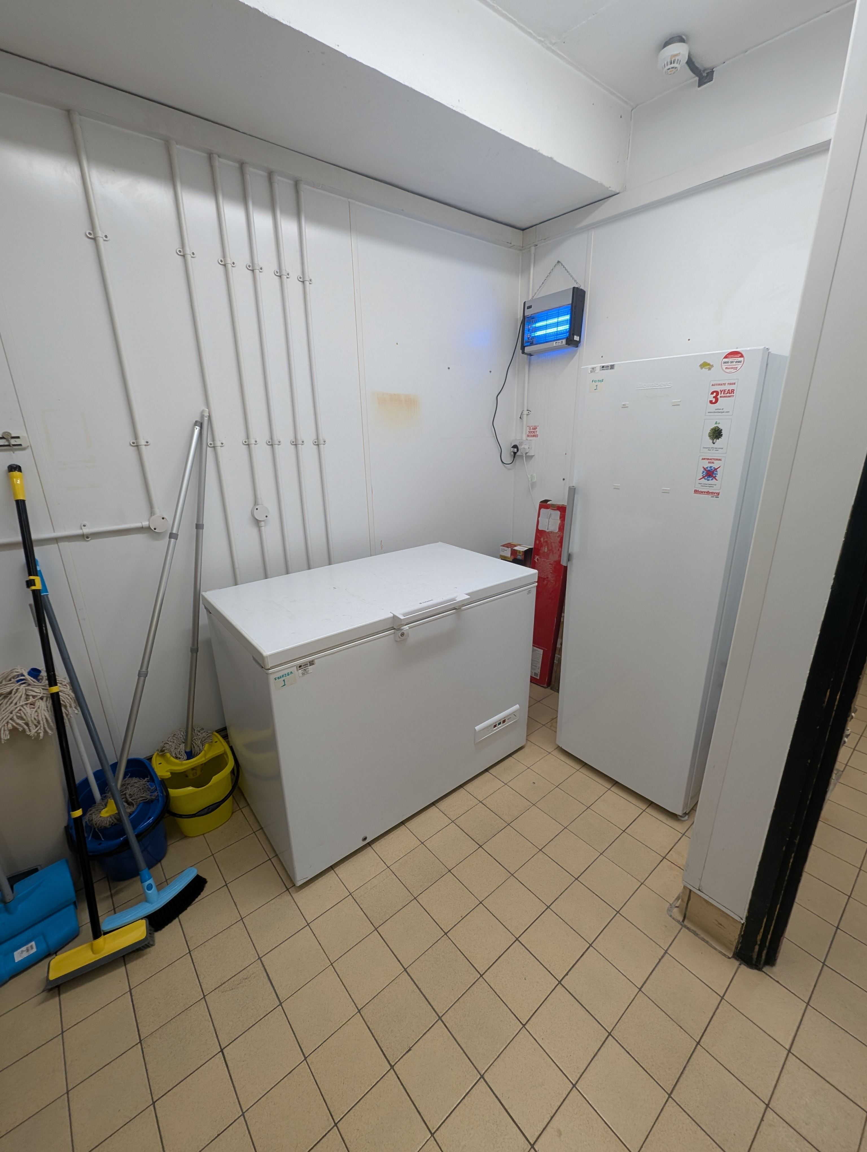
In the beginning…
Refrigerated container
Kitchen
Prep room
Storage

Slide 5
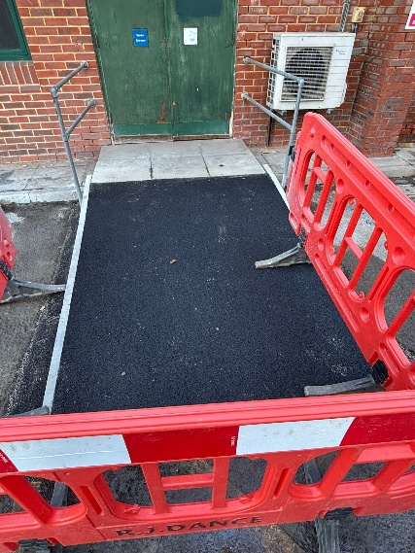
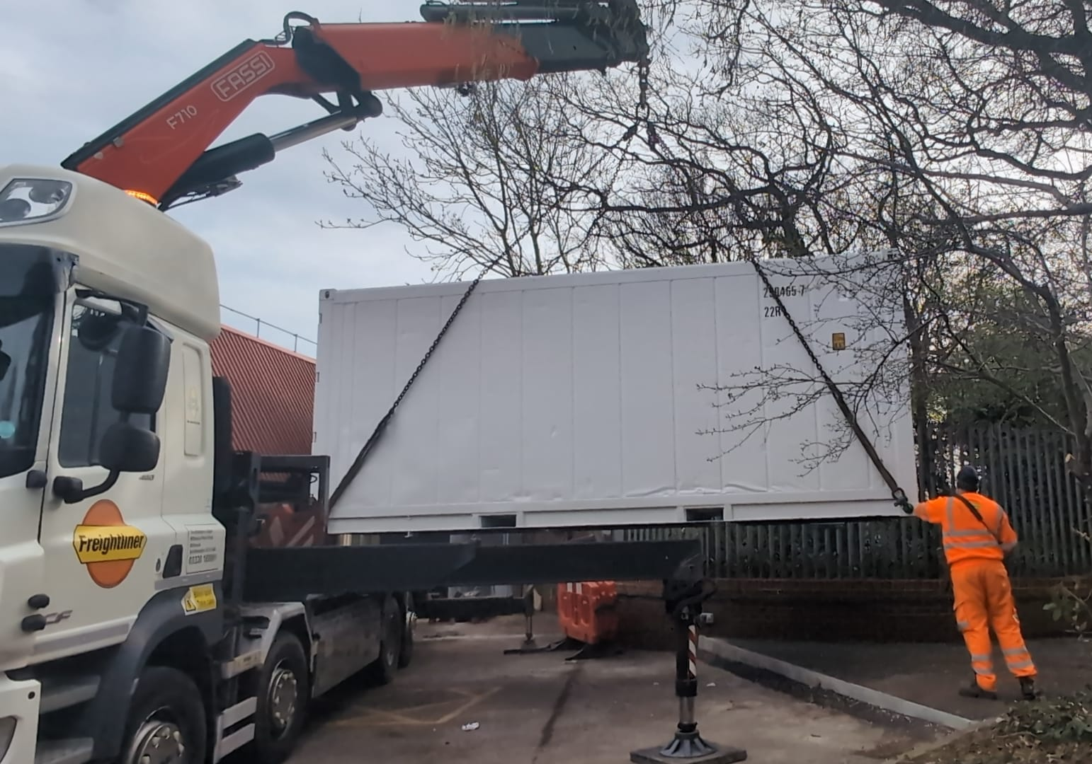
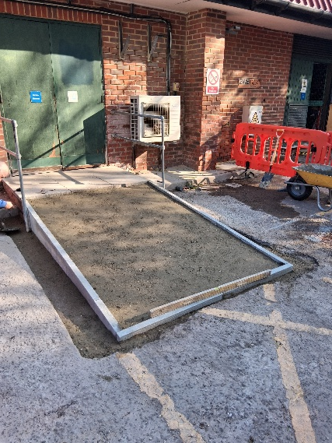
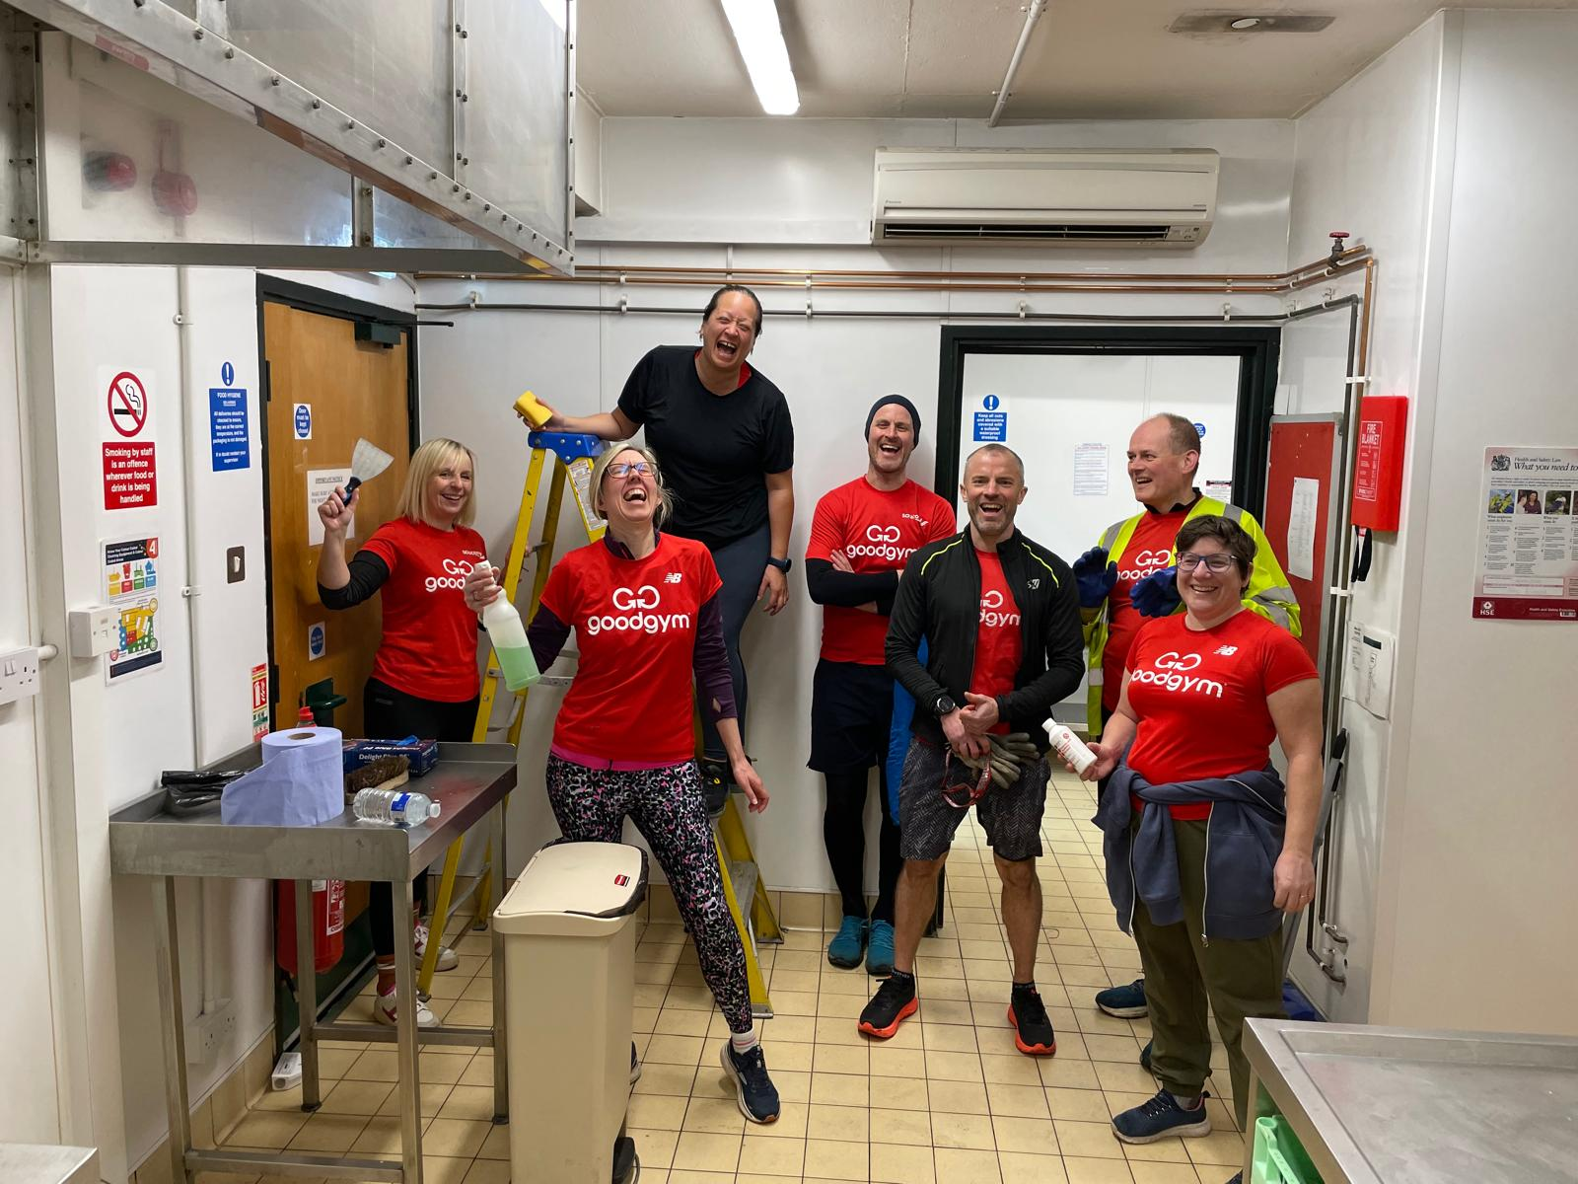
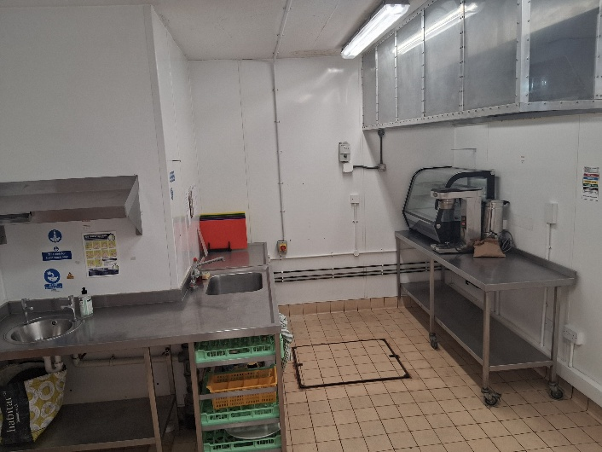
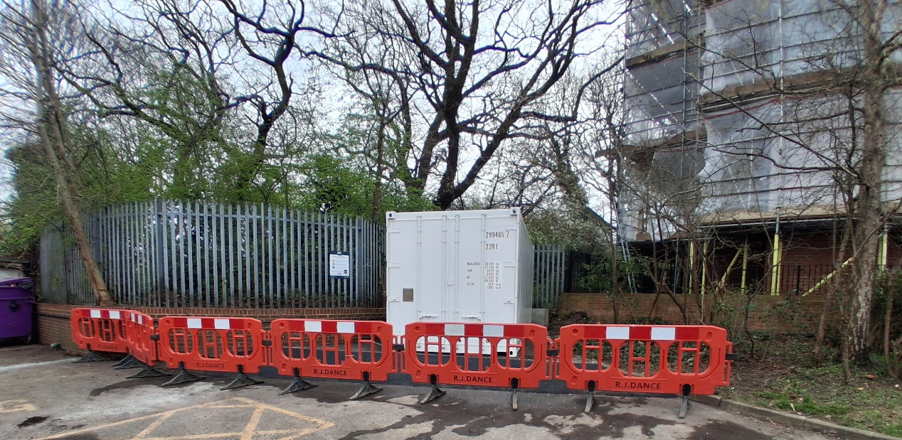
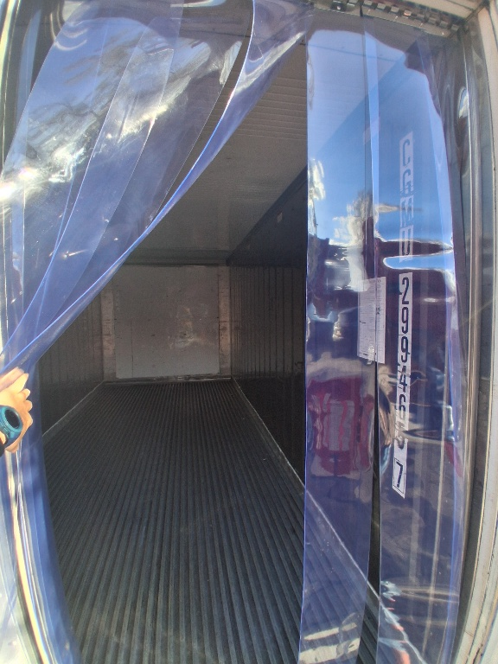
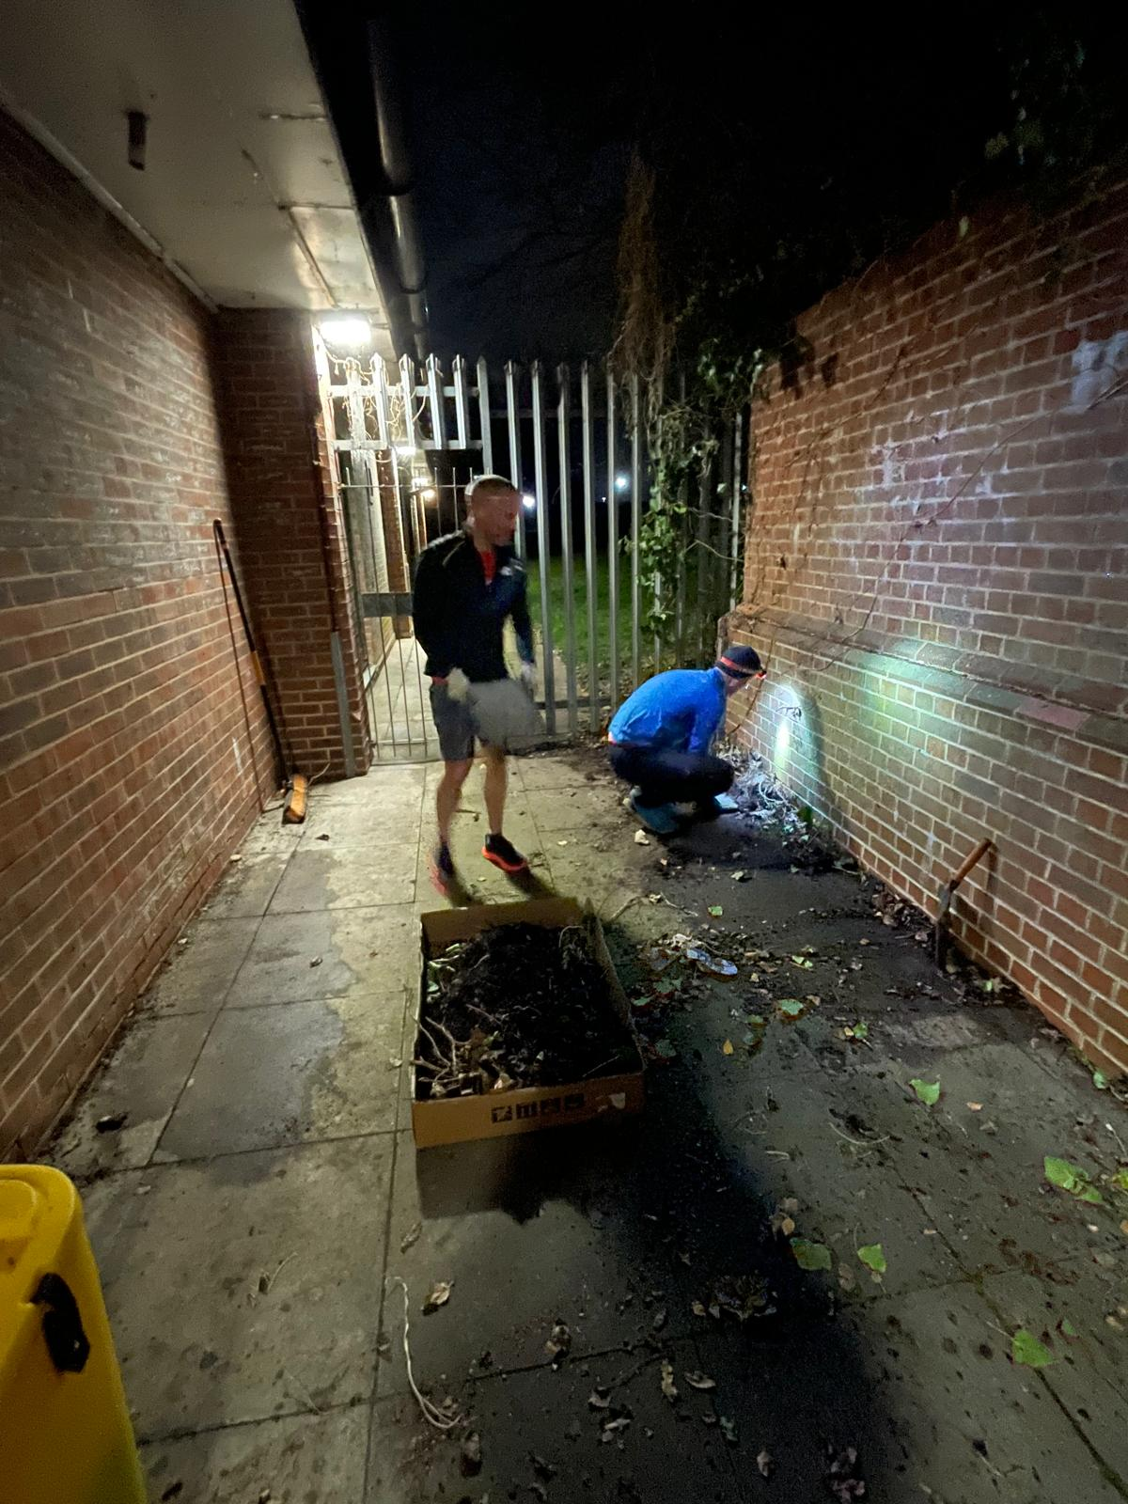
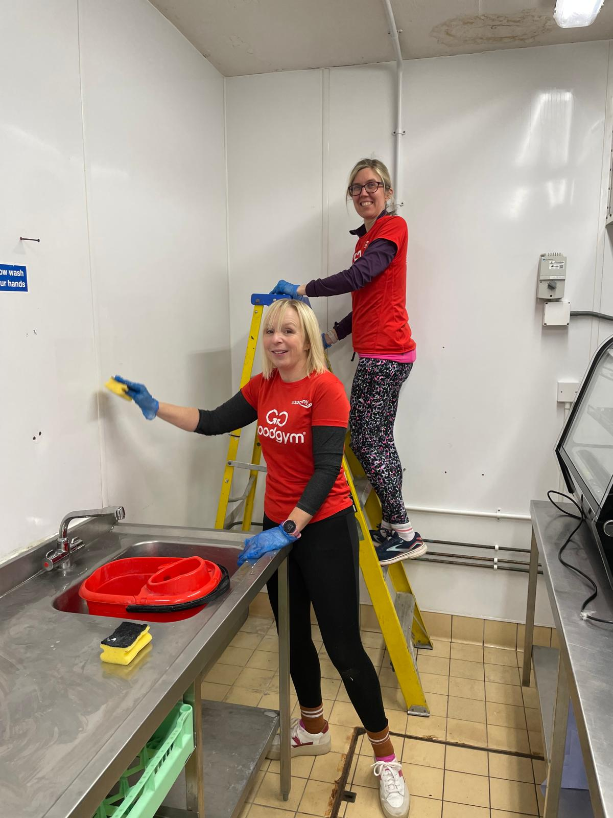
Getting ready!
Ramp access
Refrigerated container
Good Gym Clean

Slide 6
Surplus Hub Phases
Phase 1
Set up Surplus Hub inc. registration
Data gathering/meeting the community
Phase 2
Phase 3
Processing surplus collections (Kitchen)
Direct to consumer surplus
Phase 4
Full cycle Surplus Hub operations
Future planning
Collection and distribution of surplus
Volunteer onboarding

Slide 7
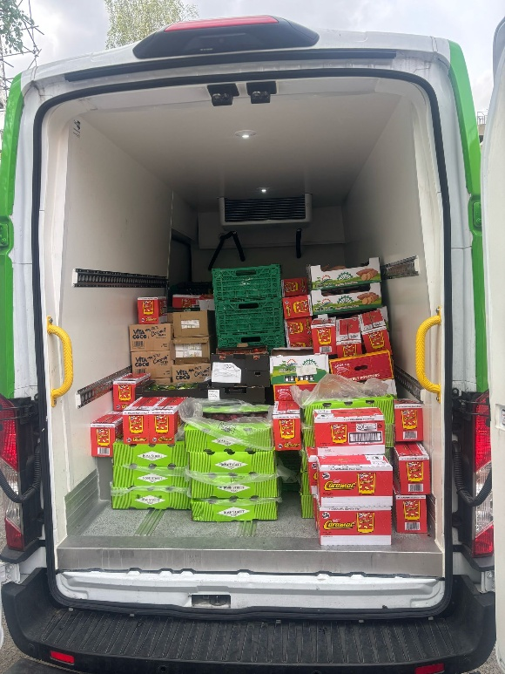
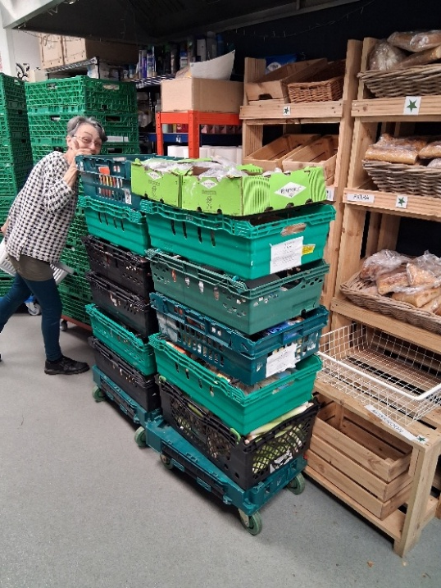
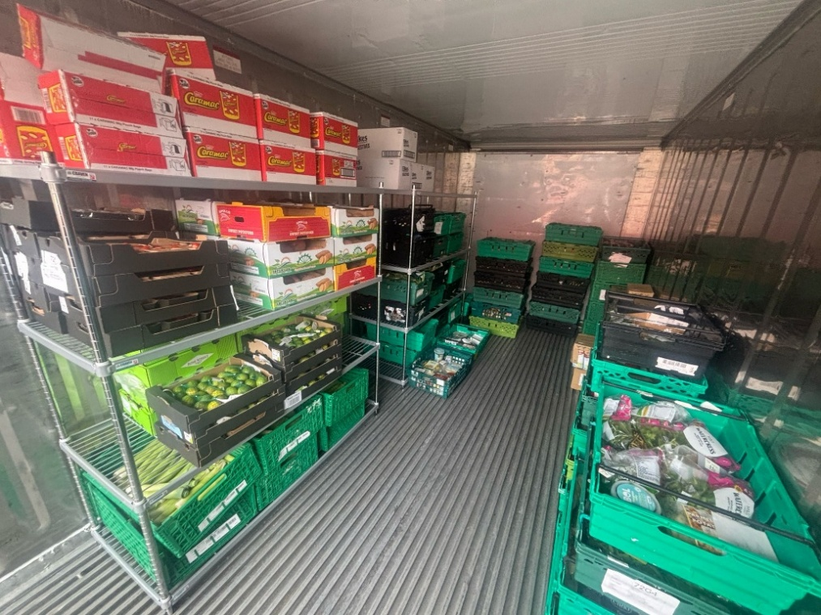
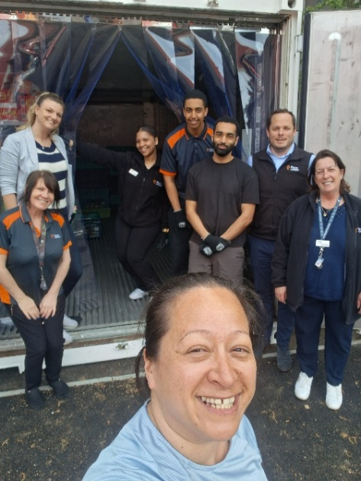
Felix delivery
Kingston Food Bank
900kg surplus food
Volunteers
Notes:
Improving the nutritional content of food support across the borough

Slide 8
Any Question??
Emma.idris@kva.org.uk

