Slide 1
Health & Well-being network
Community Health Project Worker
Kathy Wong

Slide 2
Contents
Introduction
NHS Core20PLUS5 approach
What KVA will do in the community health

Slide 3
KVA Community Health Project worker
Kathy Wong
Registered Nurse & Registered Midwife in Hong Kong
Master of Public Health
International Board Certified Lactation Consultant (IBCLC)

Slide 4
What is Health
World Health Organization state: ‘Health is a state of complete physical, mental and social well-being and not merely the absence of disease or infirmity.’

Slide 5
Health and well-being
Prevent disease
Promote healthy behaviour
Ensure access to healthcare

Slide 6
Factors affecting health and wellbeing
Health & Wellbeing
Physical
Mental
Social
Lifestyles
Environment
Healthcare access
Cultural influences

Slide 7
Health and well-being services in Kingston
Promote Physical Activity and healthy diet
Support mental wellbeing
Smoking cessation
Alcohol & drugs advice
Sexual Health services
Support employment
Housing and living
Social care

Slide 8
Dedicated to helping Kingston residents find local activities and navigate local services.
To help residents of Kingston stay happy, healthy and connected to each other
To maintain and build Kingston’s community so we can all live our best lives.

Slide 9
NHS Core20PLUS5 approach
Core20PLUS5 is a national NHS England approach to inform action to reduce healthcare inequalities at both national and system level. The approach defines a target population – the ‘Core20PLUS’ – and identifies ‘5’ focus clinical areas requiring accelerated improvement.

Slide 10
Notes:
What is the Core20PLUS5 approach?
The NHS England Core20PLUS5 vision is to deliver exceptional quality healthcare for all ensuring equitable access, excellent experience, and optimal outcomes. NHS England developed an architecture of four Core20PLUS5 trailblazers’ initiatives that support focused action across ICSs to reduce healthcare inequalities and support a social movement ethos. These programmes are: Core20PLUS Connectors, Core20PLUS Accelerators, Core20PLUS Ambassadors, and Core20PLUS Collaborative.
The Core20PLUS5 approach defines a target population of the 20% most deprived population by the Index of Multiple Deprivation (IMD) – the ‘Core 20’ of the national population, ‘PLUS’ ICS-determined groups experiencing poorer than average access, experience or outcomes from healthcare and ‘5’ clinical focus areas with the greatest opportunities to narrow the current gap in life expectancy due to health inequalities. The initial Core20PLUS5 framework focused on accelerated improvements for adults over the age of 18 years.

Slide 11
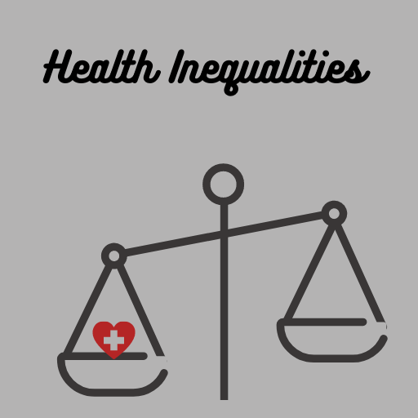
Core20PLUS5 Connectors Programme
A part of the support framework for progressing the goals of Core20Plus5
Community Connectors to take practical action to improve health and reduce inequalities

Slide 12
Core20PLUS5 Connectors role
Local knowledge
Lived experience of health inequality
The right conversations and connections with communities
Focus on what people CAN do
Linking people together
Build up long term relationship

Slide 13
KVA work in community health
Community Engagament
Networking
Working on Health inequality
Facilitating access to Primary care services
Data collection and analysis
Collaboration and coordination

Slide 14
KVA collaboration
Other than the local communities, we work closely with the local authorities and NHS ICS

Slide 15
What KVA will do in the community
Health talk
Mini Health check
Health information & advice booth
Health drop-in: Advice and health education

Slide 16
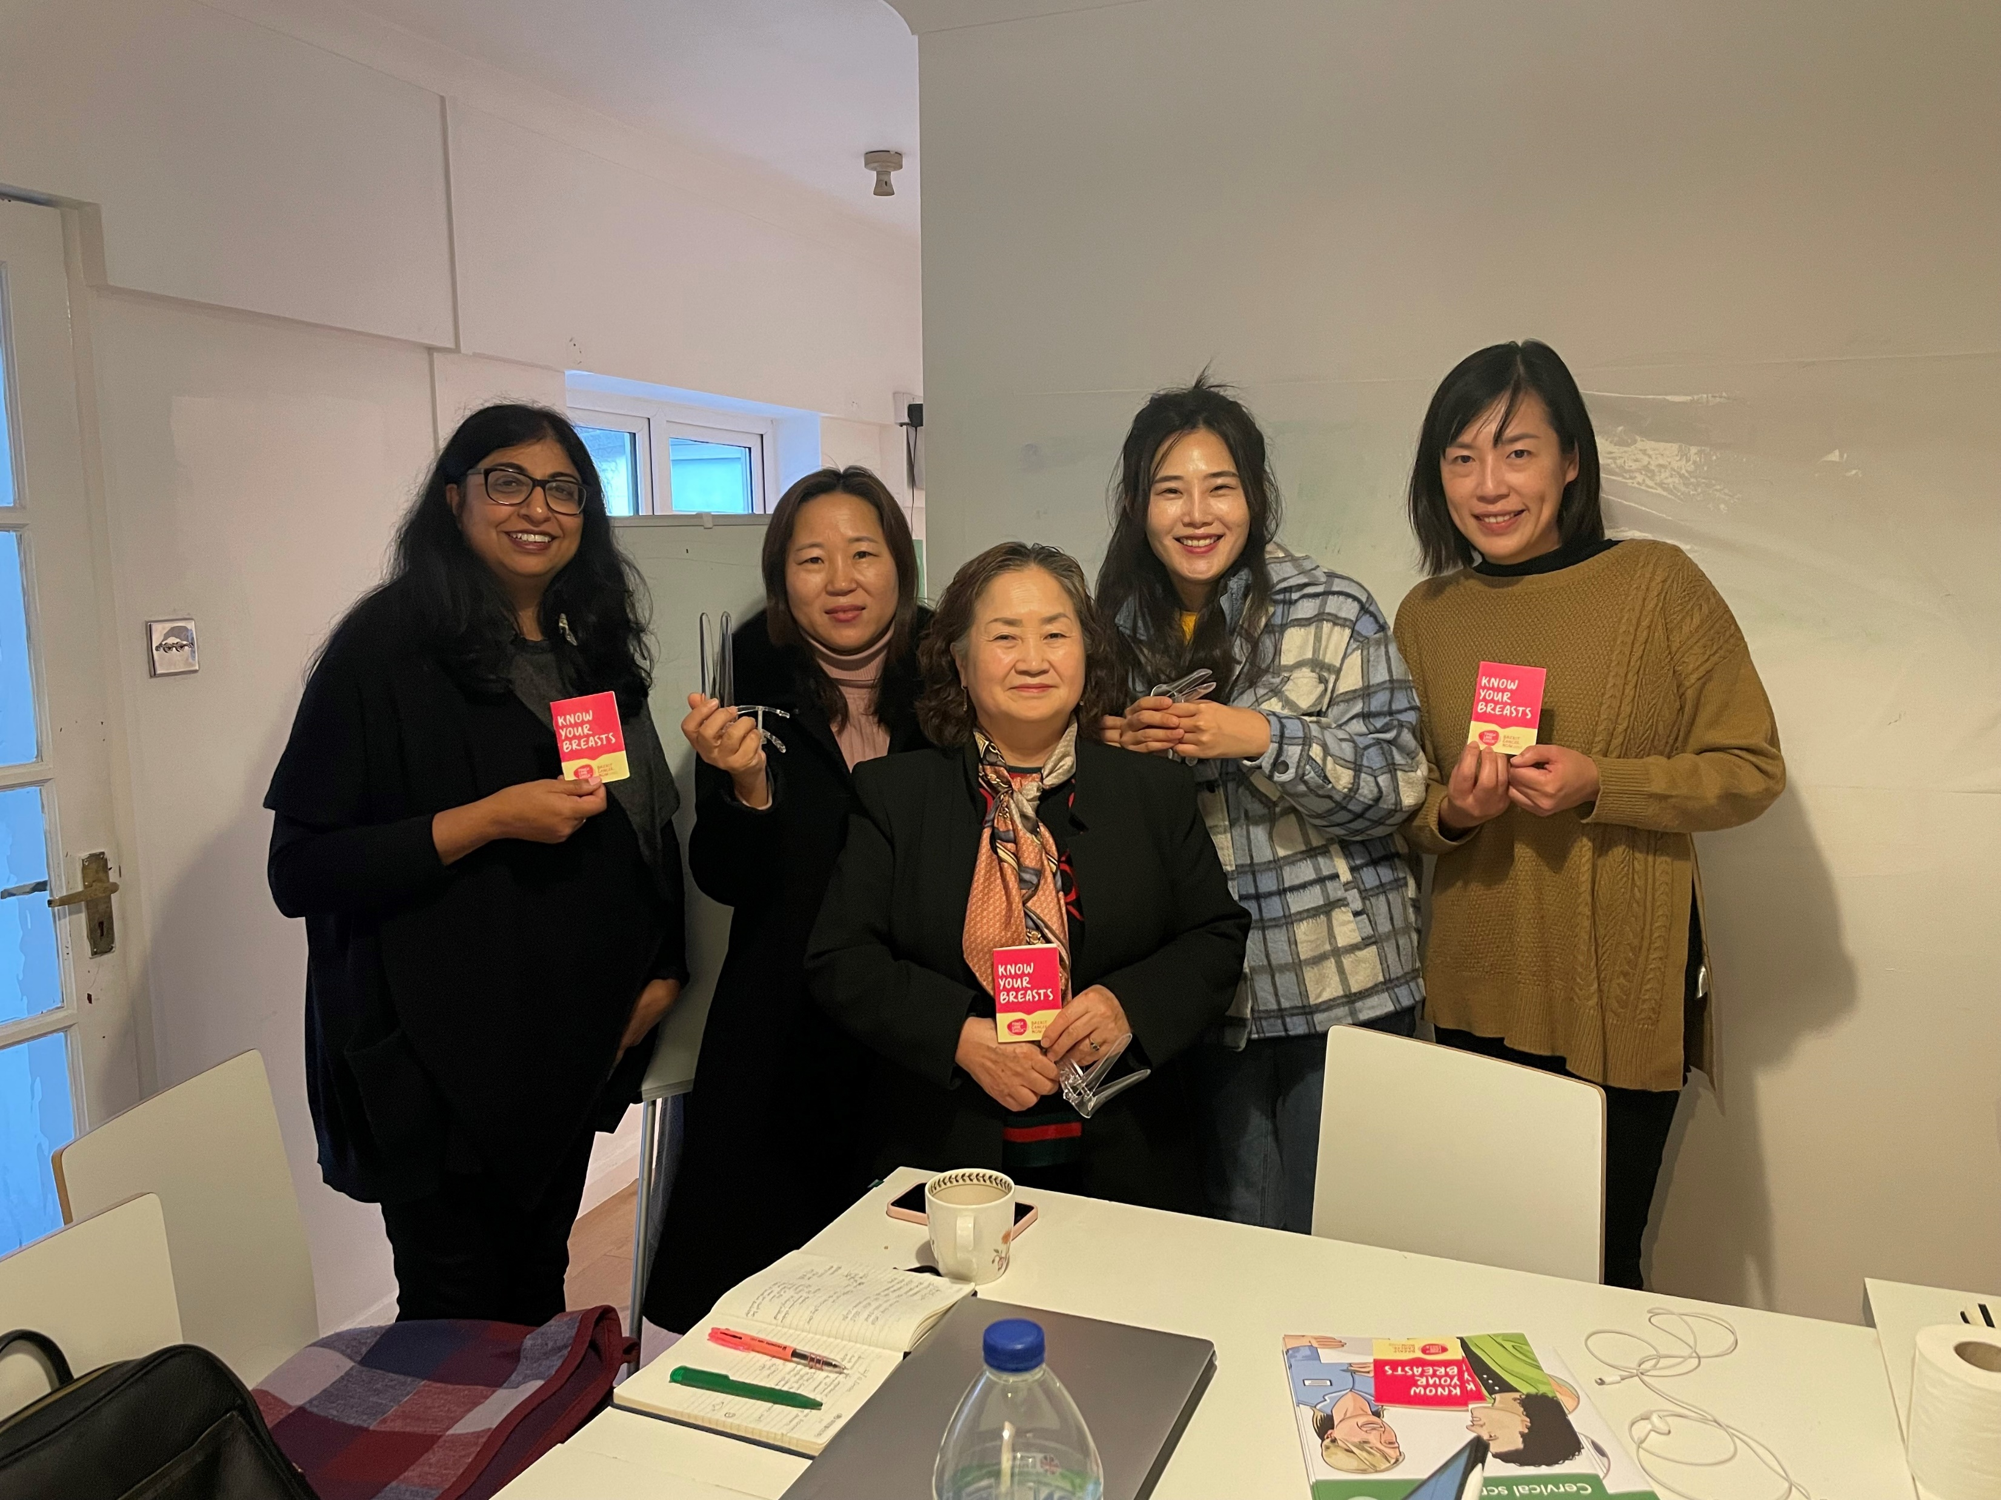
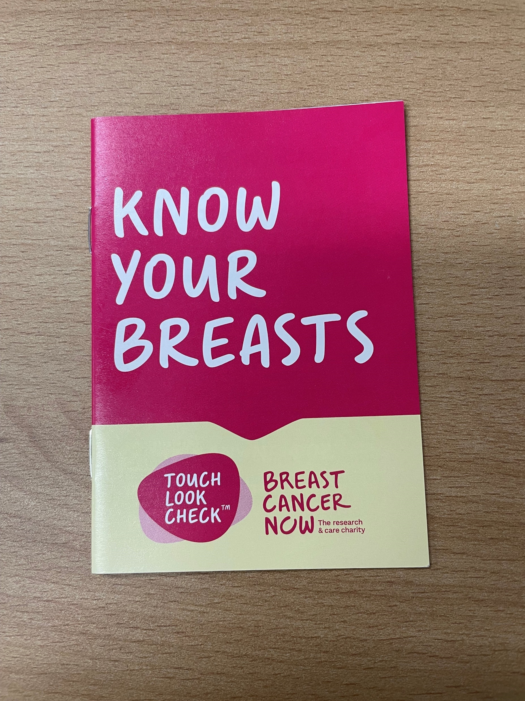
Health Talk
Liaise and conduct Health Talk for the community group
Conducting a series of Health Talks for Hong Kongers
Cancer Awareness Talk conducted by Macmillan Information and Support Manager

Slide 17
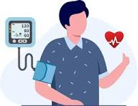
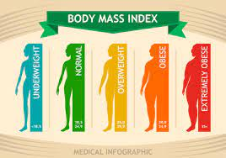
Mini Health check
Conduct Health Check for the community group
Coming sessions with Rise Café, Migrant group and Tamil group

Slide 18
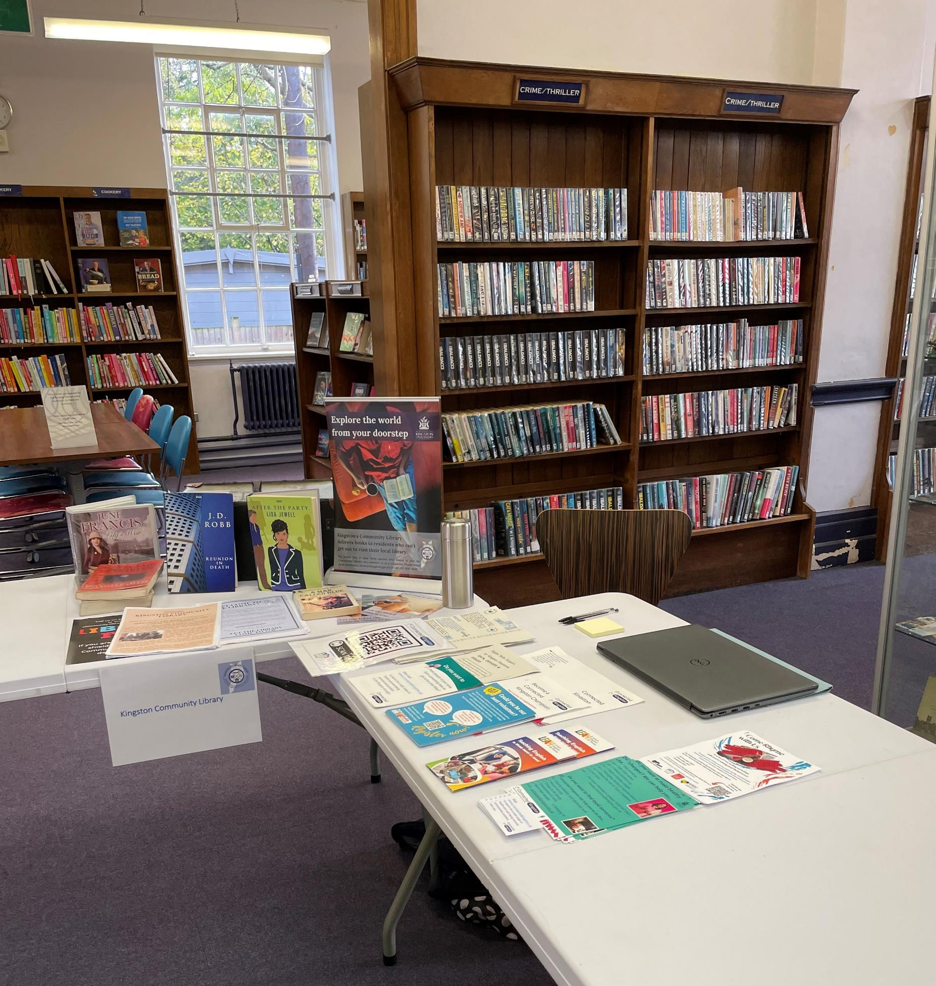
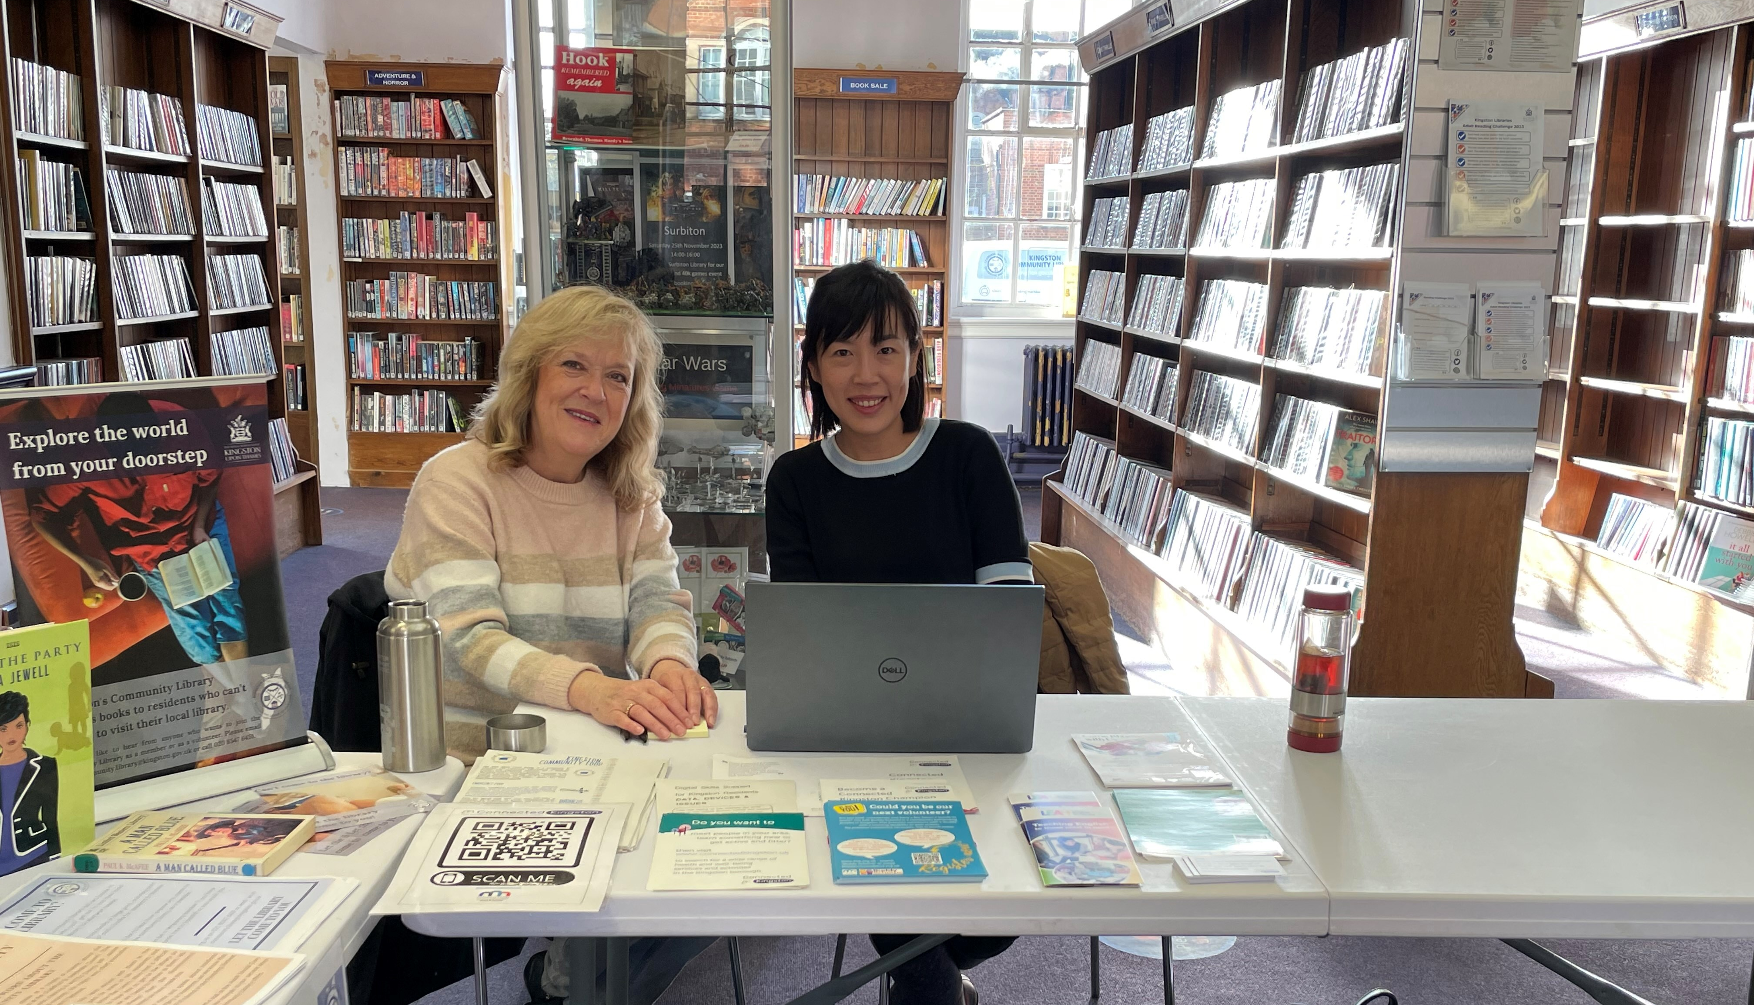
Health information & advice booth
Hold health information and advice booths at various community events
E.g. Libraries; Women’s Hub in KingsGate Church

Slide 19
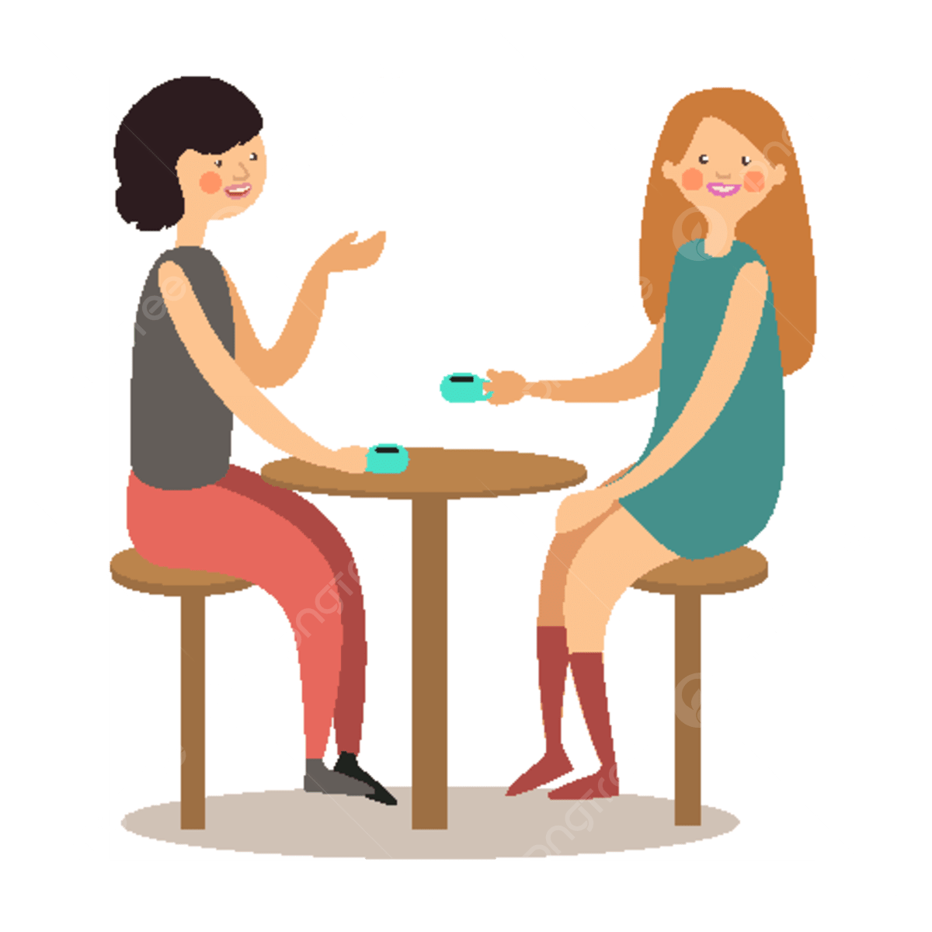
Health drop-in: Advice and health education
Open-door for individuals can seek brief consultations, advice, or information about their health concerns.
Notes:
A health drop-in session is an informal, open-door gathering where individuals can seek brief consultations, advice, or information about their health concerns. It provides an accessible and casual environment for quick interactions with healthcare professionals, fostering community well-being.

Slide 20
Q&A
Be our connectors
Connect with KVA for more community health events

