Slide 1
Health & Wellbeing Network April 2025 Emma Hill Deputy CEO / Health Programmes Manager

Slide 2
Agenda
10am - Welcome, housekeeping and introductions
10:10-10:30 - Rachael Basak - Princess Alice Hospice
10:30-10:50 - Anne Bren – Staywell
10:50- 11.00 - Dalvinder Jammu – NHS 111
11:00-11.15 – Break and networking
11:15 – 11:30 - Maddy Griffith – Tellmi
11:30-11:45 - Georgie Pepperrell – Places Leisure
11:50-12 – KVA update
12:00-12:30 - Feedback, close and networking

Slide 3
KVA Health Programmes
KVA Health
Community Health
Good Food Group
Buddy Scheme
Eco-op
Kingston Community Football
Surplus food hub
Connected Kingston

Slide 4
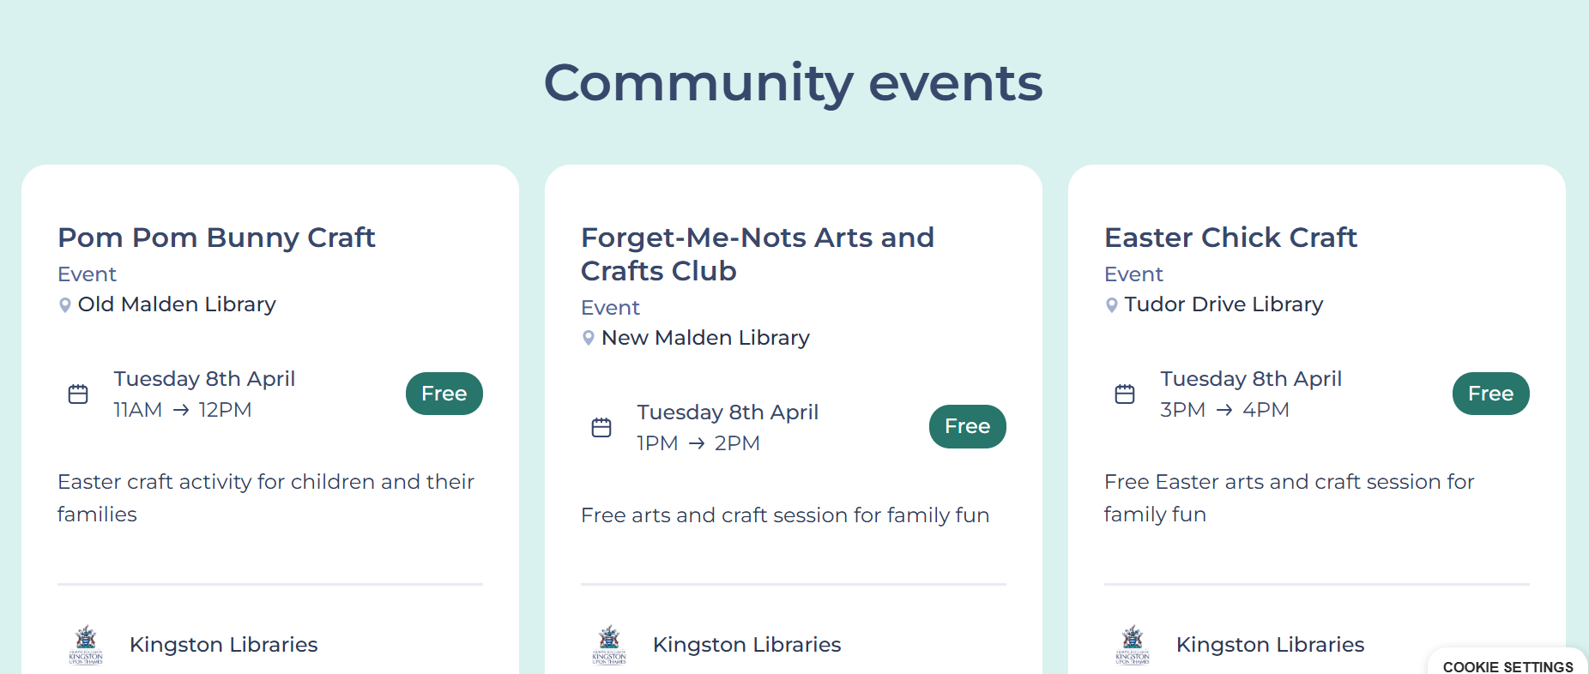
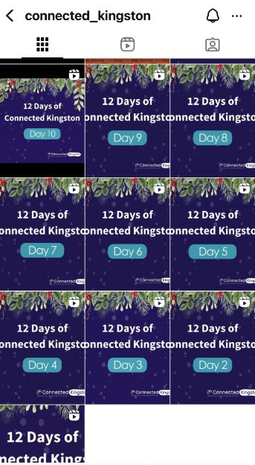
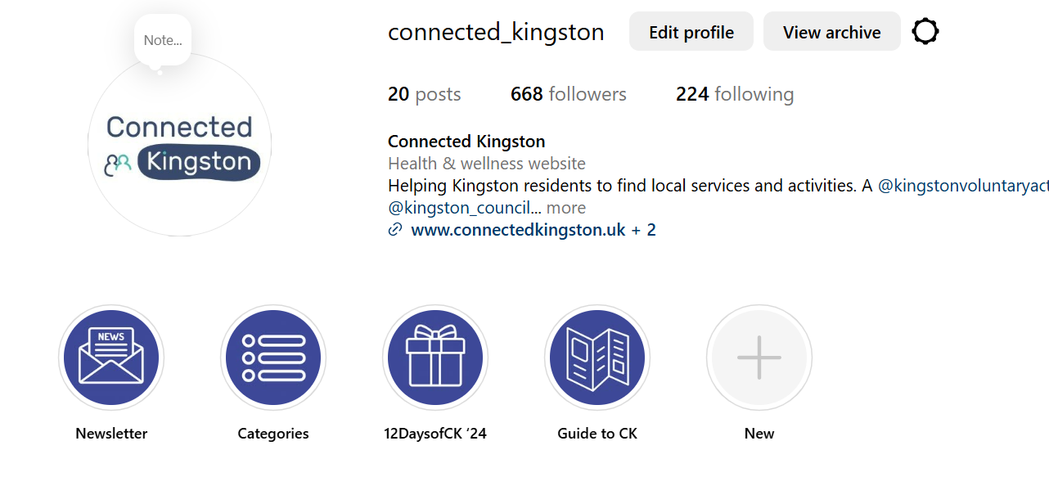
New events page and Instagram

Slide 5
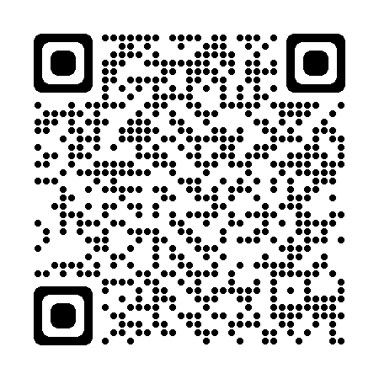
www.connectedkingston.uk

Slide 7
Contact Details Emma.hill@kva.org.uk 020 8255 3335
Any questions?

