Slide 1
Active Kingston
KVA - Health and Wellbeing Network Meeting - 17th April, 2024

Slide 2
Active Kingston
‘Increasing participation in physical activity and sport to improve health and well-being for all’
Part of Public Health, the Active Kingston team:
Maintains the Sports Development Grant aimed at encouraging those who would be less likely to take part in physical activity or may require more support to take part;
Works in partnership with schools and junior sports programmes to host junior events and ensure Kingston’s participation in the London Youth Games;
Increases physical activity within the borough through the development of sports clubs and community groups.

Slide 3
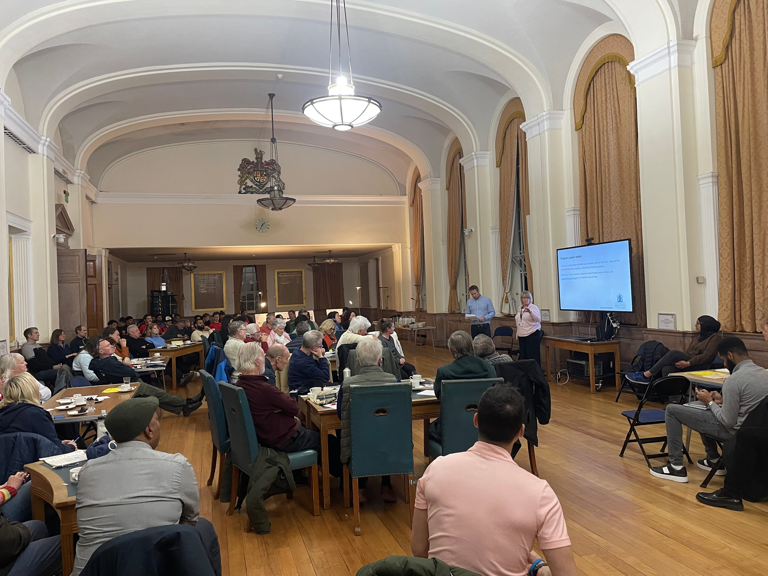
Kingston Community Club Forum and Sports Day
In February, we hosted our first Community Club Forum for all clubs and community groups who provide physical activity.
In partnership with KVA, London Sport and Councillor Alison Holt, we were able to offer information on various funding opportunities, support programmes for voluntary organisations and a Kingston Leisure update.
Following feedback from the event, we are now planning a Kingston ‘Sports Club Day’ to provide clubs and groups in Kingston an opportunity to showcase what they have to offer.

Slide 4
Schools Superzones Programme
‘School Superzones are place-based interventions around schools in areas of the greatest disadvantage.’
The School Superzones Programme is supported by the GLA and awards grants of up to £30,000 to London boroughs.
The aim is to improve the quality of health and wellbeing of children within a 400 meter radius of school in an area of high deprivation.
Reduce the threat to health from poor air quality, fast-food takeaways, low access to green space and active travel.
For this project we selected two primary schools in the Cambridge Road estate area - Kings Oak Primary and St Joseph's Primary.

Slide 5
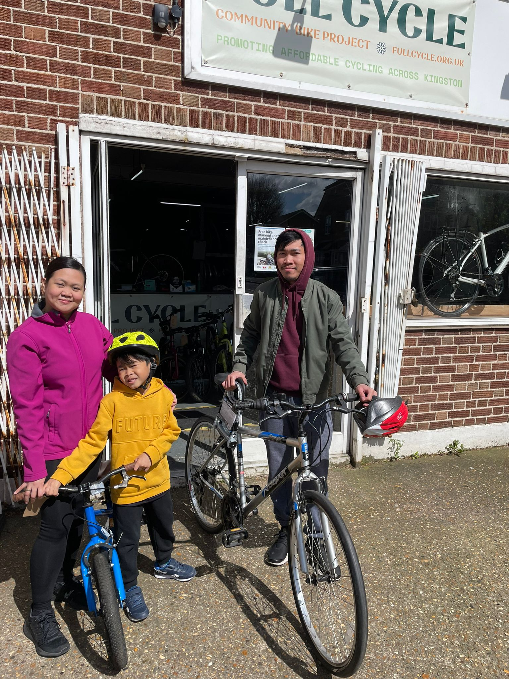
Schools Superzones Programme
As part of our healthy weight and wider public health team initiatives our School Superzone project has provided the following for two primary schools in an area of deprivation:
Recycled bikes to 14 families via Full Cycle
Bikeability courses directly to schools via our transport team
Scootability courses for 90 (each school) - coming in June
Food Growing workshops
BRITE Box - recipe kits for pupils to take home on a Friday for a family meal

Slide 6
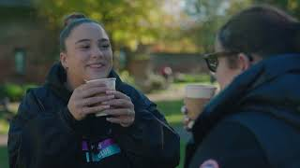
Introducing ParkPlay - Kingston
‘Building happier, healthier communities through the life-changing power of play.’
What is ParkPlay? ParkPlay is two hours of free active community games every Saturday for people of all ages, everyone's invited!
Key Features of ParkPlay:
It's two hours of community play, every Saturday morning in a park or public space.
It's active and inclusive games - all generations play together.
It's a safe, welcoming and inclusive way for people to connect and have fun.
It's run by the local community for the local community.

Slide 7
Introducing ParkPlay - Kingston
As part of our mission to increase levels of physical activity and tackle inequalities within the borough, we are excited to introduce ParkPlay to three local spaces in Kingston:
Cambridge Road Estate - J Pitch Area
New Malden - Manor Park
Churchfields - Chessington
If you know anyone that would be interested in getting involved then please let me know!

Slide 8
On-going programmes within the borough…
We are looking to increase levels of physical activity for older adults as part of our aim to become an ‘Age Friendly Borough’ by supporting groups such as Wesley’s Community Hub, Silverfit and local clubs and groups that offer activities for older adults.
In collaboration with Places Leisure, we look to promote health and wellbeing programmes in the community such as the upcoming ‘Move through Menopause’ campaign.

Slide 9
Any questions?

