Slide 1
Tellmi: Mental Health Support for Young People

Slide 2
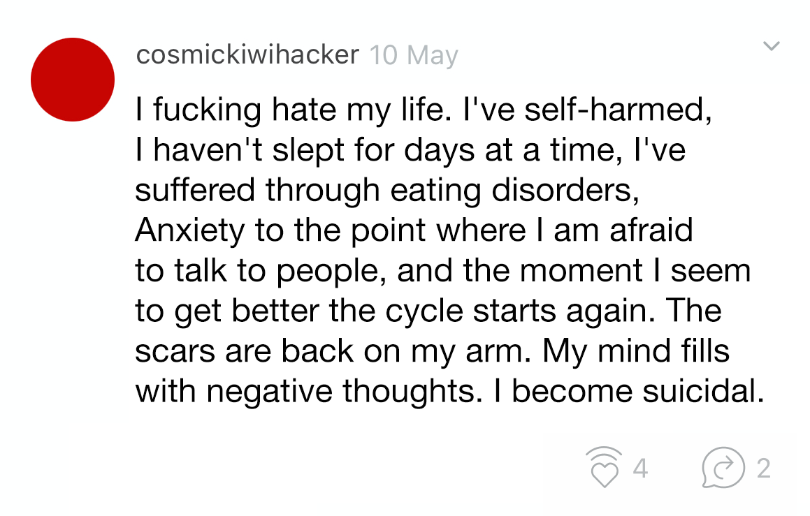

Slide 4
Moderators
Risk assess and topic tag all posts and replies before publication.

Slide 5
Counsellors
High-risk posts are quarantined and reviewed by a trained counsellor.

Slide 6
The Directory
Localised to commissioned areas.

Slide 7
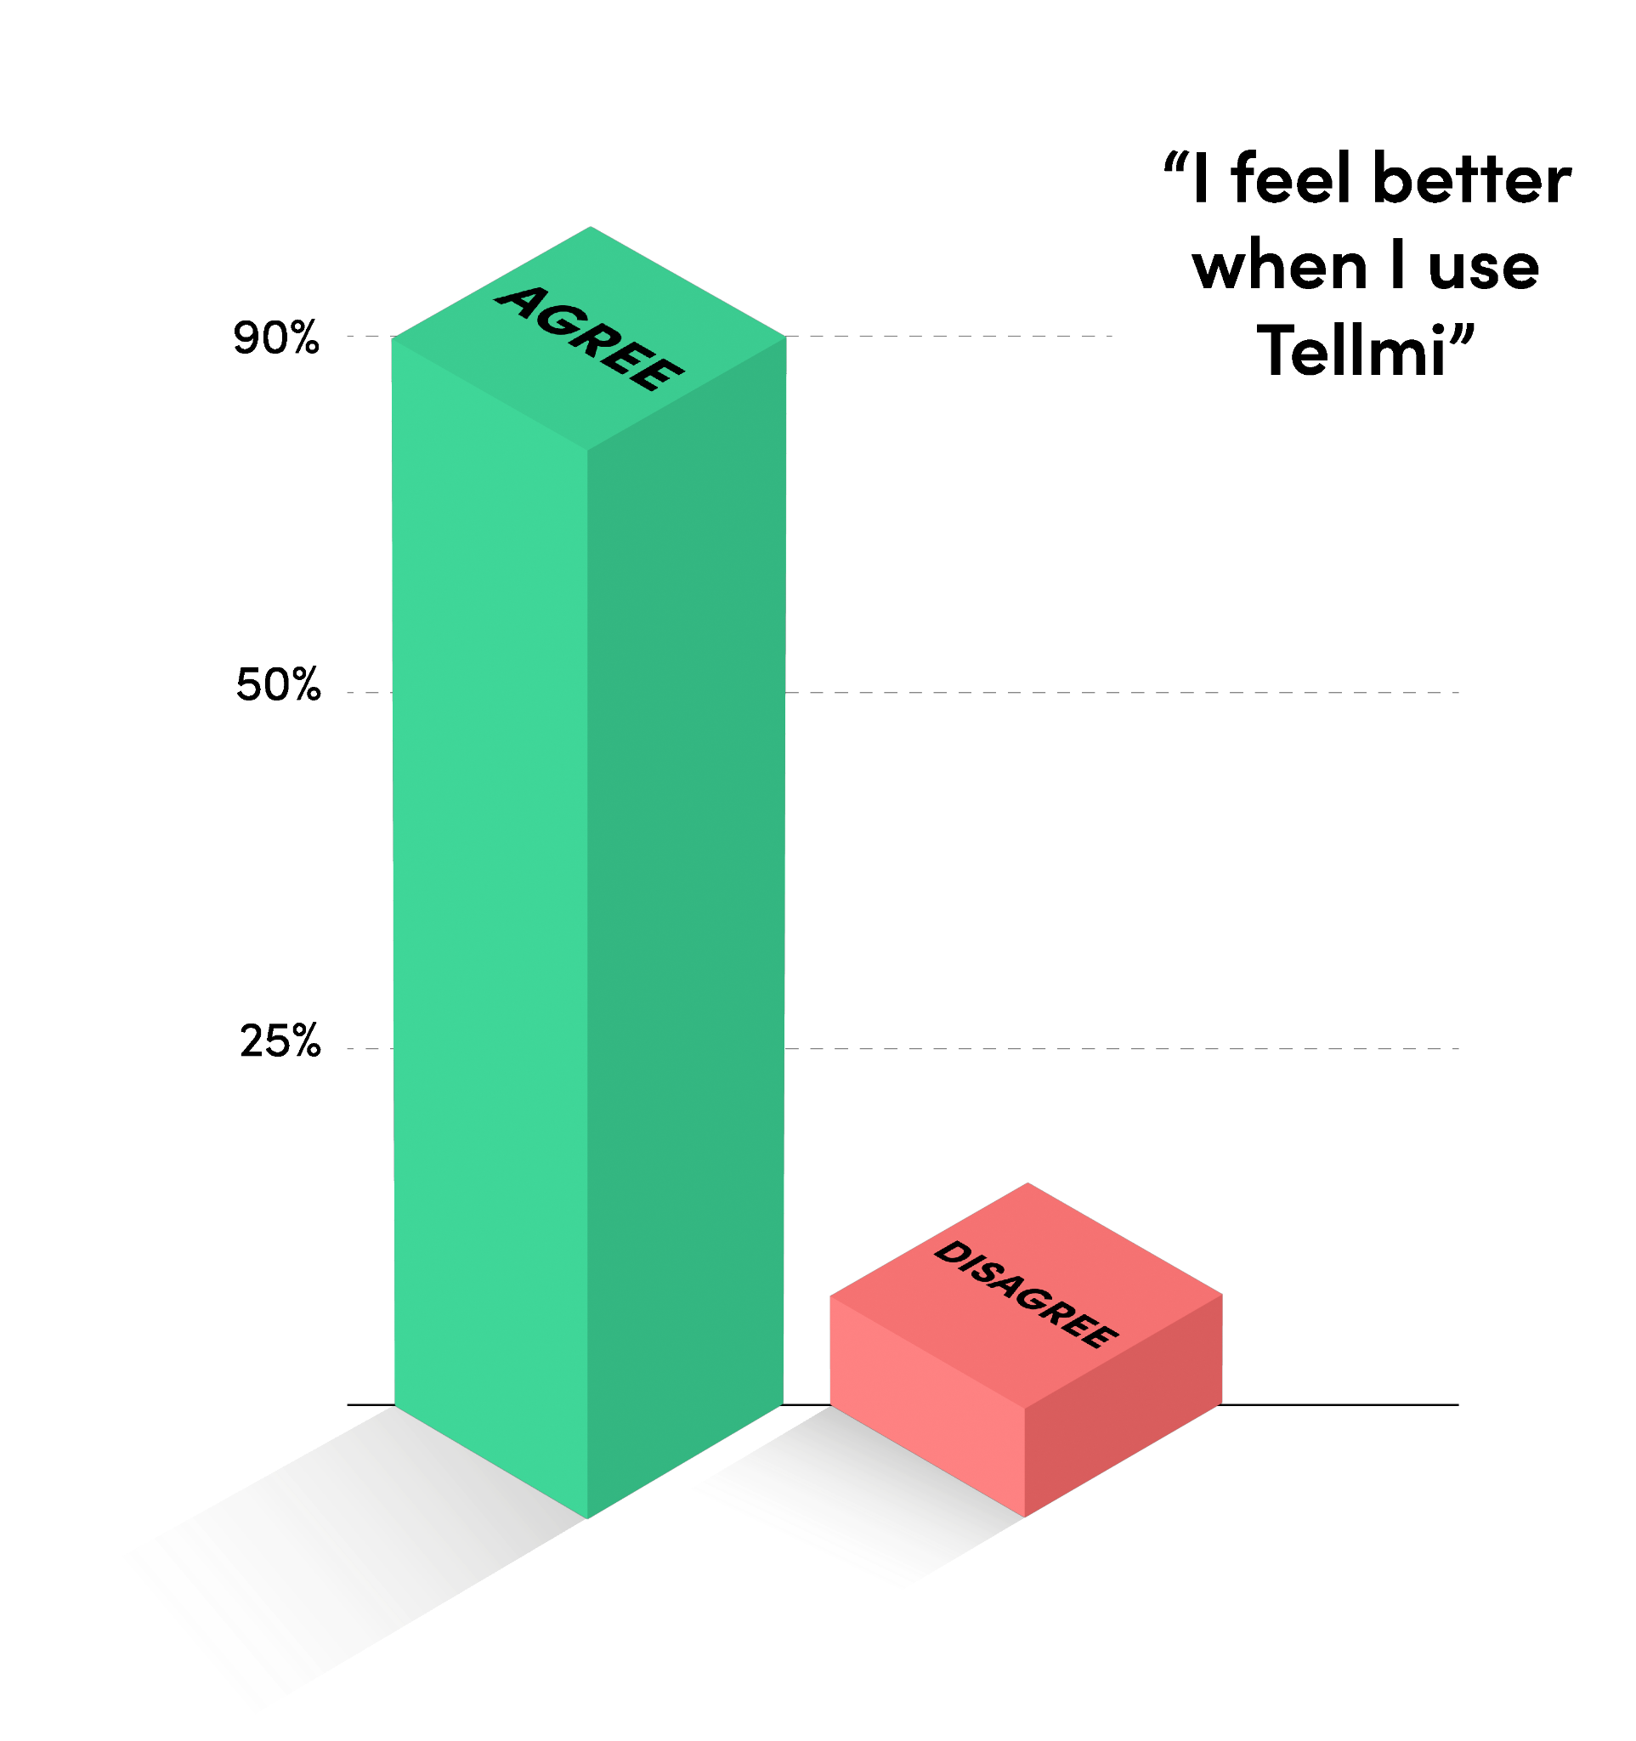
Tellmi Independent Evaluation (2022)
The Tellmi Community
Tellmi
Peer Support
82% said Tellmi connects them to others with similar problems.
78% believed it was easier to talk about problems anonymously.
71% of young people found new ways to help themselves.
—
56% of Tellmi users identify as LGBTQ+.
32% of Tellmi users receive free school meals.
19% of Tellmi users are from Black or Minority Ethnic groups.
Tellmi for Charities
Tellmi is a provider and partner to many charities in the UK who want to expand their support for the young people they serve. We do this in many ways:
Bespoke in-app charity portal providing additional data
Inclusion within app directory for user signposting
Dual engagement materials/approaches
Bid partnerships for funding and service provision

Slide 8
If every UK child with a mental health disorder used Tellmi for one month, the NHS would save
£192,000,000
every year!

Slide 9
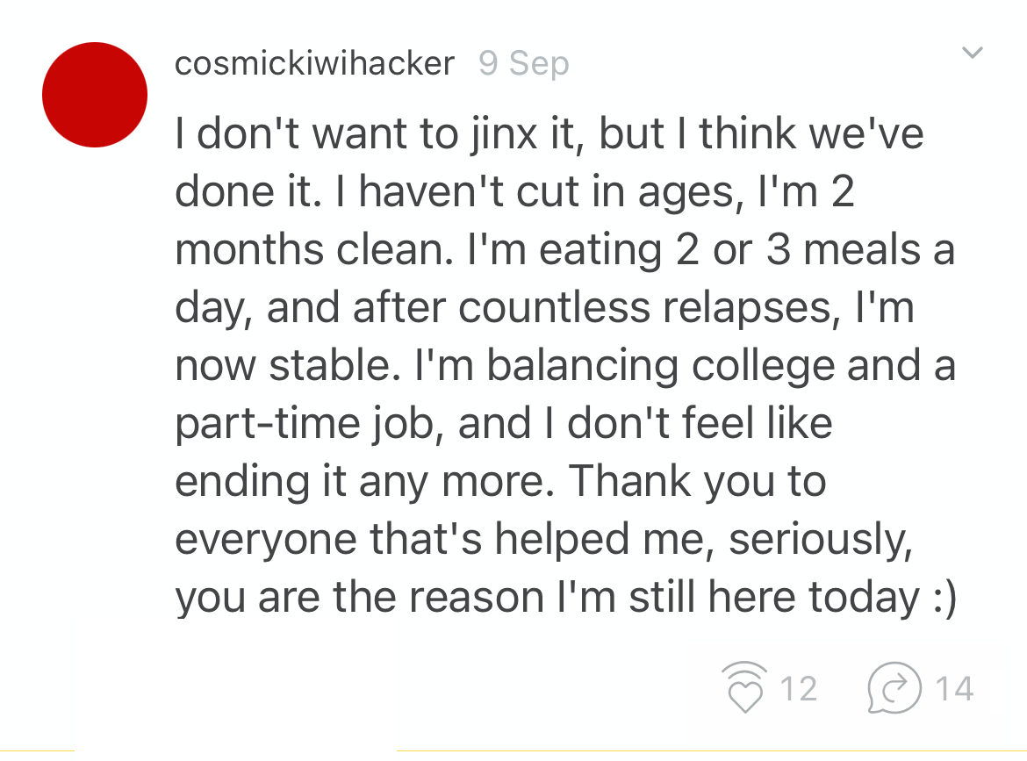
@Tellmi of course you can use my posts. It would be an absolute honour so please, do anything you want!! @cosmickiwihacker

Slide 10
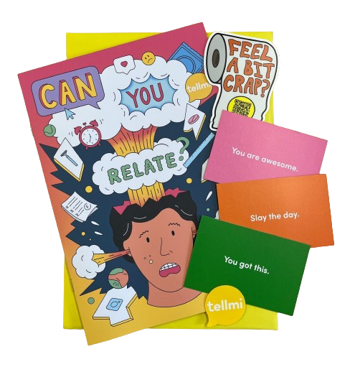
What we provide…
Staff Training
Physical/digital resources for launch and promotion.
Engagement campaigns and teaching activities.
In-Person Activities (workshops/assemblies/attendance at events).
Listing in the Tellmi Directory (local resources).

Slide 11
Thank you!
maddy@tellmi.help
www.tellmi.help
11
Notes:
Collect post its at the end.

