Slide 1
DIGITAL INCLUSION
IN KINGSTON
VCSE Forum – 12 Feb 2025
Notes:
Image by fauxels from Pexels

Slide 2
What does Superhighways do?
Superhighways helps small charities and community groups gain essential digital and data skills backed by the right tech to achieve their goals.
Find out more about our current training offer

Slide 3
Digital inclusion recap
"Digital inclusion is being able to access the internet and engage online - safely and confidently - when you need and want to." Good Things Foundation
Some key elements
It's very individual
It's about leaving no person/resident behind
It's critical to build digital apps & services inclusively so that they work for everyone not just for some

Slide 4
How to address digital inclusion
Individual
Building blocks
Organisations
Motivation & confidence
Access – device & data
Basic digital skills & know how
Support & further resources
Inclusive design of digital apps & services
Source: JS

Slide 5
What we're currently doing
Digital drop-ins and bookable sessions
Community outreach
Free SIM cards
Device gifting
Digital Champions
Digital Inclusion email updates
Connecting across & up - SWL Integrated Care System (ICS) & Get Online London

Slide 6
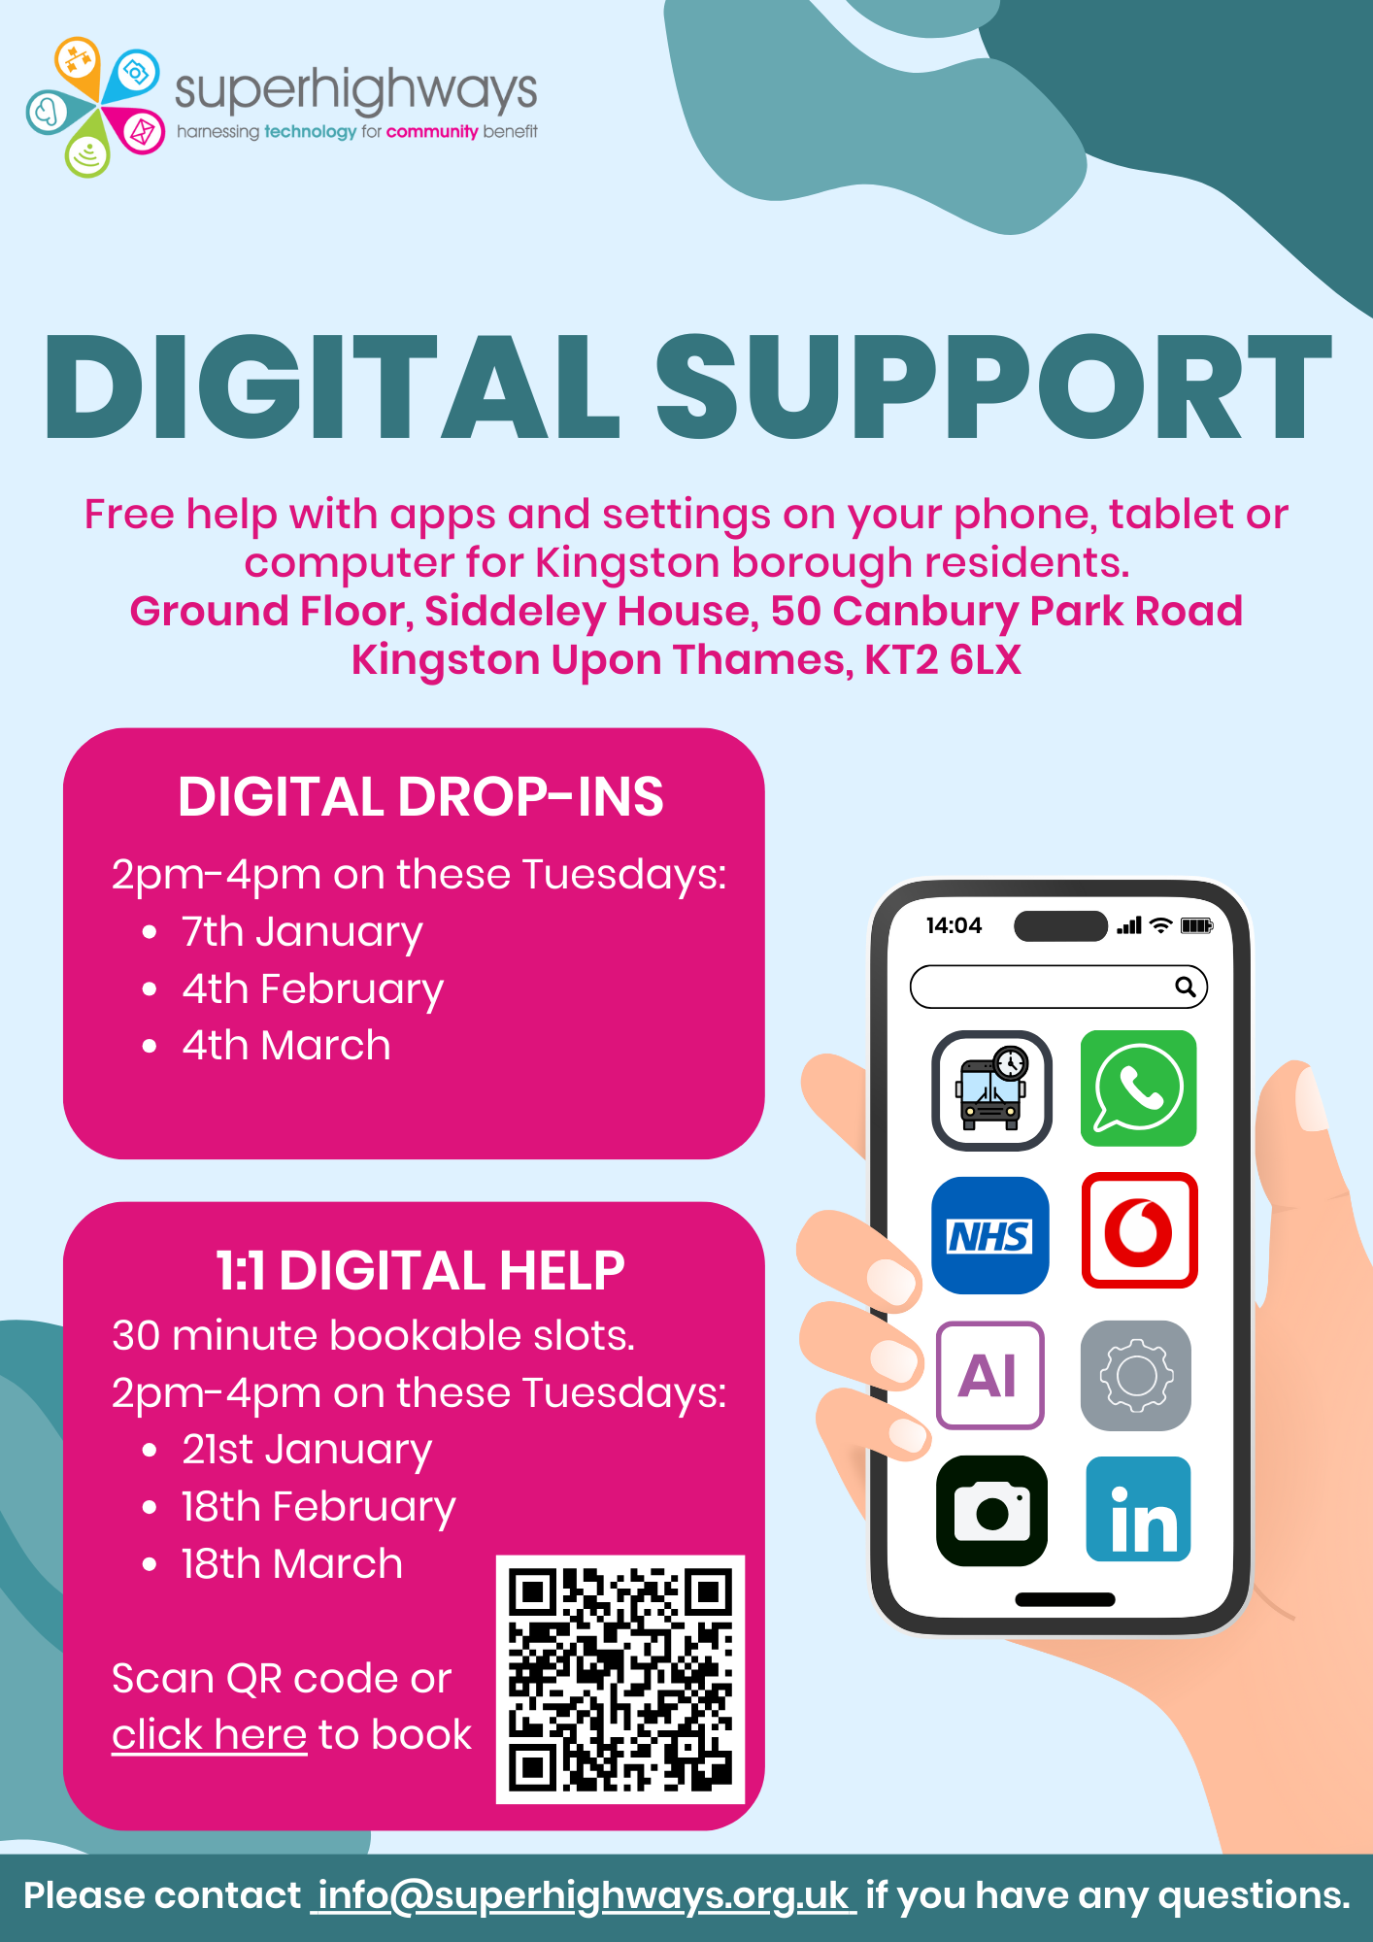
Digital drop-ins and bookable sessions
Open to all residents of Kingston borough
Plus, support for Digital Champions and VCSE staff
Includes:
Info & bitesize lessons
SIM cards
Further resources
Read a case study here

Slide 7
2. Community outreach
Informal visit
Digitial help stand
Talk or presentation
RBKares

Slide 8
“Thank you for providing digital support to our service users this morning.
We’re delighted that so many of them benefited from your guidance and reassurance.
Your help has made a noticeable impact, and it’s clear that many still have ongoing issues they’d like to resolve. I’m hopeful we can organise more workshops in the new year to address these”
Wesley's Community Hub

Slide 10
3. Free SIM cards
For people experiencing data poverty. Like a food bank but data!
SIM cards from Vodafone directly or National Databank (Vodafone /Three/O2)

Slide 11
4. Device gifting
Superhighways receives devices from a few sources periodically
For example, local businesses, Computers 4 Charity & National Device Bank
Check & update devices
Work with our community partners to gift the devices to people in need who will particularly benefit
Source: MariaKray from Pixabay

Slide 12
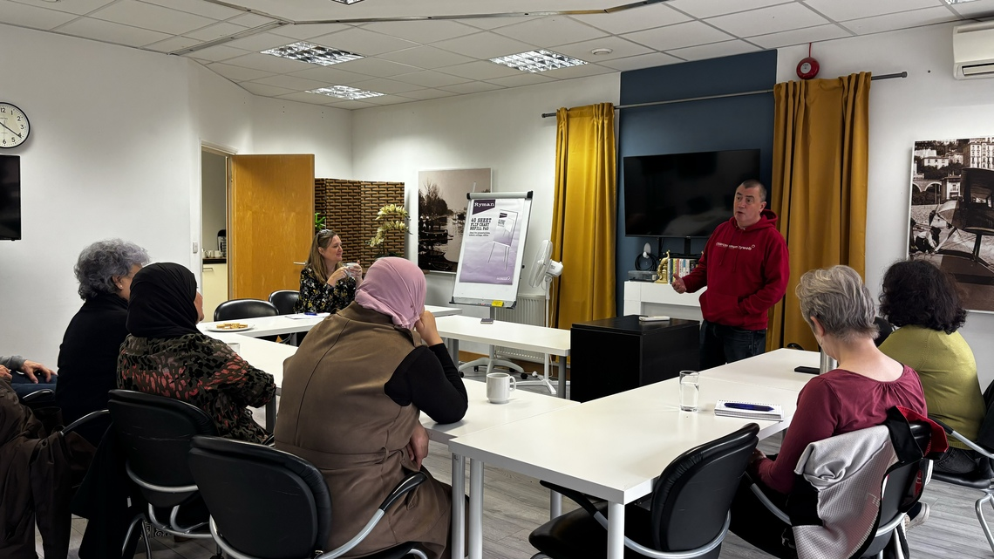
5. Digital Champions
Group made up of volunteers and VCSE employees
10 trained in summer 2024
Now support other residents & staff with digital tasks

Slide 13
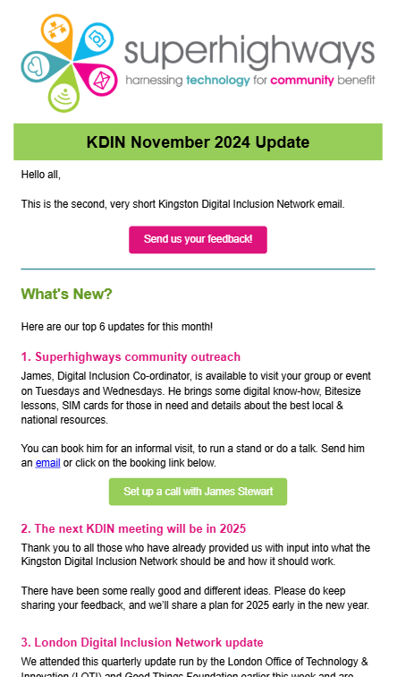
6. Digital Inclusion email updates
Short email started in October 2024 – not a long newsletter
Focus on most useful news & helpful resources
Everyone welcome
Plan to send most months

Slide 14
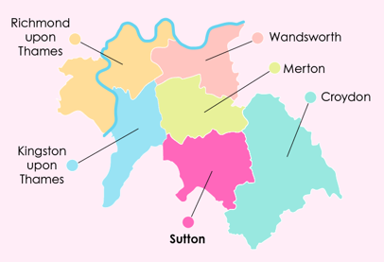
7. Connecting across & up
SWL Integrated Care System
VCSE rep on Digital Board
Piloting VCSE involvement e.g. getUBetter app
Feeding into an ICS Digital Inclusion Approach
Exploring a South London VCSE Digital Inclusion collaboration
Connecting with Digital Care Co-ordinators working in GP practices
Links to London Digital Inclusion Partnership Forum?

Slide 15
7. Connecting across & up
Get Online London
https://loti.london/get-online-london/

Slide 16
Impact in Kingston since Sept 2024
121
47 resident 1:1 sessions
116 SIM cards gifted
Other:
27 Tech presentations
9 Signposting etc.
4 devices gifted
Source: Help - OpenClipart-Vectors from Pixabay

Slide 17
Kingston Digital Inclusion Network in 2025
Working group meetings
Aimed at operational staff & volunteers who are helping residents
Open to local digital champions
Focus on practical topics, SIM card delivery, setting up training, etc.
Every 2 months on the last Weds of the respective month:
Wed 26th February 10 am – 11:30 am
Wed 30th April 10 am – 11:30 am
Wed 25th June 10 am – 11:30 am
Strategic updates
Aimed at CEOs & key decision makers
Raise profile of the topic and local buy-in e.g. having digital champions
Aligned with other local forums
Approximately every 6 months
Today is the first of these!

Slide 18
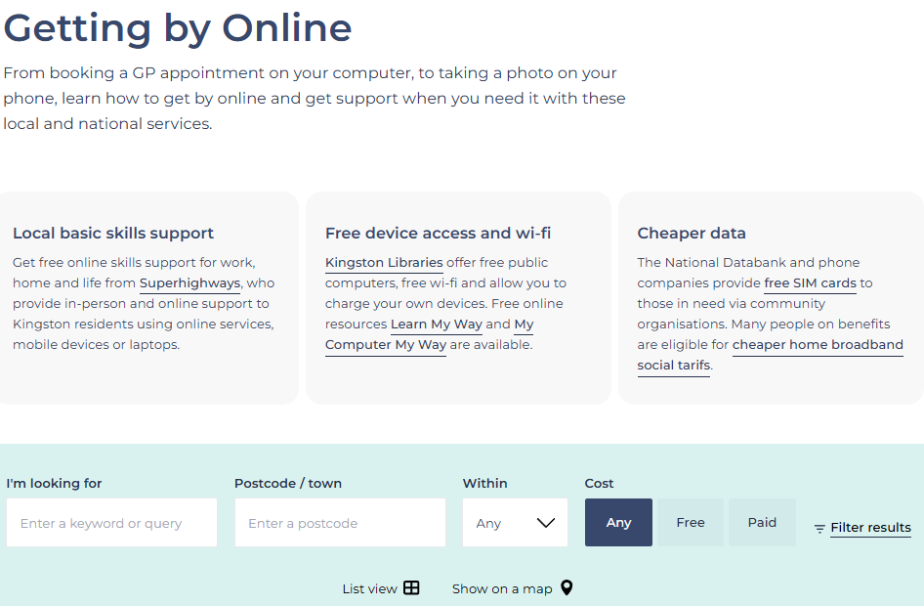
What else is happening in Kingston
Recognise there is a lot of other Digital Inclusion activitity in the borough
From the great resources provided by libraries...
...to projects like the We Are Group - Digital Training partnership with RBK
Check out the Getting by Online collection on Connected Kingston for others

Slide 19
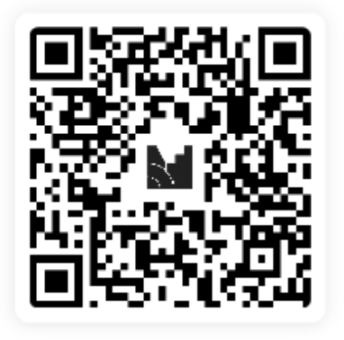
Now we’d like to hear from you!
Join at:
menti.com
Use code:
8364 4596

Slide 20
How to get involved
Would you or someone in your org like to be part of the working group?
Would you like to get the email updates?
Do you simply want to find out more on Digital Inclusion?
Would your service users benefit from SIM cards?
...and much more!
Please contact James at Superhighways:
jamesstewart@superhighways.org.uk
020 8396 4542

