Slide 1
MoveMingle CIC
Moving People from Isolation to Connection
Notes:
Good morning and thank you for the invitation. I’m Mansour Miralami, founder of MoveMingle CIC.
Imagine if your weekly coffee break could increase your social interactions and engagement with the community and halve your loneliness risk ; that is MoveMingle
We exist to transform seclusion and solitude into lasting community interactions and engagements through movement, creativity and good tea or coffee.

Slide 2
Why We Exist
🧍‍♂️ 25 % UK adults feel lonely (ONS 2025)
🏃‍♀️ 48 % Children meet activity target (Sport England 2023)
🧠 1.0 × Inactivity can double depression & anxiety risk (JAMA 2022)
Notes:
Firstly, the Office for National Statistics now finds that one in four adults often or always feels lonely;
Secondly Sport England reports only forty-eight per cent of children reach the Chief Medical Officers’ daily activity guideline of sixty minutes; and
Thirdly multiple meta-analyses show that physical inactivity can double the risk of depression and anxiety. So loneliness, mental health and physical health are tangled together.

Slide 3
Our Simple Answer
❤️‍🔥
Fun, barrier-free movement & creativity
Inclusive sessions and age-specific pathways
Everyone feels welcome
Notes:
Fun, barrier-free (pay as you can entry) activities.
The sessions will comprise mixed age groups and abilities so nobody feels judged;
Others session will be ring-fenced for teenagers or Active 60 plus so that people can learn with their peers before joining mixed age group events.

Slide 4
What We Run
🕺 Move & Mingle low-impact classes 💃 Dance sessions & pop-up dance nights 🎨 Art, music & mindful workshops
📚 Book clubs and writing workshops
🎲 Game days and nights 🏃‍♂️ 5k/10k, half & full marathons 🧗 Obstacle races
🚴 Cycling sportives 🧺 Picnics, park gatherings & café socials
Notes:
What does that look like?
Move & Mingle classes are forty-five minutes of gentle exercise with upbeat music and plenty of chat.
Dance sessions and dance-party evenings that raise the heart-rate and the smile-rate.
Creative wellbeing clubs where a variety of activities such as art, music, mindful crafts and book clubs and light movement will be on offer to all participants.
Outdoor events: 5 k and 10 k runs, a half or full marathon route, family-friendly obstacle races, and guided social rides for cyclists, including adaptive bike users.
We also host picnics, park gatherings and pop-up café socials so friends can mingle.

Slide 5
Age-specific & mixed programmes
👧 Under 18s: after-school active clubs 👵 Active 60 +: balance, chair-dance & walking football 👨‍👩‍👧‍👦 Mixed-age: events & family obstacles
Notes:
Age matters.
Under-18s will be invited to attend after-school activity clubs in safe spaces.
Our Active 60 plus group will focus on balance, dance and low-impact strength and conditioning exercises.
At weekends our focus will be to get everyone together to enjoy a family-friendly atmosphere.

Slide 6
Mental‑Health Focus
• Co-design with counsellors • Three-minute grounding start, buddy check-out finish, positive early experiences for mental resilience
• Supports low self-esteem, PTSD and anxiety
(NHS Digital 2023)
Notes:
Mental well being is our paramount goal and will be part and parcel of everything we do at MoveMingle.
The session programme will be co-designed by counsellors, instructors and organisers .
Every class begins with a three-minute grounding breath and ends with a group farewell departure session to ensure that all participants feel welcomed and encouraged to mingle and come back .
The agenda for each session will support people to rebuild confidence , increase low self-esteem, reduce anxiety and stress levels and overcome PTSD and generally help all participants to stay positive.

Slide 7
Beating Loneliness
🤝
• Inter-generational teams build new networks
• Pay-what-you-can entry removes the cost barrier
• Participant-to-volunteer pathway keeps people engaged
Notes:
Seclusion and solitude and the feeling of loneliness decreases when all age groups come together and generations cross paths.
Research shows inter-generational projects boost self-esteem and mood.
We maintain pay-what-you-can entry so cost is never the barrier, and we encourage participants to step up as volunteers, keeping them anchored in the group.

Slide 8
Growth Roadmap
2025: weekly classes & 5 k runs → Q4 2025: 10 k runs, creative clubs → Spring 2026: obstacle races & sportives → 2026+: community café hub & touring flagship events
Notes:
Our growth roadmap
This year: weekly classes and 5 k runs. By Autumn we intend to also offer 10k runs and a variety of creative clubs.
Next year we intend to put on obstacle races and sportives.
We also will be opening a community café hub for people to meet and greet daily
Finally our ultimate aspiration for Move Mingle is for the movement to be recognised in the neighbouring areas and encourage those in the neighbouring areas to join us .

Slide 9
How You Can Help
• Refer clients who need gentle activity
• Offer halls, green space or pop-up shop
• Share skills/partner introductions
• Promote volunteering opportunities
Notes:
Where can you fit in?
Refer clients who would benefit from the program.
Offer a hall or green space for Move Mingle to use for at least one evening a week;or
Simply introduce us to like-minded partners , groups or associations who could help MoveMIngle achieve its’ objectives.

Slide 10
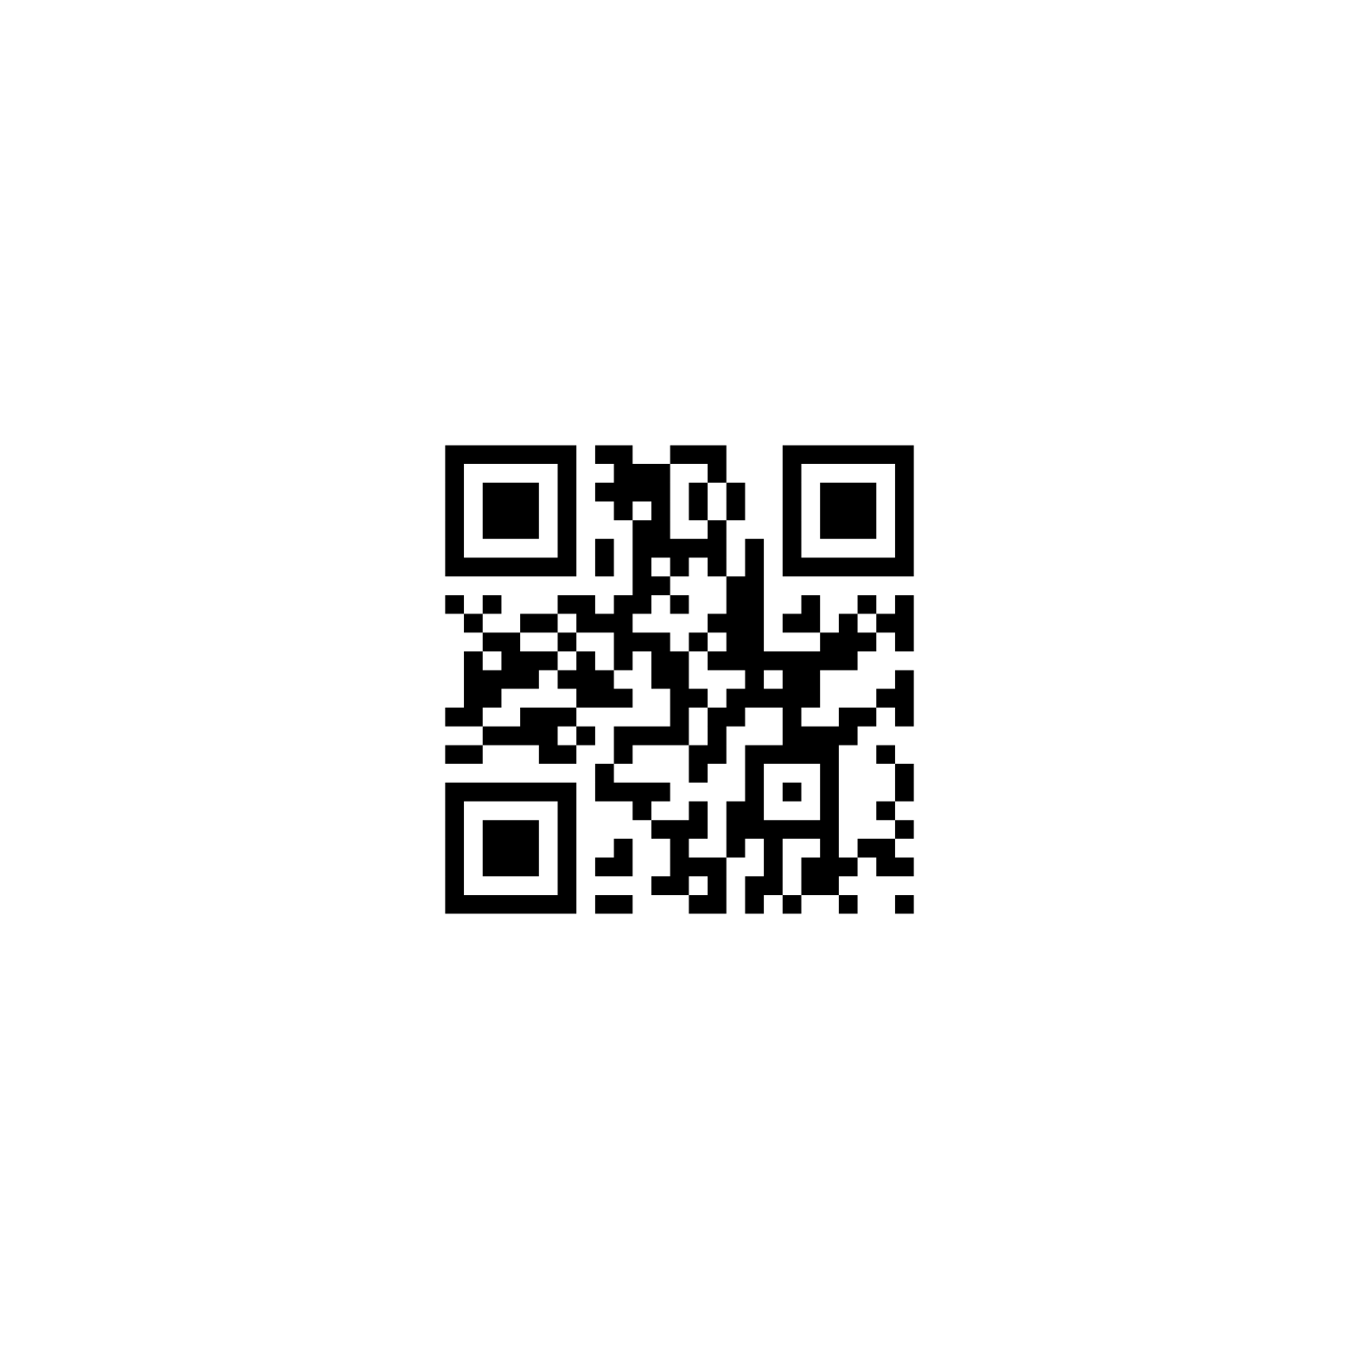
Stay in Touch
Mansour Miralami
✉️ miralami@movemingle.uk
(W) 07759 555 549
🔗 www.movemingle.uk
Notes:
Thank you for your time today.
If you share our vision for Move Mingle please contact me in person today or by email or telephone , details of which you will find on the screen.
Together we can help Kingston, Move Mingle and thrive.

