Slide 1
Kingston VCSE - Health and Care Commissioning Opportunities
VCSE Forum, July 2025
Louise Footner, Executive Director for Residents and Communities, RBK
Julia McDonald, Head of Service ASC Strategy, Transformation and Partnerships, RBK
Denise Madden, Deputy Executive Lead for Kingston and Richmond Places, SWL Integrated Care System

Slide 2
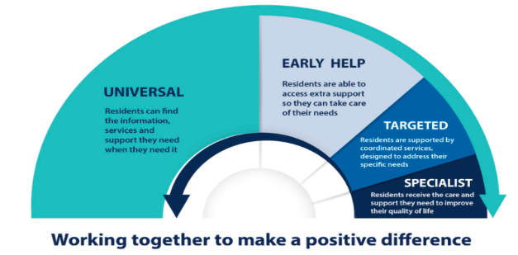
Context
Prevention Arch - how the system support people across different levels of needs and services.
Key priorities (Health and Wellbeing Strategy 2025-2028):
Start Well | Mental health & wellbeing Healthy lifestyle Good respiratory health | Golden Threads Deprivation Inclusion Climate Health inequalities Ways of Working Prevention focus Communication Partnership & system working
Live Well | Healthy weight & physical health Tobacco, alcohol and substance misuse Mental health & wellbeing
Age Well | Keep active & physical health Mental health & wellbeing - community connections Stay home for longer
Notes:
JM

Slide 3
Overview
VCSE = key partners in how we support Kingston residents.
Strength = vibrant, dedicated, diverse & vast range of different organisations.
Better working together = Compact principles & guiding Place ambitions
Funding = longer term, co-ordinated, streamlined where possible, transparent and fair.
Approach for joint commissioning = Evidence based and outcomes focussed across the system.
Mechanisms for joint funding for commissioners:
Section 75 Partnership Agreement (NHS Act 2006)
Aligned contracts / grants
Notes:
JM

Slide 4
Achieving for Children also hold contracts with VCSE organisations to deliver key services (young carer support, placements, youth clubs).
Notes:
JM

Slide 5
NHS contributions to the VCSE
Better Care Fund (BCF):
approx. £1m of national NHS min contributions toward health and care-related VCSE services 25/26
Section 75 Partnership Agreement:
SWL ICB co-funds key contracts in areas such as mental health, dementia, carers, personal assistant brokerage, bereavement (RBK acts as lead commissioner)
Direct NHS Investment (Outside RBK):
Funding via contracts / grants
Notes:
JM

Slide 6
Notes:
DM - 2425/

Slide 7
Update - NHS Changes
NHS 10 year Plan - ambitions (prevention / ‘left shift’ to community) and local implications & impact on VCSE
Neighbourhood Model - key role of community orgs
New London TOM / changes to the SWL ICB
Changing role of the ICB (strategic commissioner & population health) - review type of services / commissioning functions & roles against geographic footprints
Direction of Travel known but local implications to be worked through
Notes:
DM

Slide 8
Update - RBK Commissioning
Commissioning Cycle
Partnership working is key to commissioning, e.g. exploring and reviewing delivery models and opportunities for joint commissioning is always part of the cycle (e.g. service design VCSE Phase 4 / Better Care Fund planning)
Compact
Embedding Compact ways of working - ongoing communication with the market on opportunities and developments. Streamlined funding where possible.
Procurement Act 2023
New Procurement Act 2023 launched in Feb 2025 - “designed to create a more accessible, transparent, and socially responsible public procurement system, with a particular focus on supporting the participation and success of VCSEs”.
Notes:
JM

Slide 9
Next Steps
Mapping current contracts & grants with VCSE (across RBK, AfC and ICB) in progress.
Working with the VCSE to raise awareness of the PA 2023, Section 75 & BCF and opportunities in new system.
Shaping neighbourhood model & future roles and responsibilities of RBK and ICB, and the VCSE
Discussion:
How do you want to be involved in shaping commissioning in the future?

