Slide 1
KVA Voluntary, Community & Social Enterprise Sector Resilience
Community Risk Register
20/03/2024

Slide 2
London Risk Register
Kingston Community Risk Register
Common impacts

Slide 3
London Risk Register
Is designed to provide a summary of the main risks affecting Greater London
To assist Local Authorities and businesses (this includes VCSE) develop their own emergency and business continuity arrangements.
Reasonable worst case scenario informed by history, data, modelling & professional judgement of likelihood and impact
Inclusion of a risk does not mean it will happen, nor be as bad as the worst case scenario.

Slide 4
London Risk Register summary 2022
Very High - 6
High - 18
Medium - 36
Low - 7

Slide 5
2024 review
Due for release this Spring
Risks are reviewed
Risks can be split into different levels
New risks can be added
Old risks can be removed
2022 there were 67 risks
2024 review has 102 risks under review

Slide 6
Kingston VCSE Community Risk Register
This booklet has collated the types of incidents that may occur into eight main areas and these have been assessed as the top risks for Kingston. Each section will give some suggestions on how to plan for and limit the impact on residents & VCSE.
Pandemic (Communicable disease)
Failure of Utility Network/s
Discovery of an Unexploded Ordnance
Cyber Threat
Malicious Attack on Crowded Place
Flooding
Fire
Severe Weather

Slide 7
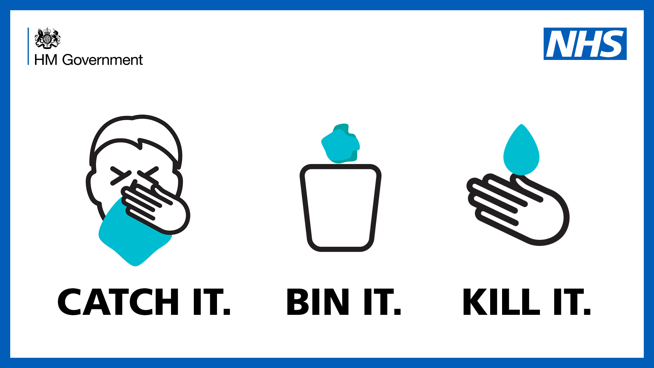
Pandemic / Communicable disease
Impacts: family & workforce sickness, disruption to day to day activities (transport & travel, food & fuel supplies), Isolation, increase in vulnerable residents and their support needs, increase in hospital admissions and fatalities.
What the VCSE sector can do:
Have triggers to reduce face to face work arrangements and start work from home arrangements
Have telephone and social media routes to contact staff and general users
If established, consider support to a community support hub and offering your building for response arrangements
Monitor and support your most vulnerable users / clients

Slide 8
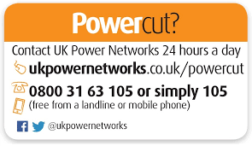
Failure of Utility Network/s
Impacts: Loss of power, heating, cooking & washing facilities. Critical home health equipment fails, Communication systems fail, transport and traffic management systems fail / long delays, darker streets, disruption to food shops/supplies.
What the VCSE sector can do:
Consider some form of backup power supply (fixed or portable) mains power or renewable
Don’t open use refrigeration equipment until necessary
Have paper copies of essential documents (contact details, address, payment details and for vulnerable users).
Have a paper based system for taking orders and requests in case of a protracted power disruption (have printed spare copies).

Slide 9
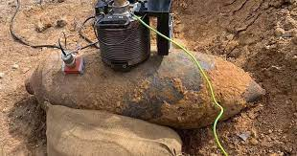
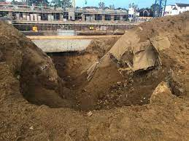
Discovery of an Unexploded Ordnance
Impacts: Traffic diversions, evacuations, duration (hours/days), loss of or damage to home/building/work location
What VCSE can do:
Plan alternative travel routes to and from work and to/from vulnerable clients
Plan alternative travel method to and from work and to/from vulnerable clients
Offer use of buildings for rest centres or emergency response purposes.
Have alternative ways to access your key data
Have a buddy/mutual aid agreement to use a partners building in an emergency
Alert the emergency services to vulnerable residents within the evacuation zone.
Check if your insurance covers you for UXO damage & costs

Slide 10
Cyber Threat

Slide 11
Cyber Threat
Impacts: Loss of data (days, weeks, months & years), ransom demands, financial loss, fraud, vulnerable clients now more vulnerable.
What residents and VCSE can do:
Use a Firewall on your computer & use antivirus software
Keep software updated, older software may be redundant
Have a strong password
Use a Multi Factor Authenticator when possible
Know the signs of an active attack
Check the sender email address on an email
Back up your data regularly, have paper copies of essential documents
Don’t follow links or open attachments in emails unless from a trusted source
Be wary of what you post online
Have high security settings on social media sites
Be wary when using public Wi-Fi, if unsure use 3G or 4G data instead
CVSE: Have business continuity arrangements in place
Report your attack ASAP.

Slide 12
Malicious Attack on Crowded Place
Impacts: No public transport network, diversions, disruption and delays on transport routes. Family and or staff directly affected by the incident. Avoidance of affected location, loss of volunteers
What residents and VCSE can do:
Download the free app, CitizenAID (https://www.citizenaid.org/) which provides clear and simple actions in a shooting, stabbing or bomb incident.
Attend Metropolitan Police offer of ACT Awareness Training (https://www.met.police.uk/advice/advice-and-information/t/terrorism-in-the-uk/ctsa/protecting-your-business-from-terrorism/)
Report suspicious activity on the following Confidential Hotline 0800 789 321.
Support the emergency services and local authority response to the incident.
Ensure high school children know alternative routes to school, home and to your chosen relocation site.

Slide 13
Flooding
Impacts: Evacuation, loss of access to home & work locations, diversion routes & disruption to transport routes, isolation, vulnerability increase, health issues, disruption to normal life / business for prolonged periods (recovery).
What residents and VCSE can do:
Find out if your property is in a flood risk area and check your insurance cover
Sign up for flood warnings - https://www.gov.uk/sign-up-for-flood-warnings
Sign up for weather warnings - https://www.metoffice.gov/weather/weather-and-advice/uk-warnings
Support vulnerable neighbours
Support vulnerable users / clients (CVSE)
During a flood protect what you can, but evacuate when told to do so.

Slide 14
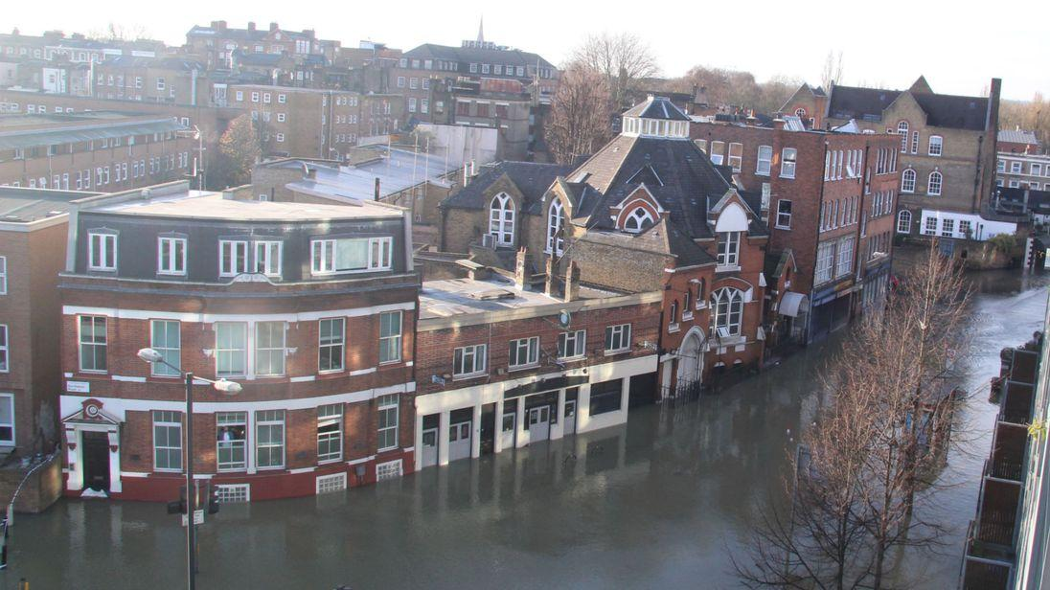
Flooding
Ensure high school children know alternative routes to school, home and to your chosen relocation site.
Plan where you will relocate to, if you have to evacuate and how will you get there
Plan what you will take with you if you need to evacuate - medicines, money, insurance details, pet/s & clothing.
Think about what you would want to move to safety during a flood - important documents, electrical goods (PC’s & white goods), pets
Switch off / shut off all electrical goods and utility supplies
Have a home or community flood plan;
Environment Agency Personal Flood Plan
Environment Agency Community Flood Plan

Slide 15
Fire
Impacts: Evacuation, loss of access to home & work locations, diversion routes & disruption to transport routes, isolation, vulnerability increase, health issues, disruption to normal life / business for prolonged periods (recovery). Complete loss of building or business.
What residents & VCSE can do:
Practice fire prevention -
Make an escape plan and practice how you will escape in a smoky atmosphere.
Install smoke and heat alarms in your home in any room where a fire can start
Try not to leave cooking unattended on the hob or grill
Try to keep your oven, hob, cooker hood, extractor fan and grill clean
Check that the cooker and hob are turned off when you have finished cooking
Keep matches out of children’s reach and buy children resistant lighters
At night close all internal doors to prevent smoke spreading if a fire starts
Don’t leave washing machines, tumble driers or dishwashers on overnight.
Don’t allow rubbish to build up and or block escape routes
.

Slide 16
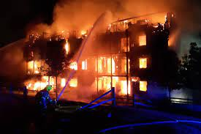
Fire
Worcester Park

Slide 17
Severe Weather
Impacts: Isolation / inability to leave home, loss of access to home & work locations, diversion routes & disruption to transport routes, vulnerability increase, health issues, disruption to normal life / business for one or more days.
What residents and VCSE can do:
Sign up for flood warnings - https://www.gov.uk/sign-up-for-flood-warnings
Sign up for weather warnings - https://www.metoffice.gov/weather/weather-and-advice/uk-warnings
During a storm stay indoors as much as possible
Take care when driving or only drive if your journey is really necessary
Make sure that vulnerable neighbours or relatives are safe
Make sure that vulnerable clients and users of community and voluntary services are safe and supported.
Stay tuned to the weather forecast and plan ahead with supplies

Slide 18
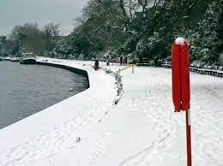
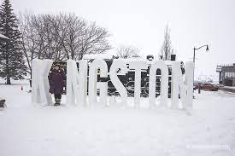
Snow in Kingston

Slide 19
Main impacts & to plan for?
Loss or limited access to buildings
Loss or limited access to road network ( road closure & traffic diversions)
Loss or limited access to travel network (bus & rail)
Loss or limited access to own data (staff, volunteers, vulnerable residents/clients & organisations finances)
Reduction in resources (staff & volunteers)
Increase in vulnerability
Increase in demand
Loss of reputation

Slide 20
Next Steps
Sign up for alert messages
Develop a basis business continuity plan
Review Cyber security - get help
Develop other plans: - Communications plan - Flood plan
Share with staff / volunteers
Train staff & volunteers

Slide 21
Questions

