Slide 1
Women’s Health Champions Training: Menstrual Health, Menopause and Urogynae
22nd January 2026
Presenters: Michelle Swer, Dr. Nicola Williams

Slide 2
Housekeeping
Introductions: Please share your name and organisation in the chat—we’d love to know who’s here.
Mic etiquette: Please stay on mute unless you’d like to ask a question.
Questions: There will be time for questions at the end, but feel free to drop questions in the chat as we go, and we’ll pick them up.
Recording: This session is being recorded. If you’d prefer not to be included, please keep your camera off.
Respectful space: Please be mindful and respectful of different opinions and experiences.
Let’s get started!

Slide 3
Objectives
1. Understand common women’s health issues across the life course
2. Learn key messages for community education
3. Build confidence to discuss sensitive health topics
4. Identify when to seek NHS help and support

Slide 4
The Role of Women’s Health Champions
1. Act as a trusted community advocate for women’s health and wellbeing
2. Raise awareness about menstruation, menopause and pelvic floor health
3. Share accurate information and help dispel myths and stigma
4. Offer peer support-listen guide and encourage open conversations
5. Connect women to local health services and support networks
6. Promote empowerment and confidence to seek help early

Slide 5
Requirements of your grant
Congratulations on successfully receiving a Women's Health Fund grant for 2025/26
As a reminder, the conditions of your grant are outlined below:
Confirm the date/s of your activity/activities (if you haven't already).
Take two photographs of your event or activity, with signed consent for NHS South West London to use these photographs.
Complete your reporting and feedback form within two weeks of completing your activity.

Slide 6
Your Community and Voluntary Sector contact
Please see below contact details for your borough Community Voluntary Sector lead:
Merton - Ali@mertonconnected.co.uk
Wandsworth - Jessica@wandcareall.org.uk
Croydon - training@cvalive.org.uk
Kingston - eneida.capaldi@kva.org.uk
Richmond - action@richmondcvs.org.uk
Sutton - razia@communityactionsutton.org.uk

Slide 7
Key things to do before your activity
Get ready for your activity:
  Read and familiarise yourself with the slides on the topics relevant to your activity; Menstruation, Menopause and Urogynaecology. The slides and resources in this pack can help you have conversations.
  Spread the word about your activity on WhatsApp, Facebook, Twitter/X, Instagram email and/or through flyers.
  Check you know what you need to do for reporting – so you can capture what you hear from people who attended your activity.
Please note: we will do our best to organise a clinician for your activity if you requested one within your application, but please give us as much advanced warning as possible.

Slide 8
Key things to do after your activity
We’re keen to hear from local people about their health and wellbeing and use of local services. This can include concerns, issues, direct feedback or other insight from your attendees of your activity.
Please remember to gather the information that you need to complete your evaluation – this includes:
  a summary of the activity, attendee numbers and demographics
  2 quotes about the activity from attendees about how they found the activity or the action they plan to take following your activity.
  2 photographs of attendees at your activity
Complete the monitoring form within two weeks of your activity. The link to the form can be found here https://forms.office.com/Pages/DesignPageV2.aspx?subpage=design&FormId=i9wEh43LkkWuUb66zissj5X345ijeBxHoFYoEScLq89UMFc4ODlTNVU1Qjg3R0NYUFZGRTQwSzVQRi4u&Token=9f98618524934d1687b90b9802168b28
Please post any photos on your social media channels and tag us so we can reshare them:
  Tag @nhsswl on Instagram
  Tag @SWLNHS on X
  Tag @NHSSouthWestLondon on Facebook

Slide 9
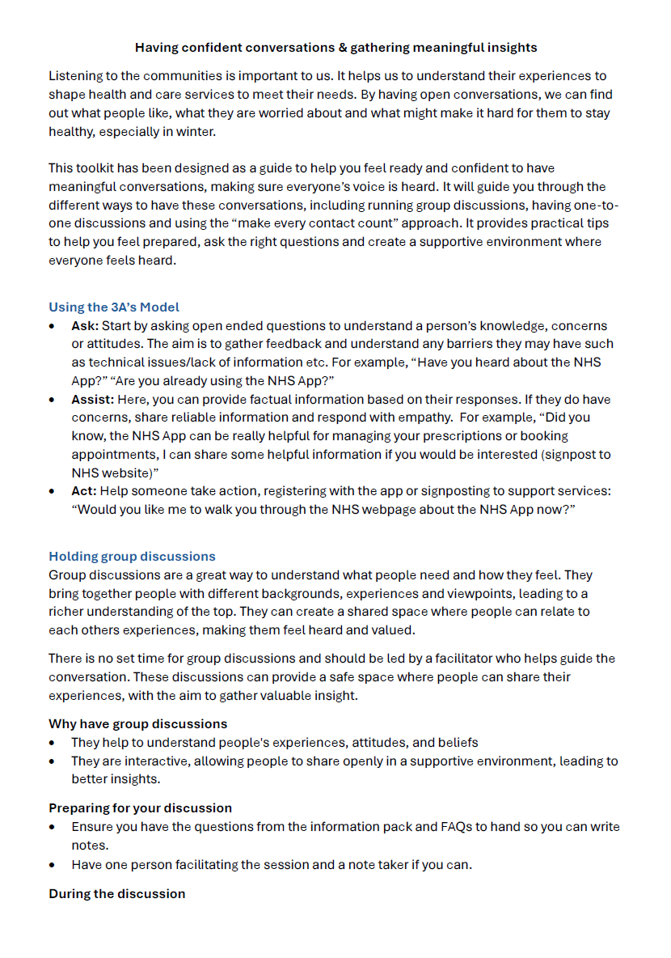
Having confident conversations and gathering meaningful insight
Listening to communities is important to us. It helps us to understand perceptions and experiences, which can then inform and shape health and care services.
We have created a guide to support you to have confident conversations and gather meaningful insight.
The next few slides draw out some of the key elements of having confident conversations.

Slide 10
Tips for Health Champions
Champion conversation tips:
Listen without embarrassment or judgement
Use inclusive language (“people who menstruate”)
Normalise words like menopause, periods and menstruation
Signpost don’t diagnose
Share information and resources not medical advice
Example conversation prompt:
“Lots of people find periods uncomfortable. Have you spoken to your GP about how it’s affecting you?”

Slide 11
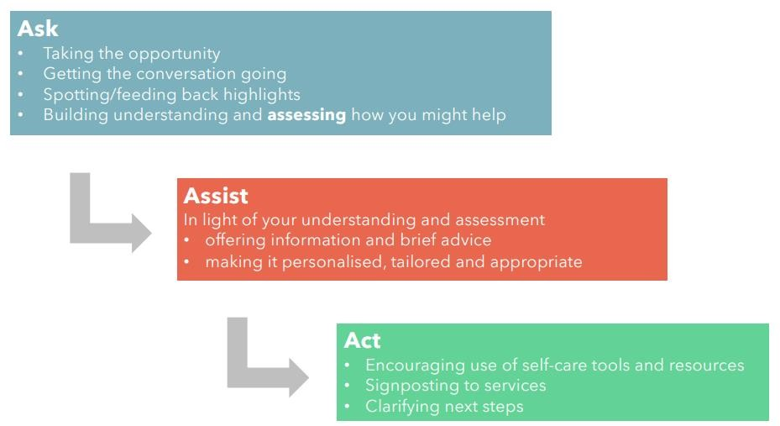
The 3A’s model – Ask, Assist and Act
Notes:
This model is all about understanding, helping, and doing something positive to improve the situation such as given out a leaflet. By following this model, we can ensure that parents and carers are informed, supported and able to take action.
ASSIST: You can give information based on their responses - this could include sharing a leaflet or guiding them to trusted NHS resources.
Act: This could be signposting to services or encouraging them to seek further information from their GP or Health Visitor. You could introduce them to the clinician or member of the NHS team at your event.

Slide 12
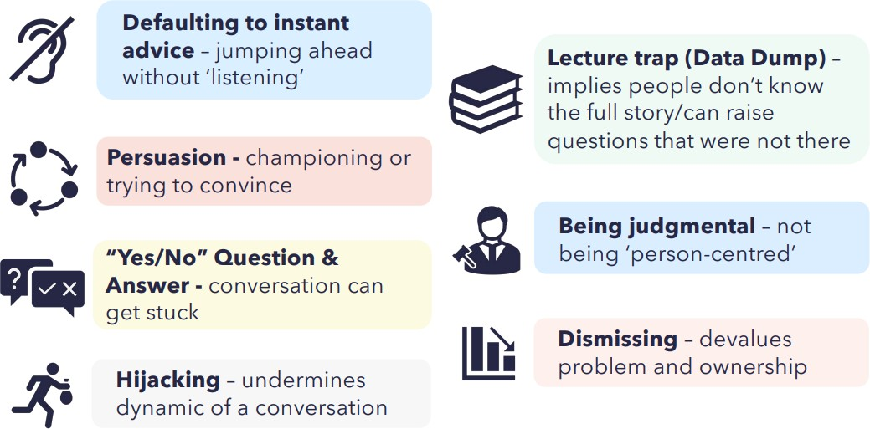
Things to be aware of
Notes:
High quality information

Slide 13

Safeguarding
If you think a child or adult are in need of support or at risk of harm, the following safeguarding referral options are available to you. Examples of a safeguarding issue could include exploiting a person financially, physically, emotionally or sexually.
If it is an emergency, please always call 999.
Borough | Adults | Children
Croydon Council | 020 8726 6500 | 020 8726 6400
Kingston Council | 0208 547 5005 | 020 8547 5008
Merton Council | 0208 545 4388 | 020 8545 4226
Richmond Council | 020 8891 7971 | 020 8547 5008
Sutton Council | 020 8770 6770 | 020 8770 6001
Wandsworth Council | 020 8871 7707 | 020 8871 6622

Slide 14
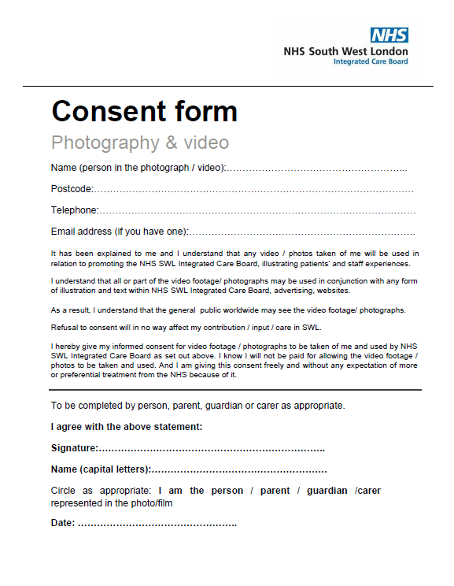
Consent for photography and filming
Please remember to take two photographs of your activity, with signed consent for NHS South West London to use these photographs.
Where possible, you will need to obtain written consent when taking photos or filming. If a person is the main focus in a photo or video then consent will be essential.
  If you have captured a person in the background of a photo or film and they are clearly identifiable, we will also need consent.
  Please ask permission before taking photos. We will provide you with consent forms to share with participants at activities.

Slide 15
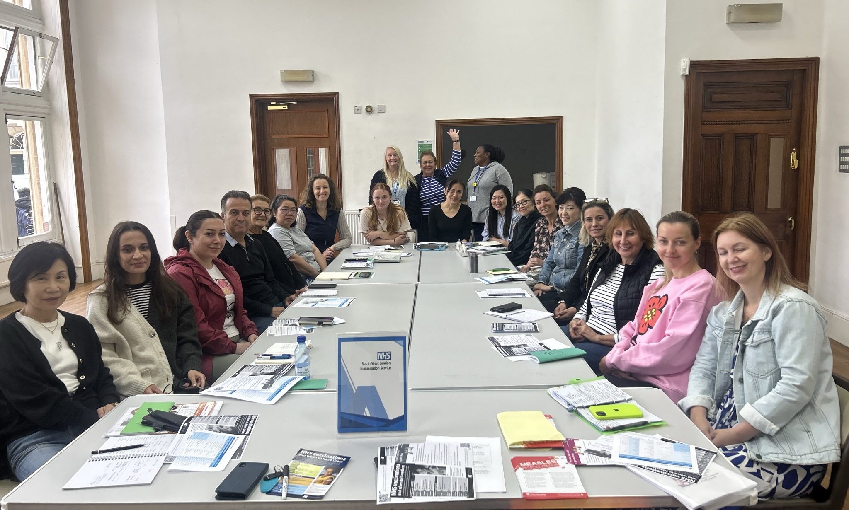
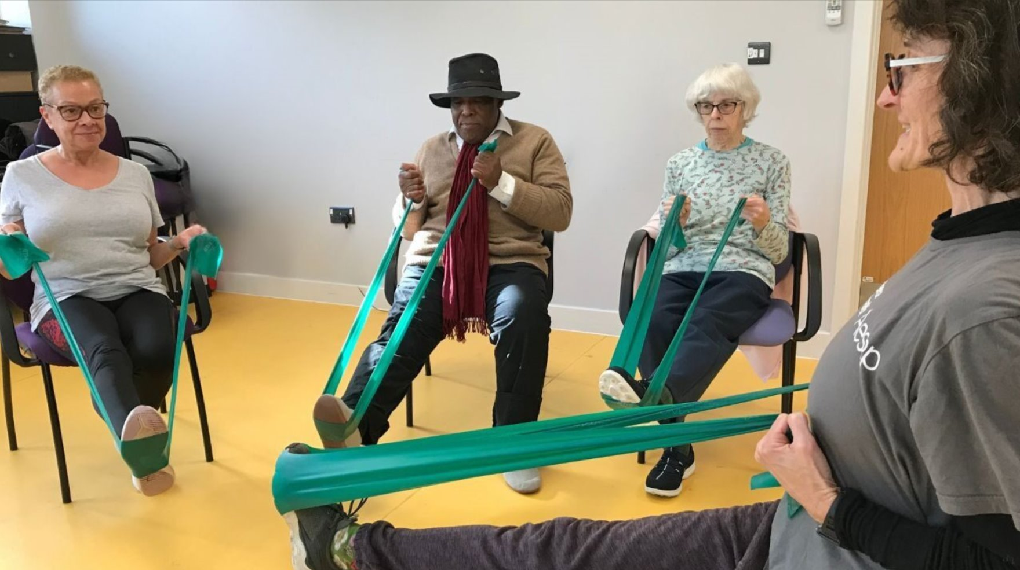
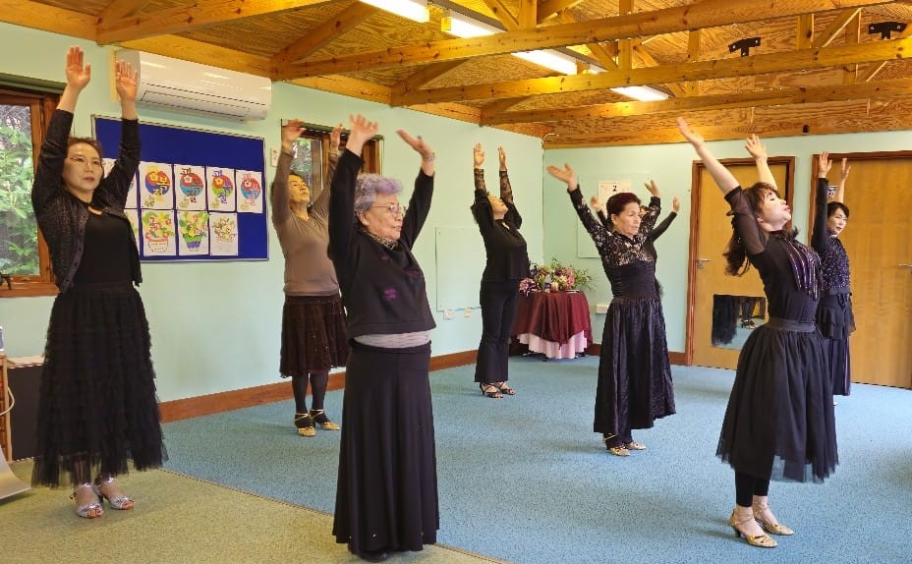
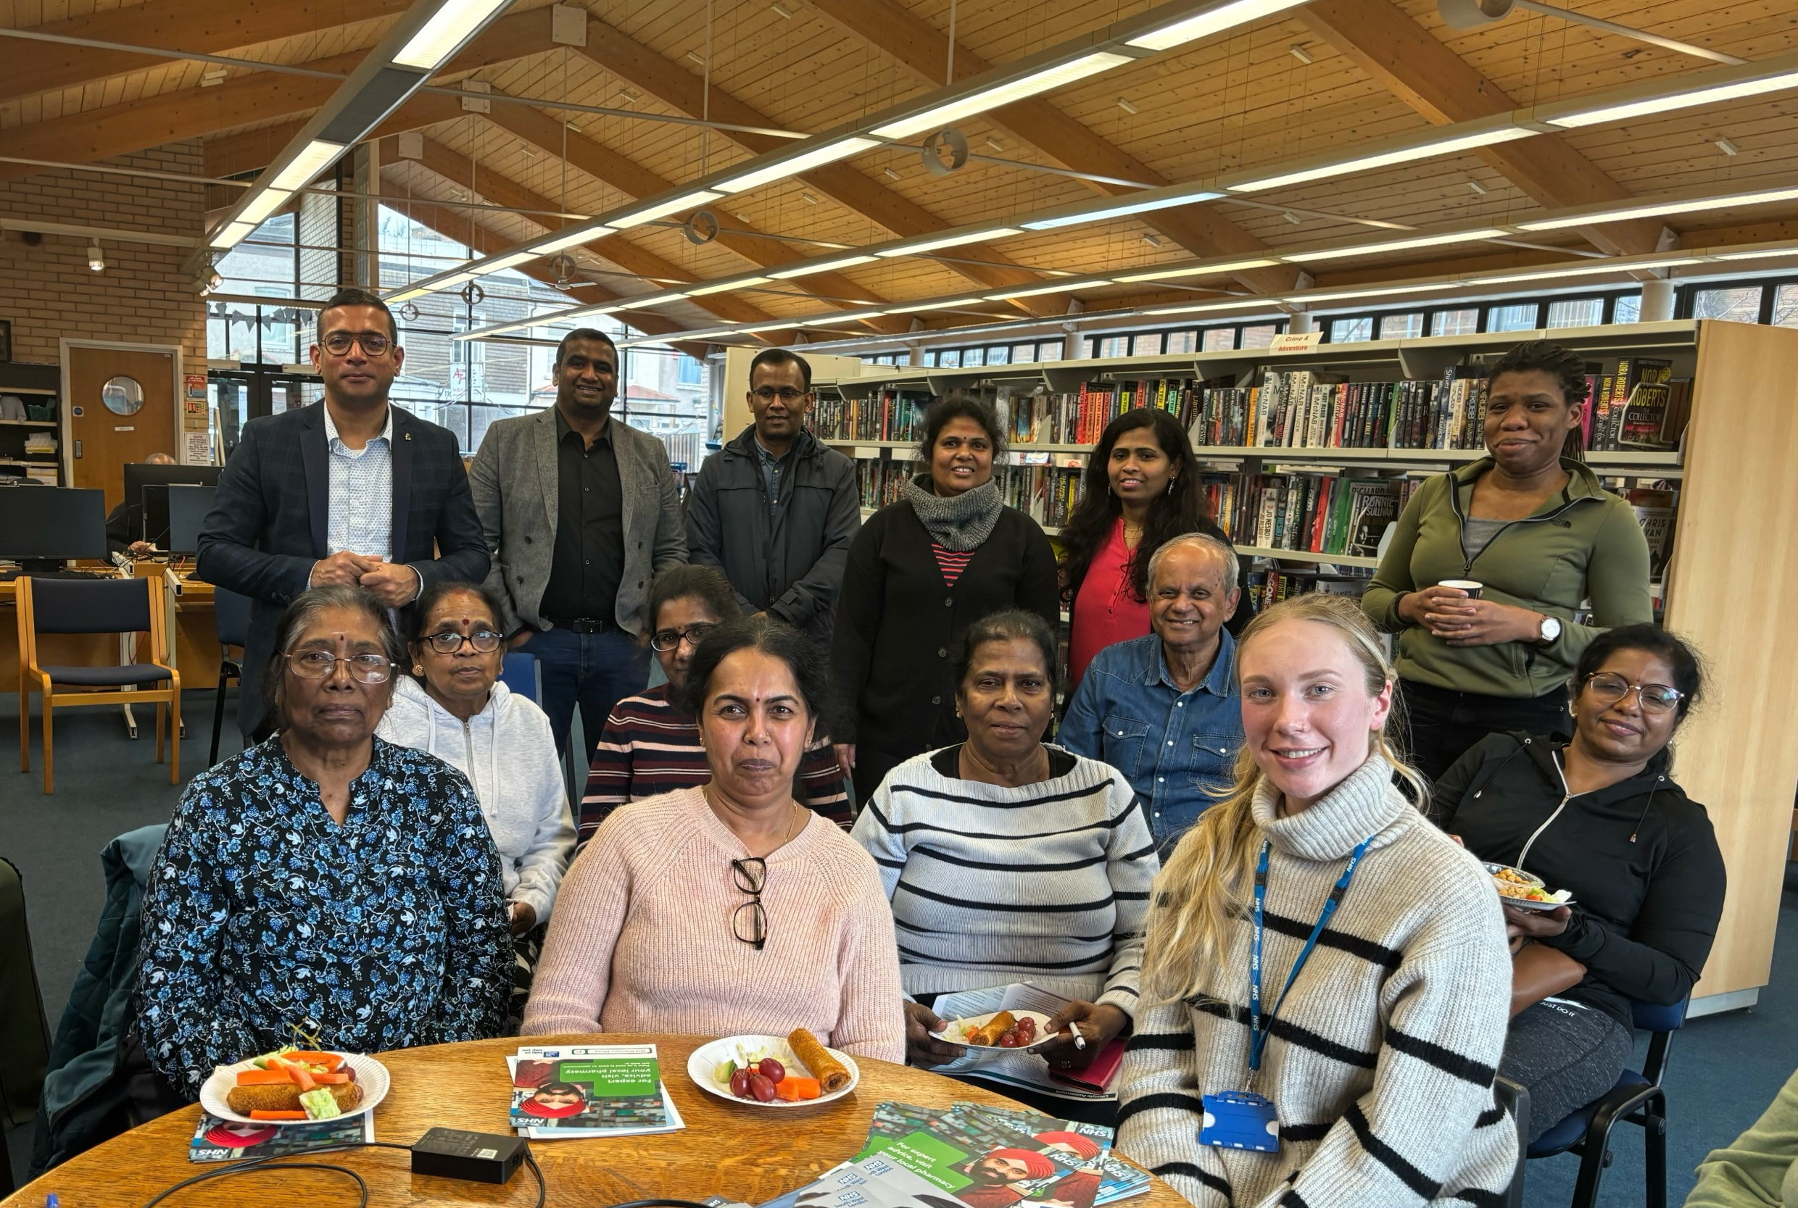
What do we want from our photos?
Top tips
Close up photos are great - no backs of heads or small people in the distance.
We would like to show people having a good time, but if people don’t want to be photographed, you could ask your staff or volunteers.
Photos that show how many people are attending – including pictures of the whole group.
A mixture of posed shots and actions shots.
A mix of landscape and portrait photos.
Photos of people taking part in the activity, e.g. doing line dancing or listening to a clinician.
For all photos:
  Make sure the environment is well-lit and there is good natural lighting where possible.
  Take plenty of photos so you have options when sending to us.
  Move clutter out of the shot if you can – especially anything with personal data.
We want to capture the breadth and range of different activities and events with our diverse south west London communities

Slide 16
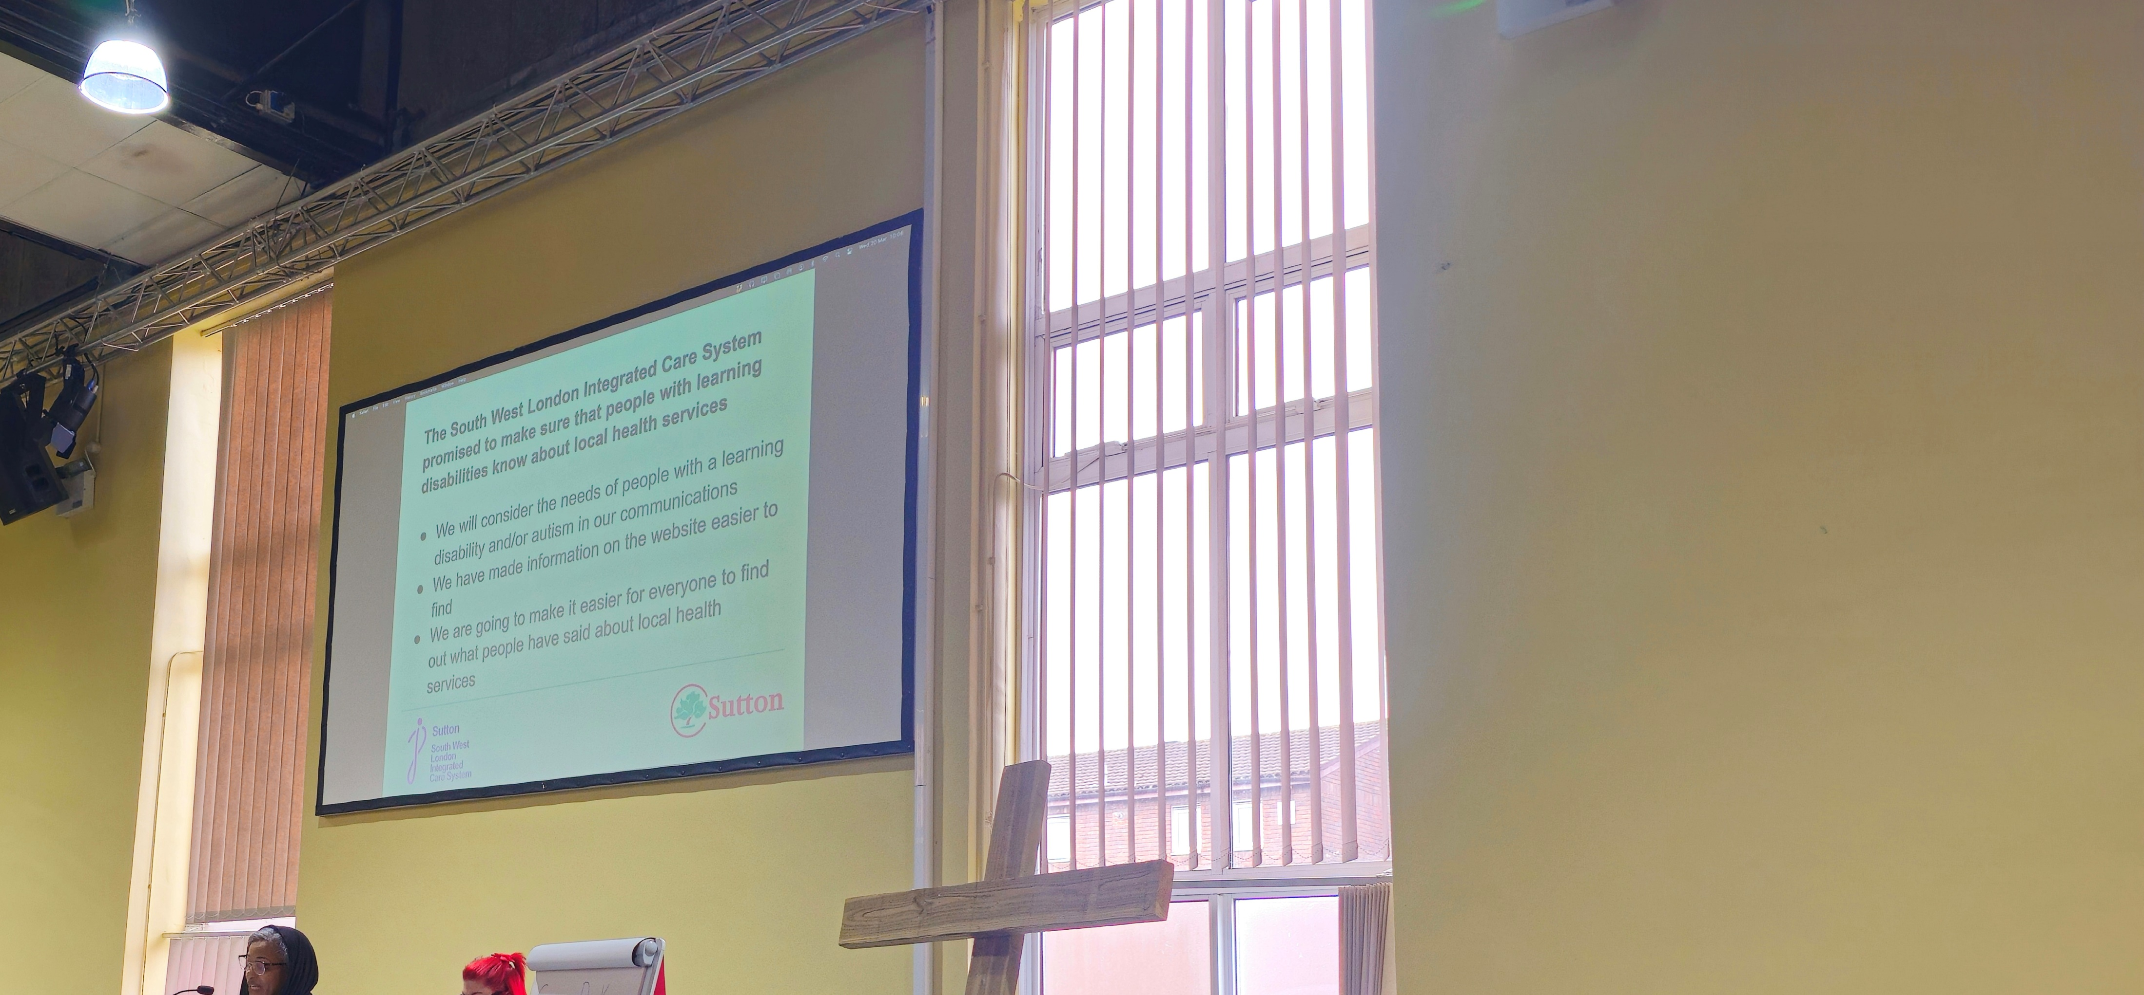
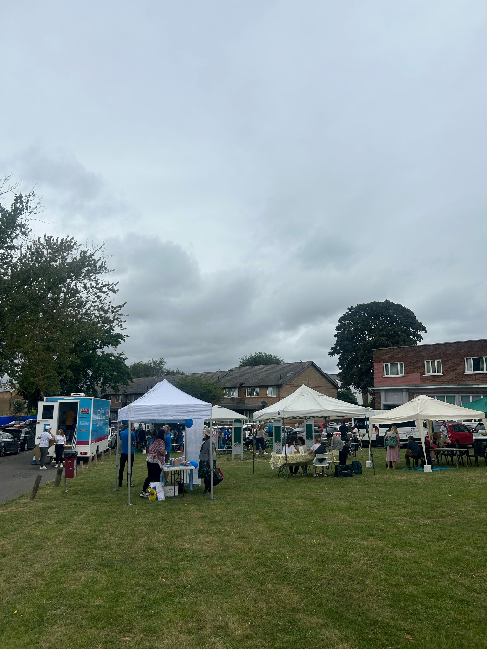
Examples of unsuitable photos
You can’t tell from the picture taken by our NHS team how successful the activity was.
This was a health awareness day with lots of services and 180 local people in attendance.
The picture was taken from a far distance and doesn’t showcase how many people attended.
This picture doesn’t feature local people. You cannot tell the context or location of the event. It does not show what happened during the event.
It also is not well-lit and you cannot read the information on the screen.

Slide 17
Section 1. Menstruation

Slide 18
‘Just a Period’ Video https://www.wellbeingofwomen.org.uk/what-we-do/campaigns/just-a-period/

Slide 19
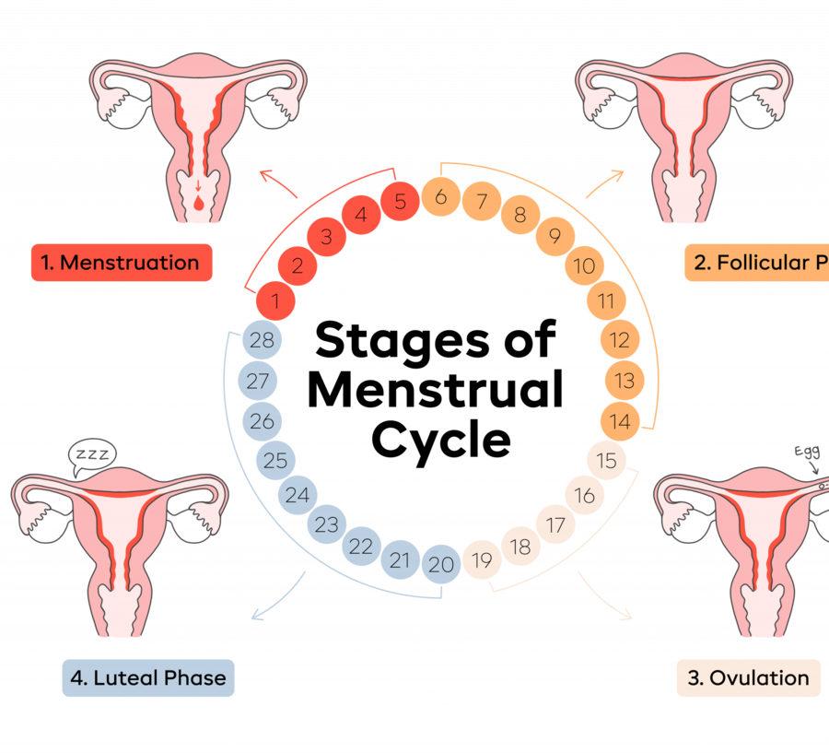
Menstruation
What is a period?
A period (menstruation) is when blood and tissue leave the body through the vagina.
It happens about once a month as part of the menstrual cycle.
It’s the body’s way of shedding the womb lining when pregnancy doesn’t happen.
The Menstrual Cycle
Average cycle: 28 days (can range 23–35).
Periods usually last 2–7 days; heaviest in first 1–2 days. Cycle count starts on the first day of bleeding.
When Periods Start and Stop?
Usually begin around age 12 (can be earlier or later).
Become regular by age 16–18.
Stop naturally between mid-40s to mid-50s
Menopause: when periods stop for more than 1 year

Slide 20
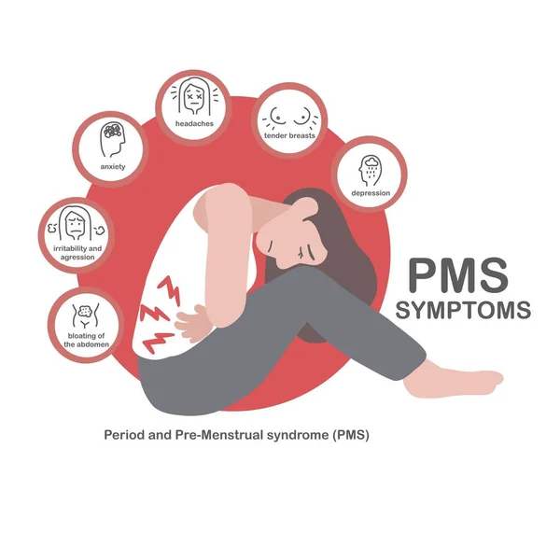
Menstrual cycle problems
PMS (Pre-Menstrual Tension)
PMS (Premenstrual Syndrome) includes mood swings, tiredness, tender breasts, headaches, bloating.
Occurs usually 1 week before period and symptoms resolve when period comes
Period pain
Pain caused by womb contractions (“cramps”).
Can lead to nausea, vomiting, difficulty going to work
Can be associated with heavy bleeding
Support tips:
Hot water bottle, gentle exercise, rest, over-the-counter pain relief.
Track symptoms using an app or diary.
See GP if pain affects daily life or have mental health issues associated with the symptoms.

Slide 21
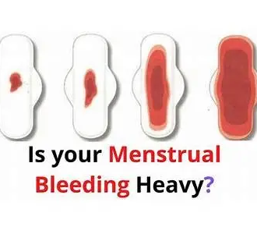
Menstrual cycle problems
Heavy periods:
Known medically as menorrhagia
Greater than 80ml of blood loss per cycle
Signs include soaking through pads/tampons quickly i.e. within 1-2 hours, leaking through to clothes, having to change pads during the night or long bleeding (7+ days).
May see blood clots
If you have these symptoms, it is important to see your GP as they may want to investigate why you are having these symptoms or offer treatments to help reduce bleeding.

Slide 22
Menstrual cycle problems
Irregular periods:
  Usually occurs first year or two of your period
  Stress, weight changes, intense exercise, contraception, or Polycystic Ovary Syndrome (PCOS).
  Perimenopause (before menopause).
  Breastfeeding.
Missed periods
can also occur with stress or use of contraception
always consider pregnancy
see a GP if you miss more than 3 in a row or if you think you could be pregnant.
In most cases irregular periods do not mean there is a medical problem. But talk to your doctor anyway. They will help find out if there’s a cause that can be treated. Keep a diary of the dates of your periods. This is so that you and your doctor can see if there is a pattern
Contraception that uses hormones can affect your periods too, like the pill and implant. Bleeding on hormone contraception is withdrawal bleeding, not a period. So you do not need to worry if this is irregular. Withdrawal bleeding is also likely to be lighter than a period.

Slide 23
When to See a Medical Professional
See a healthcare professional if you:
Have heavy bleeding which affects your daily activities
Bleed between periods
Bleed after sex
Bleed after menopause
Have sudden changes in your cycle
Pain or bleeding affects daily life

Slide 24
Section 2-Menopause

Slide 25
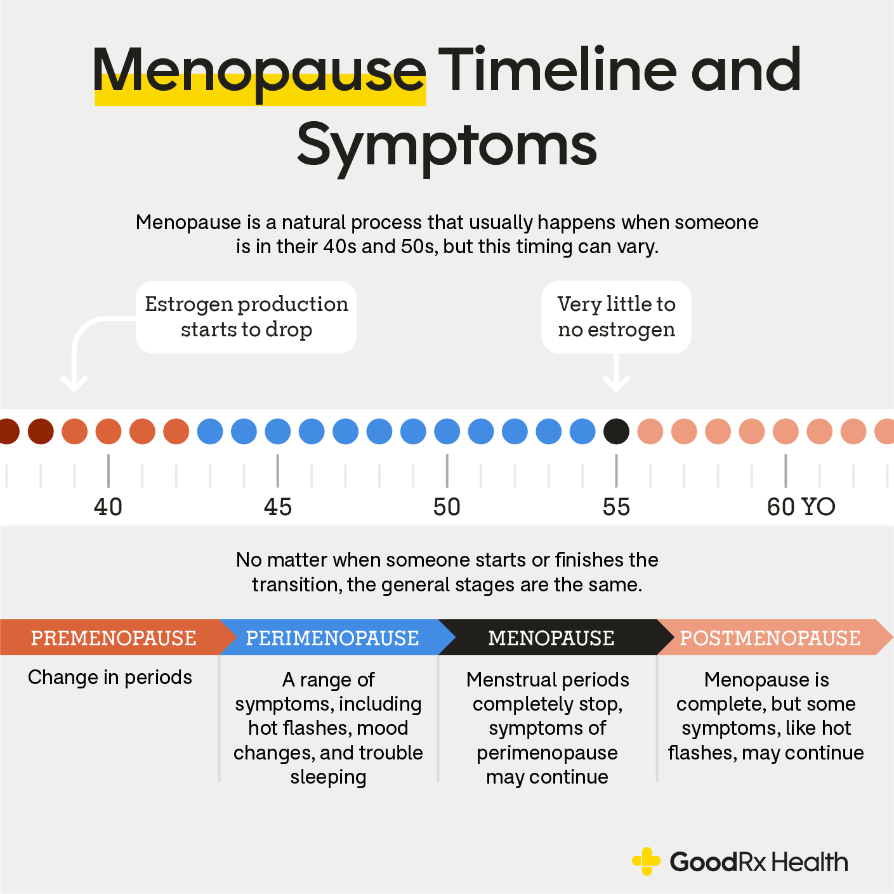
What is the Menopause?
Menopause is the natural end of menstrual periods, usually occurring between ages 45–55, but can be earlier or later.
It happens when the ovaries stop releasing eggs and produce less oestrogen and progesterone.
Perimenopause is the transition phase before periods stop completely.

Slide 26
Common Symptoms
The most common symptoms are
Hot flushes and night sweats
Mood changes,
Irritability and anxiety
Sleep disturbances and fatigue
Vaginal dryness and urinary changes
Changes in weight, skin, hair, and bone health
Many additional symptoms can occur as shown in the diagram opposite.

Slide 27
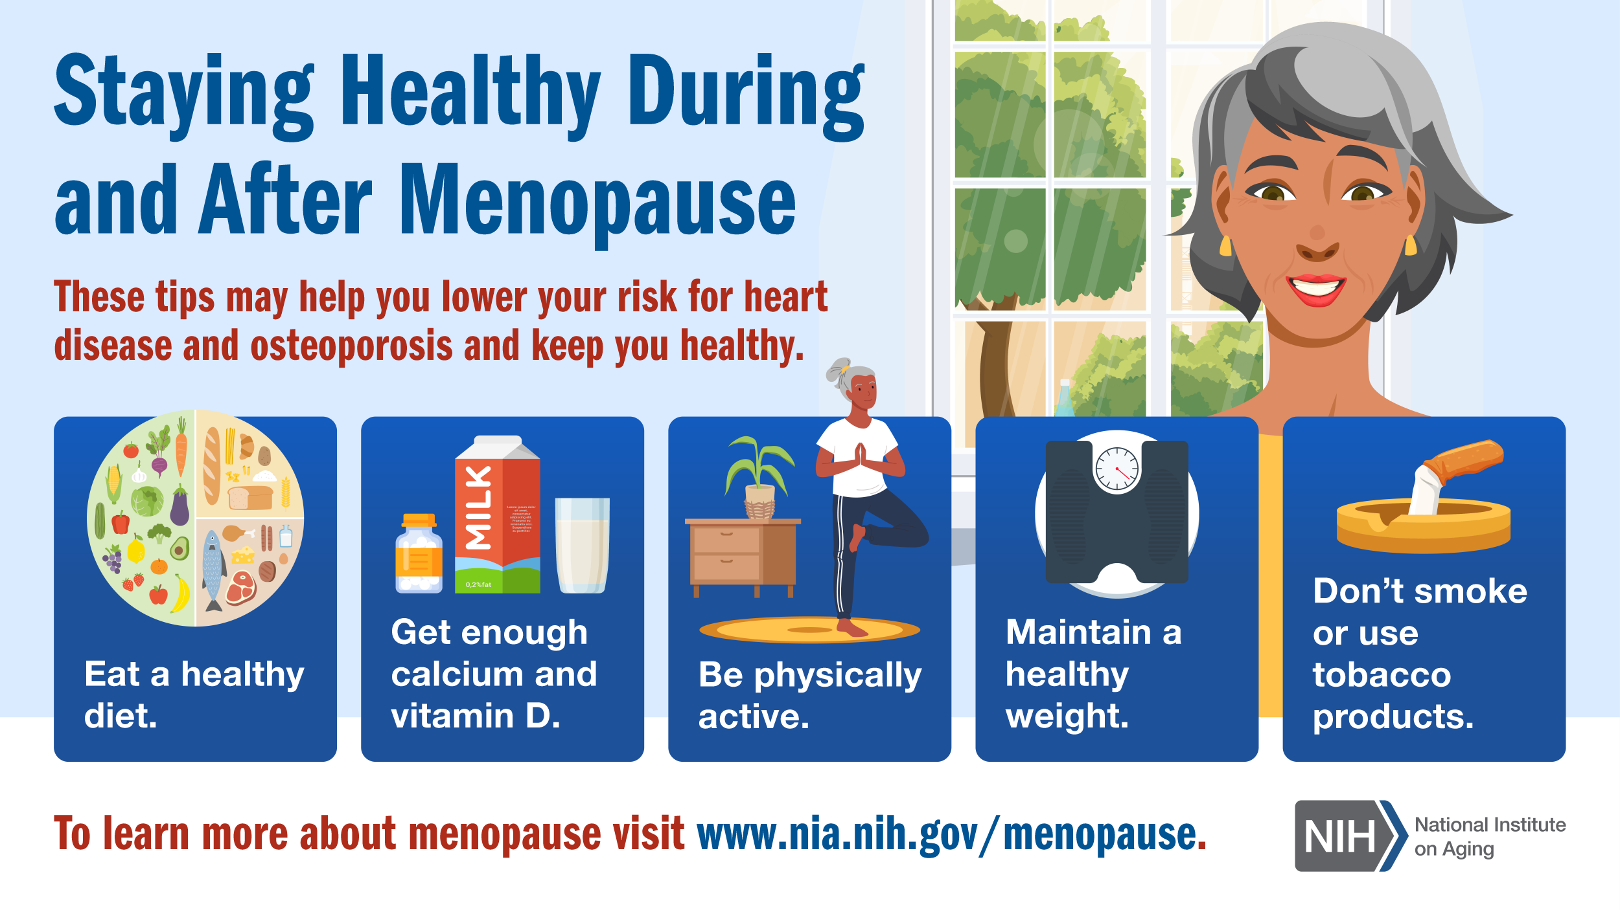
Managing Symptoms
Lifestyle support:
Regular physical activity
Healthy, balanced diet
Stress reduction: yoga, meditation
Avoid smoking and limit alcohol
Reduce caffeine intake
Medical options:
Hormone Replacement Therapy (HRT)
Non-hormonal medications for symptoms

Slide 28
How to Manage Hot Flashes
Use a Chill/Silk pillow in bed
Wear lighter clothing
Use or carry a fan
Use a hot flash necklace or bracelet

Slide 29
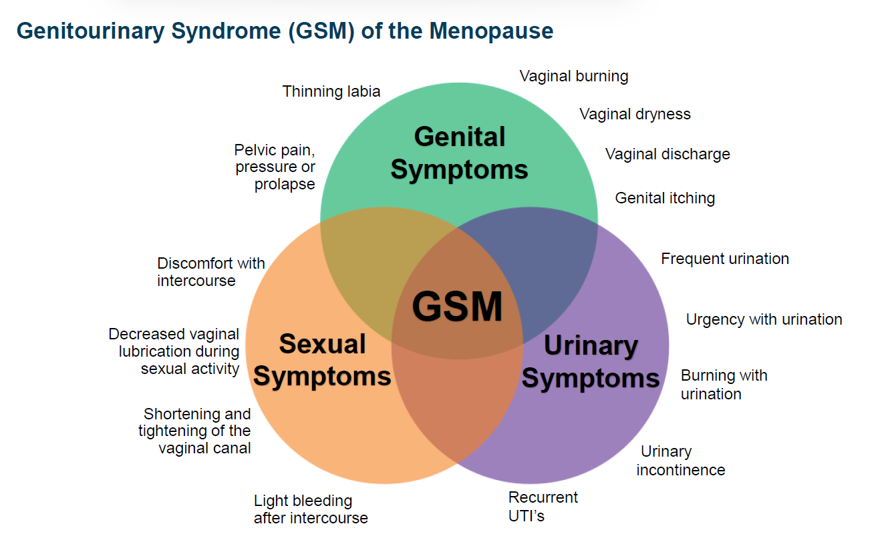
Genitourinary symptoms

Slide 30
When to See a Medical Professional
Bleeding after menopause (always check with GP)
Severe hot flushes affecting daily life
Mood or sleep disturbances that are hard to manage
Urinary or pelvic symptoms causing discomfort or infections

Slide 31
What is HRT?
HRT replaces the hormones oestrogen (and sometimes progesterone) that the body stops producing during menopause.
It helps relieve symptoms such as: Hot flashes and night sweats, mood swings and anxiety, Sleep problems, vaginal dryness, joint and muscle pain.
It can also protect bone health and reduce the risk of osteoporosis.
Types of HRT:
Combined HRT: oestrogen + progesterone (for women who still have a womb).
Oestrogen-only HRT: for those who have had a hysterectomy.
Local HRT: creams, pessaries, or rings for vaginal symptoms.
HRT is safe and effective for most people, but choices should always be made with a GP or menopause specialist.

Slide 32
Section 3-Urogynae

Slide 33
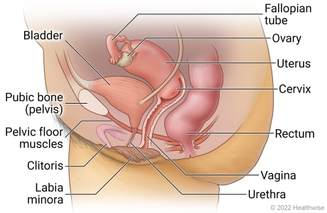
What is Urogynaecology?
Urogynae focuses on the pelvic floor (muscles, tissues, organs that support the bladder, womb, and bowel)
Common problems include:
1. Leaking urine (incontinence)
2. Feeling of “something coming down” (prolapse)
3. Pain or heaviness in the pelvic area
How common are these problems?
1 in 3 women have urinary leakage at some point
Prolapse affects about 1 in 2 women who’ve given birth
Many don’t talk about it — but help is available

Slide 34
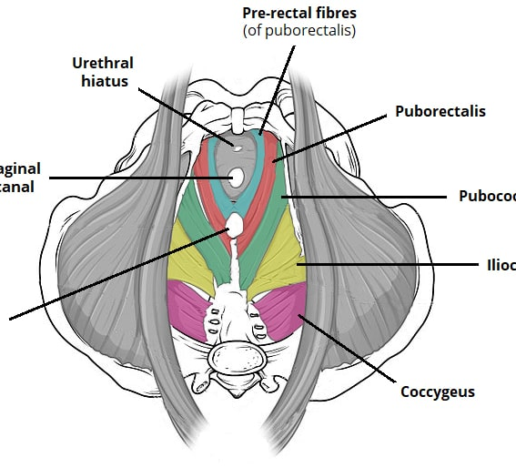
What is the Pelvic Floor?
The pelvic floor is the muscles that support bladder, bowel, womb
They help with peeing, pooing, and sexual function
They can weaken with childbirth, aging, heavy lifting, obesity, or menopause

Slide 35
Common Urogyne Conditions and Risk Factors
Urinary Incontinence – leaking when coughing, sneezing, or exercising
Overactive Bladder – strong urge to pee often
Pelvic Organ Prolapse – feeling of pressure or “bulge” in vagina
Faecal Incontinence – leaking stool or wind
Risk Factors
Pregnancy and childbirth
Being overweight
Menopause
Chronic cough or constipation
Heavy lifting
Family history

Slide 36
Prevention and Self Care
Pelvic floor exercises every day
Avoid constipation – eat fibre, drink water
Stay active – healthy weight
Stop smoking – helps cough and bladder
Seek help early especially if:
Leaking urine regularly
Feeling something “coming down”
Pain or pressure in pelvis
Difficulty emptying bladder or bowel
Impact on daily life

Slide 37
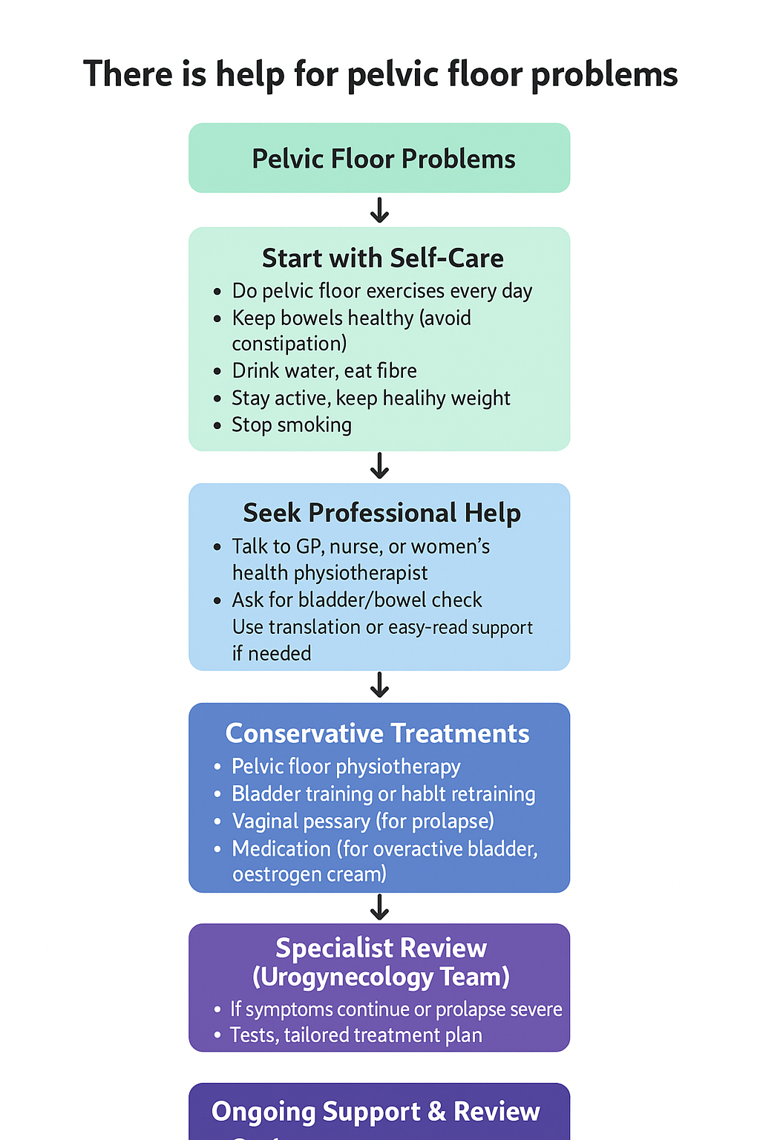
Treatment
Lifestyle changes
Pelvic floor physiotherapy
Pessaries (support device for prolapse)
Medication or surgery (if needed)

Slide 38


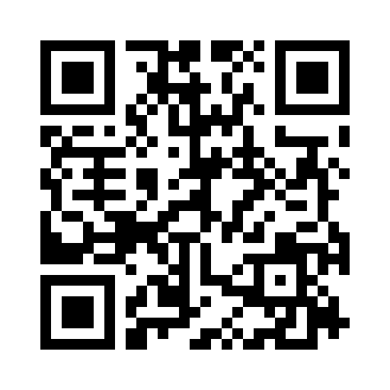

GetUBetter App
Available to all women registered with a South West London GP
NEW Women’s health support modules available in the getUbetter app - Designed to empower
women with knowledge, guidance, and practical support throughout key life stages
Our updated Perinatal Pathways provide holistic, integrated support from pregnancy through postnatal recovery, including access to local services, emotional wellbeing tools, and self-management guidance for new and expectant mothers.
Patients can self-refer to access the app via the above QR code or if applicable via the getUbetter page on the practice website.
The content has been developed with SWL clinicians in partnership with getUbetter and includes sign-posting and red flag safety netting.

Slide 39


The SWL self-management app now includes pelvic floor health support.
1 in 3 women experience symptoms related to pelvic floor dysfunction, a hidden condition that is commonly normalised and misunderstood. Patients throughout SW London reported a lack of trust and confidence to manage their pelvic floor symptoms, compounded by limited access to expert advice.
The SWL Gynaecology Clinical Network has launched a free app to empower women in South West London (SW London) to self-manage their pelvic floor health.
Co-produced by Women’s health physiotherapists, urogynaecologists, and GP clinical leads in SWL, the app provides patients with pelvic floor exercise videos, safety netting questions, and access to local support services & networks.
Copyright getUBetter 2022
Notes:
We are all aware of the harrowing stats and national problem
Patient focus groups, discovery interviews, including with SWL
- hidden condition that is commonly normalised and misunderstood

Slide 40

Pelvic Health App Focus Group
Feedback
Every woman’s birth is so different, and your pregnancy so different, and post Natal care is so different.”
“Minor incontinence but wasn’t aware what was normal.”
“Hard to know what information to trust.”
Recovery mode – it’s where I was clueless. After birth, you just aren’t sure
“Didn’t know if I was doing the exercisers correctly.”
“It’s so hard to remember to do so many things.”
“When you’re so tired after birth, sometimes you don’t look after yourself very well.”
“Changes to genitals can really impact your mental health as nothing is like it was before.”
Copyright getUBetter 2022

Slide 41

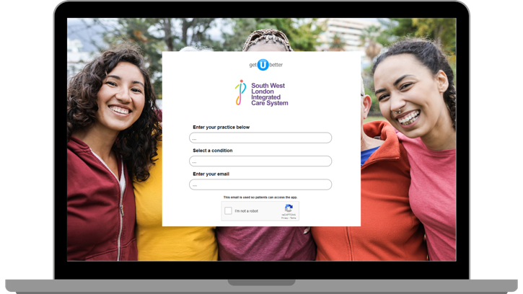
The SWL self-management app now
includes pelvic health support for
General pelvic floor health self-management
Urinary incontinence
Prolapse
Overactive bladder
Coming soon - Peri-natal pelvic health
Who is it for?
It is suitable for all women to highlight the importance of pelvic health but particularly during the perinatal period and again at the time of perimenopause and menopause.
For women experiencing symptoms of pelvic floor dysfunction such as incontinence and prolapse it also offers advice and direction to self-manage whilst awaiting a referral to a specialist pelvic health physiotherapist or doctor.
Copyright getUBetter 2022

Slide 42
Useful Resources

Slide 43
Useful Links and Resources
Royal College of Obstetricians and Gynaecologists: Includes a broad range of resources including a patient information section covering a broad range of gynaecological conditions, procedures, and situations that can occur during pregnancy and birth. All are based on evidence-based research
https://www.rcog.org.uk/
Women's Health Concern: Includes a broad range of fact sheets for patients which are approved by the British Menopause Society
https://www.womens-health-concern.org/
GetUBetter App

Slide 44
Useful Links and Resources Continued
https://www.nhsinform.scot/healthy-living/womens-health/girls-and-young-women-puberty-to-around-25/periods-and-menstrual-health/choosing-period-products/
https://www.rcog.org.uk/for-the-public/browse-our-patient-information/managing-premenstrual-syndrome-pms/
https://www.wellbeingofwomen.org.uk/health-information/what-is-a-period/
https://www.wellbeingofwomen.org.uk/what-we-do/campaigns/lets-talk-periods/
https://reproductive-health.ed.ac.uk/hope
https://www.nia.nih.gov/
20-BMS-TfC-Menopause-in-ethnic-minority-women-JULY2023-B.pdf
https://www.wellbeingofwomen.org.uk/what-we-do/campaigns/just-a-period/
https://www.wellbeingofwomen.org.uk/health-information/top-tips-for-managing-periods-as-a-teenager/
https://www.womens-health-concern.org/wp-content/uploads/2019/10/WHC-UnderstandingRisksofBreastCancer-MARCH2017.pdf

Slide 45










Samaritans 116 123 Samaritans are open 24/7 for anyone who needs to talk. | NHS 111 111 Non-emergency medical help and advice for people in England. | Money Helper 0800 138 7777 Provides free and impartial money advice. | Shout 85258 (text SHOUT) Confidential 24/7 text service offering support if you are in crisis and need immediate help. | The Silver Line 0800 4 70 80 90 Provides support, information, friendship and advice for older people (over 55) who may feel lonely or isolated.
Stand Alone standalone.org.uk Charity supporting adults who are estranged (not in contact) from their family. | Survivors of Bereavement by Suicide (SOBS) 0300 111 5065 uk-sobs.org.uk Emotional and practical support and local groups for anyone bereaved or affected by suicide. | Switchboard 0300 330 0630 switchboard.lgbt Listening services, information and support for lesbian, gay, bisexual and transgender communities. | The Trussell Trust trusselltrust.org Emergency food and support for people in need. Includes a searchable list of local foodbanks. | Papyrus Our advisers are all trained to help you focus on staying safe from suicide. For under 35s. Call 0800 068 41 41 – 9am to midnight every day Text 07860 039967 Email pat@papyrus-uk.org
Mindfulness session on 25 January with Rachael Swan
‘Take a break’
open sessions
every Tuesday
Notes:
Lots of activities planned to

