Slide 1


Wellbeing at
Kingston Adult Education
Annette Mary Brown
Community Learning Manager

Slide 2
Research Project by Department of Education
To assess if adult and community learning courses help people to develop the tools, strategies and resilience to manage, and aid recovery from mild to moderate mental health issues.
We developed a course in partnership with the charity Action for happiness called ‘Practical ideas for happier living’
Notes:
Between Sept 2015-August 2017, Kingston Adult Education were invited by the Department of Education to assess if adult and community learning courses help people to develop the tools, strategies and resilience to manage, and aid recovery from mild to moderate mental health issues.
We at KAE, worked with the charity Action for Happiness to put together a course called ‘Practical ideas for happier living’. The project was divided into two phases. In phase 1 the course was of a two week duration, but the feedback was that this was not long enough to embed the skills and this was increased to a six week course in phase 2 of the project

Slide 3










GREAT DREAM: Ten Keys to Happier Living
GIVING
Do things for others
DIRECTION
Have goals to look forward to
RELATING
Connect with people
RESILIENCE
Find ways to bounce back
EXERCISING
Take care of your body
EMOTIONS
Look for what’s good
AWARENESS
Live life mindfully
ACCEPTANCE
Be comfortable with who you are
TRYING OUT
Keep learning new things
MEANING
Be part of something bigger
Source: Action for Happiness (2011), building on nef (2008)
Notes:
3
We worked with the charity ‘Action for happiness’ to put

Slide 4
Outcomes of study:
Two phases of the project and in phase 2 of the project, we delivered 17 courses across the borough including schools, children’s centres, Kingston Carers and Kingston Churches Action on Homelessness to over 200 Learners.
The findings from KAE’s project showed that 61% of learners who started their course with clinically significant symptoms of anxiety and/or depression, no longer had clinically significant symptoms at the end of their course.

Slide 5
On the parallel course that Action for Happiness run, scientific research carried out at the Wellbeing Centre of Oxford University and the London School of Economics, stated that "the results are staggering" for learners in the research group who had attended a course. On a ‘ten point scale’ those learners increased their happiness quota by a whole one point from attending a short course. Article on the BBC news earlier this year: https://www.youtube.com/watch?v=GmsiUpfh1W4&feature=youtu.be
Many of the groups stay in touch with each other and have created ‘WhatsApp’ groups where they arrange meet ups and support each other

Slide 6
Since the end of the project, we have continued to run these courses and to date we have delivered training to over 600 Learners
Every Learner who registers for the course is invited to meet with a member of our Wellbeing team to enrol and ensure that they get the best possible outcome from attending the course.
As a progression/follow-on to the course, we run monthly refresher courses to enable Learners to build on their skills/share their experiences and reconnect with fellow Learners
Our wellbeing provision has now extended to many other courses, and we continue to expand our provision. New courses include: ‘Stress management’, ‘How to reduce anxiety and develop resilience in your child’ ‘Skills to manage emotions’, ‘Diet for good mental wellbeing’, and many more

Slide 7
Courses during lockdown:
Continued to run most of our courses online during first lockdown and we will continue to run this provision in the second lockdown
As well as our mental wellbeing courses, we ran Family Learning courses, Pilates (including Standing Pilates and Parent and Child Pilates), Singing for Fun and many more
Regular newsletter sent out to Partners and existing Learners, and we were overwhelmed with enrolments
Where online courses were impractical, our Tutors sent out pre-recorded videos as well as telephoned Learners regularly, setting them tasks to do at home and getting them to send in pictures back of their work

Slide 8
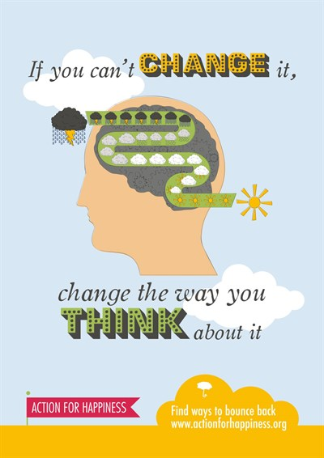

Example slides we use for ‘Practical ideas for happier living’
Notes:
This normally takes around half an hour on the actual course and we have 5 minutes to do it tonight………but I just want to give you an idea

Slide 9

EMOTIONS
Look for what’s good

Slide 10

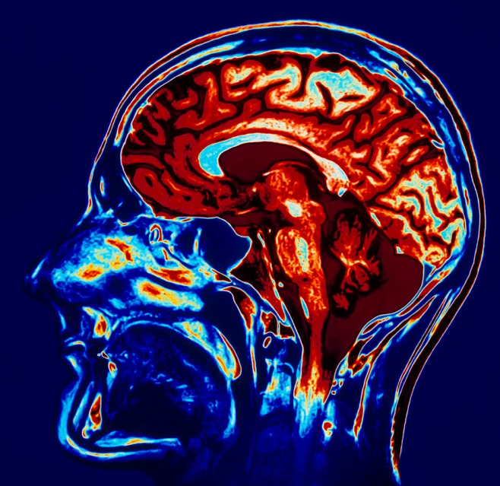
Happiness
Our happiness is affected by…
Our genes
Our circumstances
Our choices & behaviours
And research shows that we can
learn habits to be happier
Source: Lyubomirsky et al (2005)

Slide 11



Focus on the Good Things
TRY IT YOURSELF
Look back over the last day or so of your life…
Think of one good thing that happened – things that you enjoyed or were pleased about, big or small
Share your thoughts with the person next to you
Notes:
2 minutes for thought and sharing and 1 minute of feedback from the audience
How did it feel talking about what was positive?
We often don’t talk about the small positive things in our day:day life, and sometimes by recalling them and talking about them, it can give us joy, and listening to those things can also give joy and often inspiration

Slide 12


EMOTIONS
Look for what’s good
Pleasant or positive feelings aren’t just enjoyable, they can also enhance our capabilities, relationships and resilience
We have a natural ‘negativity bias’ but we can retrain our brains to also look for good things
©Action for Happiness. All Rights Reserved
Notes:
In a scientific experiment people were asked to do this activity each night for one week. After doing so they showed an increase in happiness and a decrease in depressive symptoms (they weren’t clinically depressed) that lasted for up to 6 months!

Slide 13
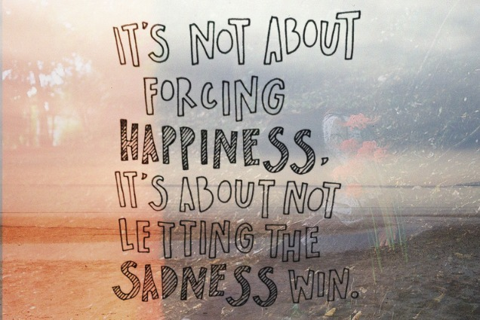
©Action for Happiness. All Rights Reserved
Notes:
By getting into the habit of recalling the good things every day, it means that when we have had had a bad day, we are more likely to be able to acknowledge that ‘yes that was a bad day’, but then able to reflect on what was good, even if it was just a sunny day, or we ate a great dinner………..it refocuses our thoughts and helps us to balance out the day .
Think of it like taking Vitamin C to help build up your resistance to fight a cold. You may still get a cold……….but, it may have been a lot worse if you hadn’t taken it. It’s the same with building up resilience skills – you may still have your low and bad times, but by learning skills for resilience, you are more likely to bounce back. We like to say , when life is tough, it’s about bending but not breaking.

Slide 14

Visualisation

Slide 15

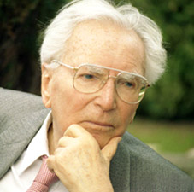
and finally…………….we always have a choice
  “Everything can be taken from a man but one thing:
  the last of the human freedoms which is –
  to choose one's attitude in any given set of circumstances”
Victor Frankl
Notes:
15
Prisoner in a concentration camp in 2nd world war and survived. He later became psychiatrist and psychotherapist and said…….
Despite Viktor Frankl’s very wise and true words, sometimes we need to re-focus on what is important in life, re-train our brain and take some time out…….

Slide 16
Our courses include:
Funded courses:
Private/ Bespoke Courses:
Practical ideas for happier living (6 weeks)
How to Successfully Regulate Your Emotions
Developing Emotional Resilience to Cope with Changing Times Workshop
Stress management
Relaxation and Meditation
Developing healthy relationships
How to reduce anxiety & develop resilience in your child
Exercise classes including: Standing Pilates, Tai Chi, Yoga
Diet for good mental and physical wellbeing
Accredited mental wellbeing training leading to a Level 1 Certificate in Health and Wellbeing (OCN)
and many more……..
We can run any of our courses as private provision including:
The Compassionate Manager
School inset training sessions
For more details contact:
  Annette Brown
  Community Learning Manager, Kingston Adult Education
  Email: annette.brown@kingston.gov.uk
  Telephone: 02085476763
Notes:
The Compassionate Manager: This course guides your management through a journey of understanding how looking after their team's emotional wellbeing improves productivity, loyalty and motivation. They will be guided to learn how to recognise and support each person with their own specific needs ensuring each individual has what they need to address their emotional challenges. During these challenging times, never has good emotional health management been needed within the workplace.
How to Successfully Regulate Your Emotions
In this workshop, you will deepen your understanding of how to deal with your feelings using the emotional regulation model. You will feel empowered to make informed choices about what you bring into your life to help regulate your emotional response to individual situations.

