Slide 1
Kingston – overview of health response
KVA Health & Wellbeing Network
1 July 2020

Slide 2
Kingston – borough update
NHS continues to be in a level 4 national incident. NHS England has asked NHS organisations to fully retain their emergency preparedness, resilience and response incident coordination functions given the ongoing uncertainty.
Quick set up of services to support - hot hubs, hot cars and cold cars, to support practices and separate patients; with collaborative working between all the partners
Quick set up of triage protocols based on latest evidence and admission criteria across services
New ways of working – online, videos and telephone triage of patients prior to any face to face
Community services discharge support services and set up of drive-through observation services for Covid -19 positive patient monitoring.
Marie Curie support for co-ordinate my care (CMC) records, and commencement of new advance care plans in care homes
The ability to get volunteers working across organisations
Hospital and community partners working more closely – stranded / super-stranded patients are at record lows

Slide 3
Key changes
Virtual By default
Separation of Covid and non-Covid patients
Patients seeking advice from 111 and primary care before coming into A&E or other hospital setting
Quicker discharge from hospital to community beds
New approach to long term conditions
Focus on Inequalities

Slide 4
Learning and re-engaging with our local population
Lookback and learning
System leaders, health and care organisations, South West London (SWL) incident response cells and Healthwatch are:
identifying what changes they would want to maintain over the short, medium and/or long term.
what we have done as a system in response to Covid-19 they would like to continue and suggest we stop.
Help refresh our local health and care plan’s vision and priorities and our clinically-led SWL focus to continue to provide safe services and manage Covid-19 within our borough and organisations
Understanding impact
We want to understand the impact of the pandemic on local people and staff (particular focus on BAME and vulnerable people with long term conditions).
How have our residents and staff been affected by service changes and governmental measures (e.g. social distancing)?
Map (local and SWL) any insight gathered or planned (staff and local people) against key service changes.
To provide a clearer picture of the impact and who has shared their views and experiences so far
Identify gaps to help us target our communications and engagement working in partnership where possible.
This work will inform new ways of working while continuing to respond to Covid-19 and in the longer-term refresh and reshape local health and care plans

Slide 5
Introduction
A framework has been developed to support a consistent approach to phase 2, the framework focuses on five objectives:
Providing effective care to COVID-19 patients in a safe environment, whilst minimising the risk of infection to all staff and patients
  Protecting the capacity of ITU will require a continued (e.g. 12m) operating model within general practice that focuses on COVID-19 positive/suspected patients, whilst minimising risk to the vulnerable.
Supporting a resilient general practice;
  General practice will remain at the heart of the NHS, and we need to take pro-active steps to both support resilience whilst at the same time taking opportunities to transform how great care is delivered
Designing and implementing new ways of working (including good practice and clinical effectiveness);
  Many new ways of working have been implemented recently that practices report they want to keep, e.g. video conferencing, and therefore we need to support this to both happen and to encourage people to get the most benefits.
Embedding new ways of working;
  Providing educational tools and toolkits will be important to ensure good practice is articulated.
Supporting the “Business as Usual” (BAU) of general practice;
  Ensuring practices receive support to deliver contractual requirements.

Slide 6
What have we done in phase 1?
Designed and implemented ‘hot hub’ models
  Repurposed existing extended access service capacity to deliver standalone ‘hot hub’ pathway
  Hot hub models successfully demonstrated ability to manage demand and promote system resilience in response to a surge in covid-19 positive and suspected patients.
Implemented integrated hot and cold service home visiting services
  Commissioned and deployed a paramedic home visiting service for hot and cold patients
  Paramedic home visiting intergraded with HRCH and YHC Rapid Response Teams
  East Berkshire Out of Hours have provided in hours urgent 2 hour response in Richmond. Equivalent service not mobilised in Kingston.
Management of COVID-19 in General Practice
  All practices have successfully put in place full triage model
  All practices providing remote consultations via video and telephone are being provided possible and appropriate
  Majority of practices operating zoning in practices for patients that require face to face consultations
  All practices supporting shielding and at risk patients with local partners.

Slide 7
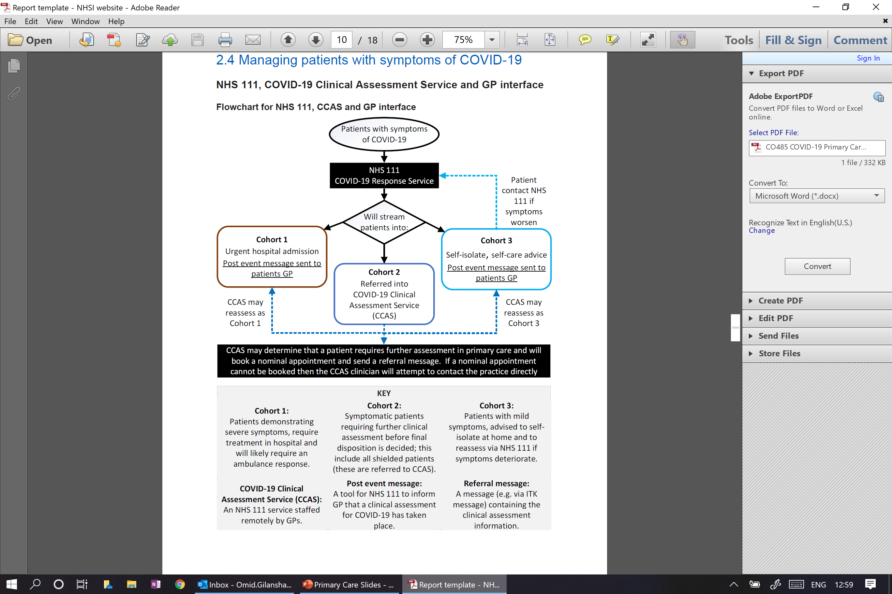
What do we need to do for phase 2?
Stand-down ‘hot hubs’ from 1 July 2020
  Rationale: (i) hot hubs were originally implemented to address peak demand (ii) service has been underutilised for for a number of weeks
  Scale up normal extended access provision to historic contracted levels – 30mins/1000 pop.
  Develop a plan to reinstated similar ‘hot hubs’ pathway in response to a future surge – appendix 1
  Revise COVID-19 Directory of Services (DOS) to enable Clinical Assessment Service (CAS) and COVID-19 CAS pathway to general practice via GP Connect (see chart opposite)
Serve notice to home visiting service providers
Rationale: home visiting services were originally implemented to address peak demand (ii) service has been underutilised for a number of weeks
  Existing contracts expire on 30 June 2020
  Formal notice issued to providers w/c 8 June 2020
  Revise DOS to enable CAS and COVID-19 CAS pathway to general practice via GP Connect or alternative

Slide 8
What do we need to do for phase 2? Cont.
Step-up general practice care of all patients from 1 July 2020
  Rationale: (i) new ways of working in response to COVID-19 have enabled general practice to manage current demand in primary care (ii) new GP standard operating procedure sets out expectations of COVID-19 management in general practice (iii) new guidelines for managing infection prevention and control provides principles that supports effective management of care of all patients in general practice.
  Put in place arrangements set out in new standard operating procedure for general practice – appendix 2
  Put in place ‘talk, intervene, walk’ infection prevention and control model in general practice – appendix 3
Reinstate locally commissioned services from 1 July 2020
Rationale: (i) to increase access to additional services to meet the needs of patients (ii) to ensure there is a consistent level of service across general practice.
  Develop a managed transition of services
  Develop a funding calculation based on historic payment levels.

Slide 9
Appendix 1 – Surge Principles
Level | Description | Recommended Action
1 | As level 4 and there is a material risk of healthcare services being overwhelmed. | All Boroughs operating with ‘Hot Hubs’ and Home Visiting Services to meet local demand. Video and Telephone triage Face to Face activity is only conducted when absolutely necessary in a dedicated ‘Green’ location adhering to PPE Guidance.
2 | A COVID-19 epidemic is in general circulation; transmission is high or rising exponentially. | Based on local demand Boroughs are required to have a clear plan for the management of hot patients through Hubs, Home Visiting and Practice zoning and plans for escalation. Triaging of all patients is in place. The majority of activity for Green/Amber patients should be conducted virtually where clinically appropriate.
3 | A COVID-19 epidemic is in general circulation. | Triaging of all patients is in place. Vulnerable patients are able to access Primary Care in safe ‘Green’ sites or areas in their Practice or Network. Some ‘Hot’ services such as ‘GP in a car’ may be commissioned were local demand dictates this and Networks or Practices will have plans for the management of all patient groups. Where possible virtual consultations should be the norm. Extended Access services should be operating as normal and not utilised as Hot Hubs.
4 | COVID-19 is present in the Borough, but the number of cases and transmission is low. | Practices will be operating as normal with the ability to accommodate Amber or Hot patients through zoning with the practice or network. Triaging and Virtual consultations are still highly recommended and utilised.
5 | COVID-19 is not known to be present in the UK. | Practices are operating as ‘normal’ however all staff ae informed of pathways for suspected cases. Suspected cases should be triaged prior to being given an appointment.

Slide 10
Supporting Information
Guidance and standard operating procedures: General practice in the context of coronavirus (COVID-19):
https://www.england.nhs.uk/coronavirus/wp-content/uploads/sites/52/2020/03/CO485-COVID-19-Primary-Care-SOP-GP-Practice-V3-29-May-2020.pdf
London Principles of Managing Infection Prevention and Control in General Practice whilst caring for all patients during the COVID-19 Pandemic:

Slide 11
Questions?
Contact us at kingstonccg.engage@swlondon.nhs.uk
Notes:
Thank you for your time.

