Slide 1

Bridging Divides
A new fund for London

Slide 2
Bridging Divides
Work must be for the benefit of Londoners
No minimum or maximum revenue grant size
Revenue grants for up to five years
Applications for core funding will be considered
Capital grants for access works up to £100k

Slide 3
Bridging Divides
Our three key funding programmes are:
  Connecting the Capital
  Positive Transitions
  Advice and Support
These are cross-cut by our two over-arching priorities of Reducing Inequalities and Enabling Voice & Representation.

Slide 4

Connecting the Capital

Slide 5
Connecting the Capital
Helping to make London’s communities stronger, more resilient and thriving.
Creating a healthy and vibrant voluntary sector, working with communities and across sectors, plays a vital role.

Slide 6
Connecting the Capital:
What we will fund
Civil society support organisations providing capacity building, voice and leadership for the sector.
Place-based giving schemes to develop and become sustainable.
Growing and greening projects which bring communities together and improve the local environment.
Disadvantaged disabled & older people to participate in arts, sports and health & well-being opportunities.
Enable Community Buildings in London to be fully accessible.

Slide 7

Positive Transitions

Slide 8
Positive Transitions
Support work that will enable Londoners experiencing inequality and disadvantage to make important transitions in their lives.
Enable these transitions to be positive for the individuals, give them greater choice and control over their lives and result in a reduction in inequality within communities.

Slide 9
Positive Transitions: What we will fund
Work that will enable positive transitions in relation to:
Children and young people, specifically those affected by domestic abuse; with mental health needs; transitioning from care; disabled people transitioning into adulthood; who have become carers.
Migrants & refugees who wish to access mainstream services and feel part of the community in which they live.
Disabled people & older people having increased choice and control over their lives in terms of their independent living.
Survivors of domestic & sexual abuse; modern day slavery; trafficking; or hate crime.
Ex-offenders leaving custody or serving community sentences.

Slide 10
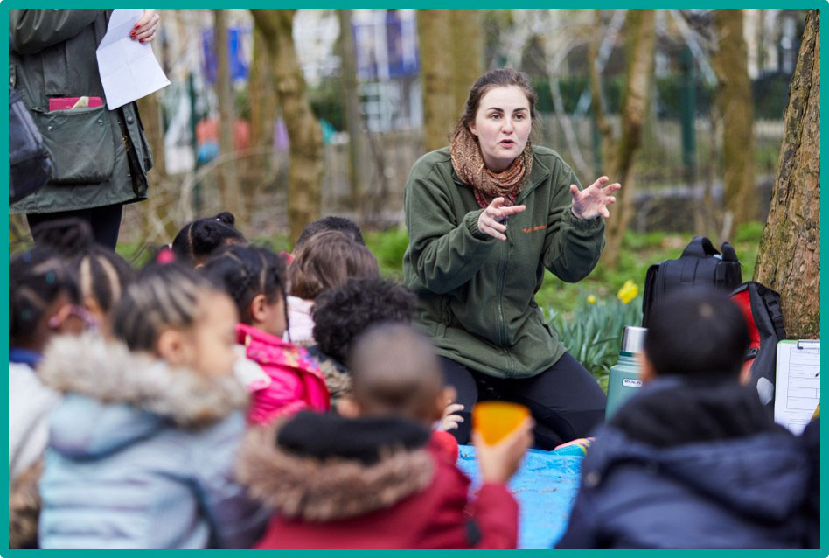
Advice & Support

Slide 11
Advice & Support
Access to good quality advice and support plays a vital role in addressing inequalities & services should be informed by the voice and experience of those who are impacted by those inequalities.
We want applications from organisations providing suitably accredited advice and support to individuals effected by inequalities.

Slide 12
Advice & Support:
What we will fund
Services offering advice & support in relation to:
  Benefits
  Debt and money
  Employment problems
  Housing
  Immigration status
In addition, we will fund the infrastructure needed to support the distribution of donated food.

Slide 13
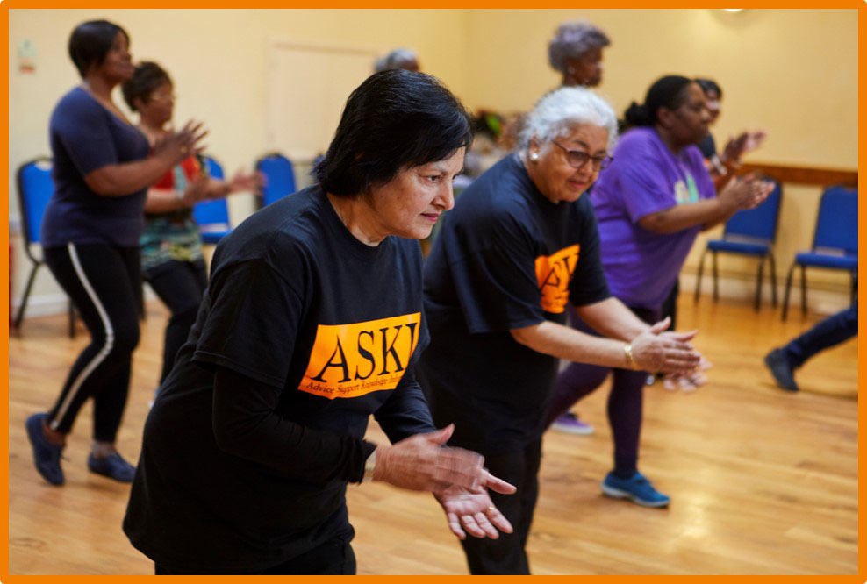
Small Grants

Slide 14
Small Grants
Grants of £1,000 to £10,000 over 12 months
Capital, revenue or a mixture
Must be a registered charity, charitable company or CIC
Must have an income of less than £75,000 with at least one year’s annual accounts
Decisions provided within two months of application

Slide 15
Small Grants
Applications currently invited for:
Greening and growing projects which brings communities together and improve the local environment.
Projects which enable those who are disabled or older people to participate in arts, sports or well-being activities.

