Slide 1
The South West London Integrated Care System (ICS) - and introduction
Iona Lidington, Director of Public Health (DPH)
Kingston Place Convenor
Integrated Care Partnership DPH Lead

Slide 2
Establishing the South West London Integrated Care System (ICS)
On 11 February 2021, the Department of Health and Social Care published the White Paper ‘Integration and innovation: working together to improve health and social care for all’, which set out legislative proposals for a health and care bill.
The White Paper brought together proposals that build on the recommendations made by NHS England and NHS Improvement on integrating care.
The White Paper proposed the creation of Integrated Care Systems; new partnerships between organisations including the functions of what were previously called Clinical Commissioning Groups, NHS trusts, Local Authorities, and the Voluntary and Community Sector, that work together to meet health and care needs across an area.
Integrated Care System partnerships build on the work of previous Sustainability and Transformation Partnerships (STPs) to coordinate services to deliver the NHS Long Term Plan, develop ways to improve population health and reduce inequalities between different groups.
The Health and Care Bill passed through parliament, providing the mechanism for establishing Integrated Care Systems in law and removing legal barriers to integrated care for patients and communities.

Slide 3
Establishing the South West London Integrated Care System (ICS)
The ICS became a statutory organisation from 1^{st of} July 2022, with the establishment of an Integrated Care Board (ICB) and an Integrated Care Partnership (ICP). The ICP will be a statutory committee of the ICS alongside the Integrated Care Board (ICB) which is a legal entity.
The South West London Integrated Care System includes NHS services for the populations that reside in
Croydon
Kingston upon Thames
Wandsworth
Richmond
Merton
Sutton
The four main aims of the ICS are:
Improve outcomes in population health and healthcare
Tackle inequalities in outcomes, experience and access
Enhancing productivity and value for money
Help the NHS support broader social and economic development
www.swlondon.nhs.uk

Slide 4
Establishing the SWL Integrated Care System
In line with national guidance the SWL ICS will comprise of four main components:
Integrated Care Board – lead integration within the NHS bringing together those involved in planning and providing NHS services; this will replace the SWL CCG
Integrated Care Partnership – the broad sub-regional alliance of organisations concerned with improving the care, health and wellbeing of the population, jointly convened by local authorities and the NHS
Place Based Partnerships - collaborative arrangements formed by partners responsible for arranging and delivering health and care services in a locality
Provider Collaboratives – NHS trusts working in partnership across multiple places to improve quality, efficiency and outcomes

Slide 5
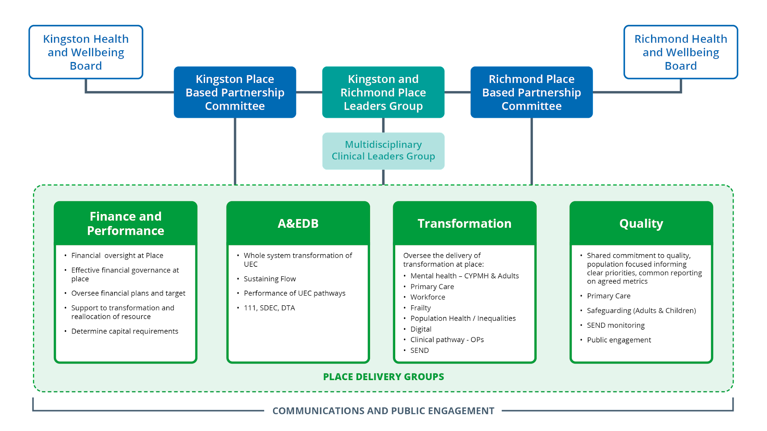
Proposed Governance Arrangements at Place
Kingston Partnership Board (Health & Wellbeing Board

Slide 6
Establishing the South West London Integrated Care Partnership (ICP)
The ICP is at a system level and is being jointly convened by the NHS and local government. The ICP will be a broad alliance of organisations and representatives concerned with improving the care, health, and wellbeing of the Southwest London population.
The ICP will operate as a forum to bring partners together across the ICS area to align purpose and ambitions with plans to integrate care, tackle health inequalities and improve health and wellbeing outcomes for the population.
The ICP is co-chaired between Health and the Local Authority, as equal partners.
www.swlondon.nhs.uk

Slide 7
Terms of reference for the ICP (extract/1)
The ICP will :
Bring local government, the NHS and wider partners together to agree joint action to improve health and care services in SWL
Agree where coordination is needed on health and care issues and challenge partners to deliver the action required. These include, but are not limited to:
  helping people live more independent, healthier lives for longer
  taking a holistic view of people’s interactions with services across the system and the different pathways within it
  addressing inequalities in health and wellbeing outcomes, experiences and access to health services
  improving the wider social determinants that drive these inequalities, including employment, housing, education environment, and reducing offending
  improving the life chances and health outcomes of babies, children and young people
  improving people’s overall wellbeing and preventing ill-health
Support the triple aim (better health for everyone, better care for all and efficient use of NHS resources), the legal duties on statutory bodies to co-operate and the principle of subsidiarity (that decision-making should happen at the most local appropriate level).
www.swlondon.nhs.uk

Slide 8
Terms of reference for the ICP (extract/2)
The ICP will :
Focus on improving outcomes for people, including improved health and wellbeing, supporting people to live more independent lives, and reduced health inequalities.
Champion co-production and inclusiveness throughout the ICS.
Ensure place-based partnership arrangements are respected and supported, and have appropriate resource, capacity and autonomy to address community priorities, in line with the principle of subsidiarity.
Draw on the experience and expertise of professional, clinical, political and community leaders and promote strong clinical and professional system leadership.
Enable closer integrated health and care services – so that people receive seamless care across health, social care, housing, education and other public services (including those delivered by independent providers), and between different NHS providers.
Bring together integrated data sets – which all partners can contribute and have access to in order to inform planning and the delivery of services for the benefit of communities – to understand and be driven by local population wants and needs.
Use Population Health Management and other data/information sources to set priorities, through a SWL ‘integrated care strategy’, to improve system-wide health and care outcomes and experiences, and influence the wider determinants of health, including creating healthier environments and inclusive and sustainable economies.
www.swlondon.nhs.uk

Slide 9
Terms of reference for the ICP (extract/3)
The ICP will :
Agree two of three system-wide priorities and the contribution required from all partners to deliver them.
Champion integrated approaches and strengthen our collective approach to improving longer-term health and wellbeing outcomes. For example, across education, housing, environment, transport, employment, and community safety; as these wider social determinants of health, and others, have a significant bearing on the health and wellbeing of communities and health inequalities, particularly for people experiencing deprivation-poverty.
Support place-based partnerships and coalitions with community partners to act on the wider determinants of health in local areas and Identify opportunities for wider partnerships, or action that should be taken at a SWL-level, to strengthen a collective approach to improving health inequalities and targeting the wider determinants of health.
Support place and neighbourhood-level engagement, ensuring the system is connected to the needs of every community.
Set the tone and culture for the SWL Integrated Care System, championing co-production, diversity, equality and inclusiveness, recognising that the challenges organisations and the ICS are trying to solve are complex, and require input from a range of people, include community associations and residents themselves.
Agree action to support social and economic development at a SWL level.
Agree how partners collective resources will be targeted at the areas which will have the greatest impact on outcomes and inequalities.
www.swlondon.nhs.uk

Slide 10
Core membership : The South West London Integrated Care Partnership (SWL ICP)
Co-Chairs members
Health members
Local Authorities members
Place members
Other members
Chair ICB
Leader of Council
Sarah Blow (ICB CEO )
ICB Population Health Director
Helen Jamerson (ICB CFO)
5 NHS SWL Provider chairs (or their representative
Primary care rep
Croydon HWBB Chair– Cllr Yvette Hopley
Kingston HWBB Chair - Cllr Sabah Hamed
Merton HWBB Chair– Cllr Peter McCabe
Richmond HWBB Chair – Cllr Piers Allen
Sutton HWBB Chair– Cllr Ruth Dombey
Wandsworth HWBB Chair – Cllr Graeme Henderson
CEO rep –Ian Thomas
DCS rep-Anna Popovici
DASS rep-Annette McPartland
DPH rep (Iona Lidington)
Growth/Economy-Carolyn Dwyer
6 place representatives nominated by place
Clinical Senate Co-Chairs: Gloria Rowland/John Byrne
SWL ICB Deputy CEO – Karen Broughton
Healthwatch rep
Voluntary Sector rep
We believe in an inclusive and innovative approach to care. www.swlondon.nhs.uk

