Slide 1
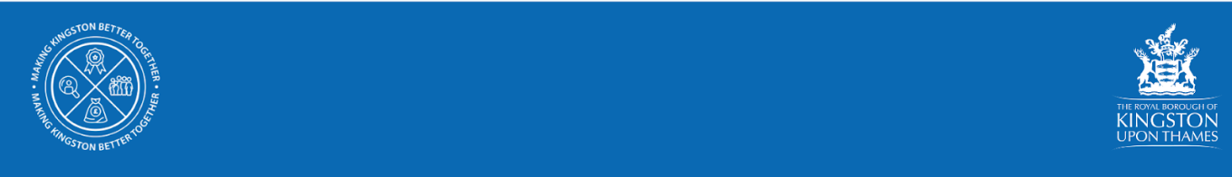
Cost of living crisis
Kingston Voluntary Sector Forum
05 October 2022

Slide 2

Cost of living crisis Workshop - 12 July 2022
Cllr Kirsch called a workshop on the Cost of Living crisis
The workshop explored 4 themes
Energy
Food
Income maximisation (money guidance and support)
Employment
Explored:
Support offered by Citizens Advice Kingston
Fuel and Food insecurity & the support offered by Kingston Food Banks, The Good Food Group, Kingston Stronger Together Hub with VCS partners and Thinking Works
RBK Financial support - assistance to council tenants and Adult Social Care Users who are facing financial difficulty.
Focus on older people’s incomes, the impact of the Cost of Living crisis on pensioners and what this means for quality of life (Staywell)
RBK Employment, Skills and Enterprise

Slide 3
Actions and next steps
As a partnership to share and raise awareness of the support and advice available in the borough and more widely and promote our webpage: kingston.gov.uk/costoflivingsupport
To inform residents about the support available to them in Kingston and engage with them on what other support they may need.
Partner communications leads working closely together to ensure the message is consistent and all frontline workers have the same information.
Develop an early intervention offer to identify those who could fall through the gaps (e.g. by developing three core screening questions and embedding these across the partnership)
Further develop local information for residents, including mapping resources and ensuring effective communications (including potential for warm hubs and digital access)

Slide 4
Actions and next steps - community/warm spaces
Mapped what’s being offered across the borough
Use existing buildings and spaces which are easily accessible to residents, includes council buildings such as libraries, leisure centres and community spaces
To develop a collaborative approach to offer warm spaces for people to sit and have a hot drink - potentially also access wifi and advice
To offer spaces where services, advice and signposting can be accessed, provided by organisations across the borough
To engage with residents and offer activities to reduce isolation
Some spaces will be for advice and signposting only - offer tailored to space
Support residents through Community Library Service and Adult Social Care services, visiting people in their own homes
To work with organisations who support people in their own homes to offer consistent sharing of information and resources
To check on service users who may be vulnerable adults and to signpost / escalate need if appropriate

Slide 5

Local support available

Slide 6
RBK: Household Support Fund
Thanks to fantastic partnership working, we were able to successfully support over 2500 households in the previous rounds of this scheme as well as provide over 12000 vouchers to families with children on Free School Meals. We would like to continue to reach as many households as possible, who are need of support.
Kingston has been granted up to £860,000 from the Department of Work and Pensions in a third round of funding to support low income households in Kingston, who are struggling to afford food, utility bills and other essentials.
This funding runs from 1 October 2022 - 31 March 23.
Applications can be made by professionals on behalf of a resident or residents can apply directly via RBK’s website and is a short Google Form.
Any enquiries: householdsupportfund@kingston.gov.uk or telephone RBK’s contact centre of 0208 547 5000 requesting a call back from the Household Support Fund team.

Slide 7
Voluntary & Community Sector grants
We are inviting Voluntary and Community Sector organisations to apply for projects that will help people stay warm and well, and access meals and equipment and support.
The funding retains flexibility in how this money can be spent and we are hoping to include the following:
  Nutritional meals for residents, especially clinically vulnerable residents.
  Warm Spaces for residents to attend.
  Support with food; energy/utility bills, essentials e.g. bedding, boiler repairs, clothing.
  Provision of household equipment to help with keeping warm, eg. electric blankets, hot water bottles and thermos flasks.
For more information is available on the RBK website or email the team.

Slide 8
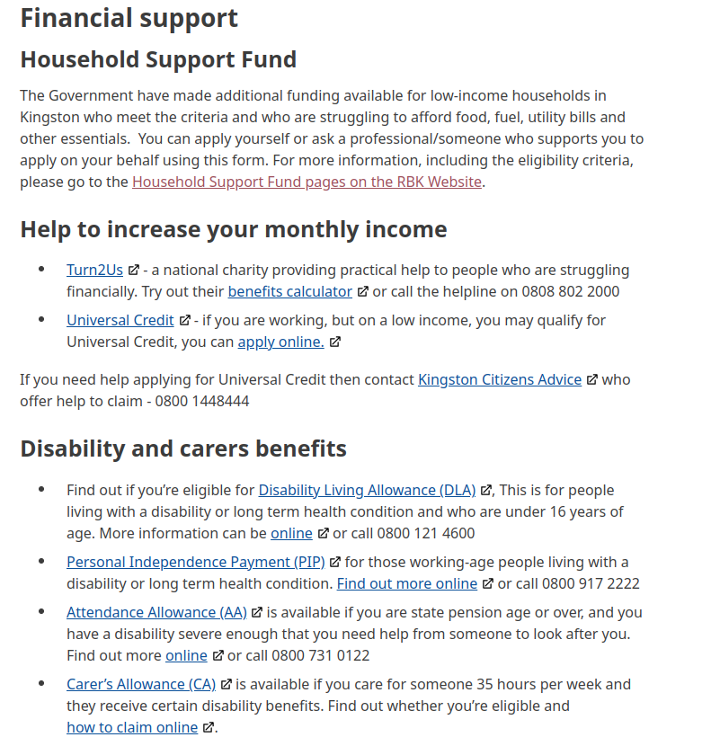

RBK: Cost of Living
https://www.kingston.gov.uk/costoflivingsupport

Slide 9
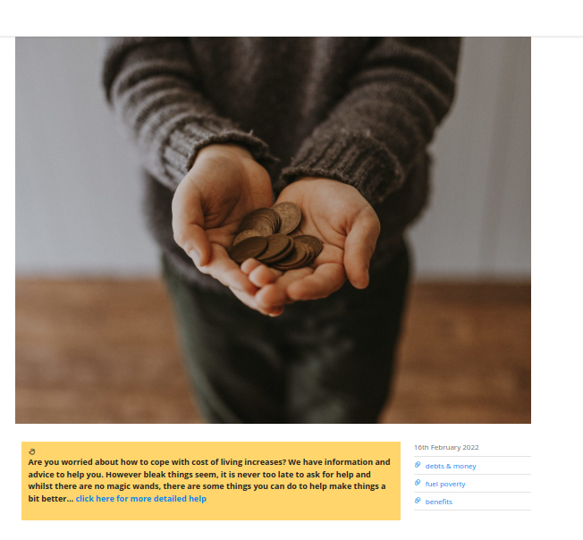
CAK: Cost of Living Toolkit
https://www.citizensadvicekingston.org.uk/?portfolio=cost-of-living-crisis-2
Information and advice to help local people cope with the cost of living increases. Find out more information by calling 020 3166 0953.

Slide 10
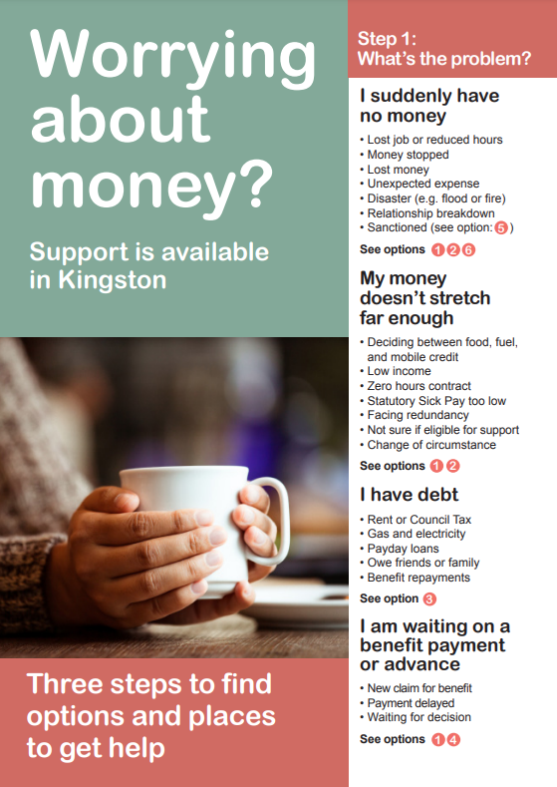
Worrying About Money
Leaflet PDF: https://ifanuk.org/kingston-leaflet
Digital Version: https://www.worryingaboutmoney.co.uk/kingston

Slide 11
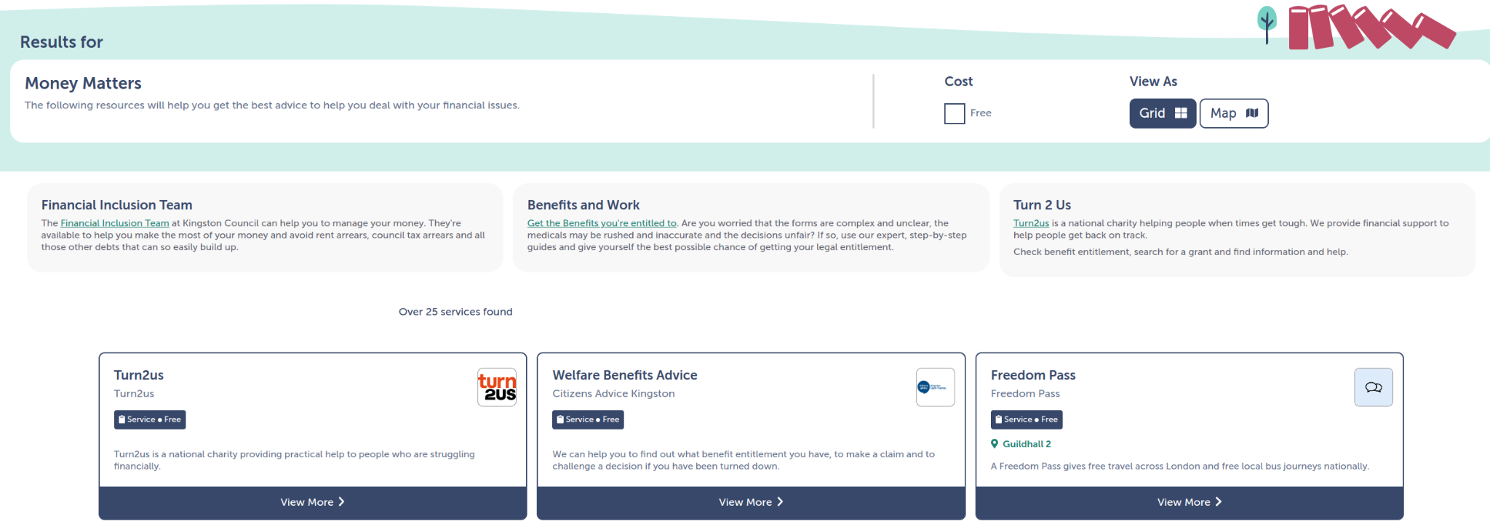
Connected Kingston: Money Matters
https://www.connectedkingston.uk/results?category=9857fe1c-17dc-4994-819d-1977ea416633

Slide 12
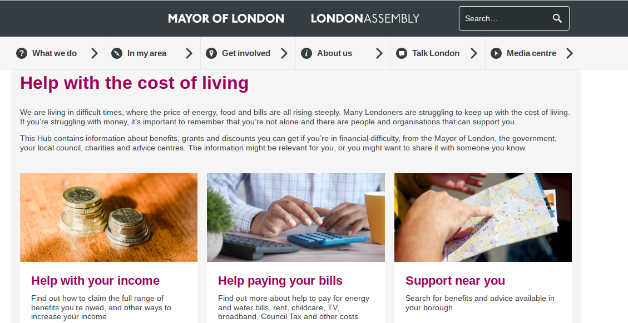
GLA Cost of Living Toolkit
https://www.london.gov.uk/what-we-do/communities/help-cost-living

Slide 13
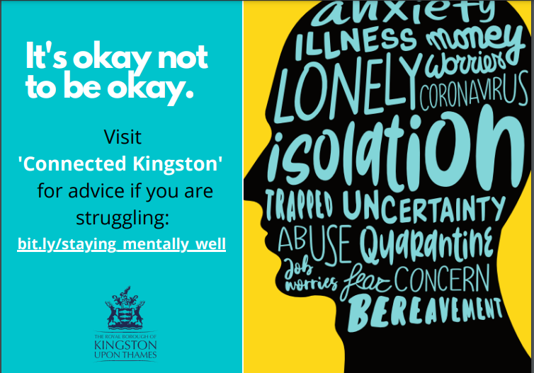
Mental Health support
Connected Kingston (www.connectedkingston.uk/)
Connected Kingston lists a range of services and support
available across Kingston bit.ly/staying_mentally_well).
Mental Health First Aid
Mental Health First Aid (MHFA) is a training course which teaches people how to identify, understand and help someone who may be experiencing a mental health issue.
Online 20 minute suicide prevention training: https://www.zerosuicidealliance.com/training
For details of future MHFA training contact Niza.ravi@kingston.gov.uk

Slide 14
Mental Health Links - emotional support
GLA Cost of Living Toolkit - money worries and mental health
Struggling with money and debt can be a stressful & lonely experience.
Whether you would like to feel more in control of your finances, or would like specific support for your mental health, there are options available to help you feel better.
Support helplines are available for those in need of emotional support.
  Samaritans - confidential support service for anyone experiencing distress or despair
  Papyrus - helpline service to under 35s experiencing thoughts of self-harm or suicide
  CALM (Campaign Against Living Miserably) - helpline for anyone who needs help.
  The Silverline - anyone over 55 to provide friendship, conversation and support

Slide 15
Information gathering
KVA and RBK are developing a Cost of Living section on the Connected Kingston website. We would like to tag as many offers as possible. Please do let us know of any service that could be added under this category
Exploring data: RBK Data and Insight are looking at local data sources to understand need. What information do you have? How can we identify people earlier?
Are there groups that we need to target (where people are particularly vulnerable)

Slide 16
Please complete the Google form or get in touch
In this presentation we have considered the importance of using data to inform our approach (including which groups to target for support). We also talked about the importance of signposting to the right services on Connected Kingston. Therefore questions have been included below to collect this information. If you would prefer to email or chat this through please contact katharine.dallas@kingston.gov.uk
https://docs.google.com/forms/d/e/1FAIpQLSfPxZvCDnCI11Sn0KIgzEMl-HFvFqzSkH8VFui1JhBma1R8rg/viewform?usp=sf_link

